Slide 1
Lugol-stained leaf discs from greenhouse-harvested plants
Experiment 240130 starch initiation mega harvest I
Constructs: 60444, FEC5(SB5), 37490, 37488, 37493, 37499, 37501, 37502
Christina Müller
ETHZürich

Slide 2
Method
Leaf discs were collected from leaf 1 (sink leaf) through 8 (source leaf) and cleared with 70% EtOH before being stained with Lugol.
The lugol was quickly washed with water and the samples were immediately imaged.

Slide 3
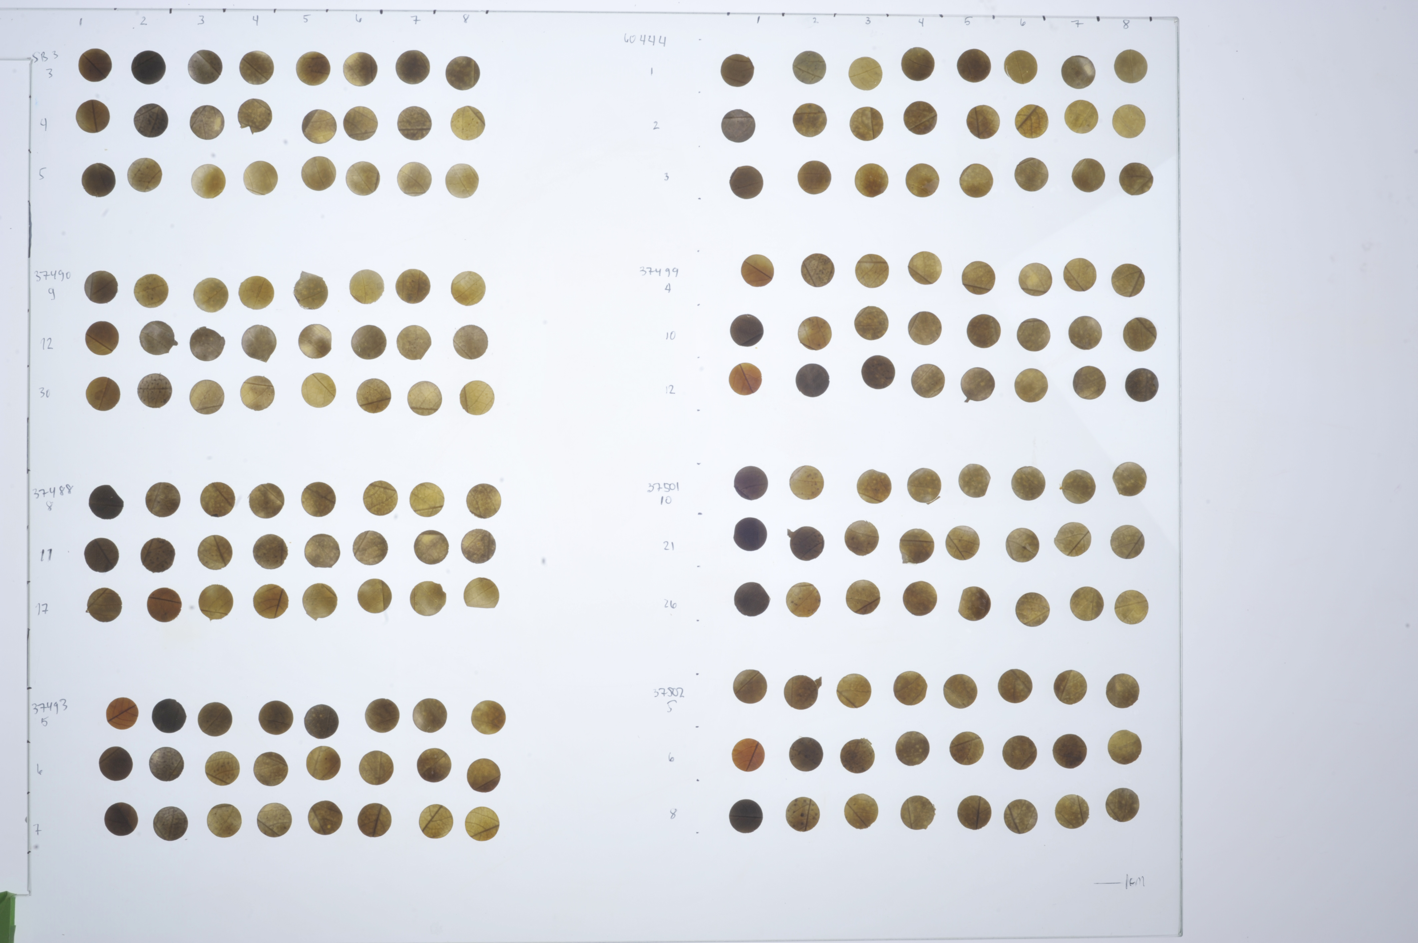
Leaf 1 → 8
Leaf 1 → 8

Slide 4
SB5
60444
pStPatatin-PTST2-tNOS
37490
37499
pStPatatin-PTST2-tNOS :
pGPT2-SS4-tHSP :
pMeGBSS-MRC-tHSP :
pStGBSS-MFP1-t35S

Slide 5
SB5
37488
pStPatatin-PTST2-tNOS
37490
37493
pStPatatin-PTST2-tNOS :
pGPT2-SS4-tHSP :
pMeGBSS-MRC-tHSP :

Slide 6
SB5
37501
pMeGBSS-MRC-tHSP :
pStGBSS-MFP1-t35S
37490
37502
HYG-pMeGBSS-MRC-tHSP :
pStGBSS-MFP1-t35S :
pStPatatin-PTST2-tNOS

