Slide 1
Cassava Source-Sink Project
Improving cassava yield to support smallholder farmers in Sub-Saharan Africa
Metabolic engineering of carbon and energy pathways to enhance cassava yield
Laise Rosado-Souza
AG Fernie
CASS Project Meeting
08.04.2024

Slide 2
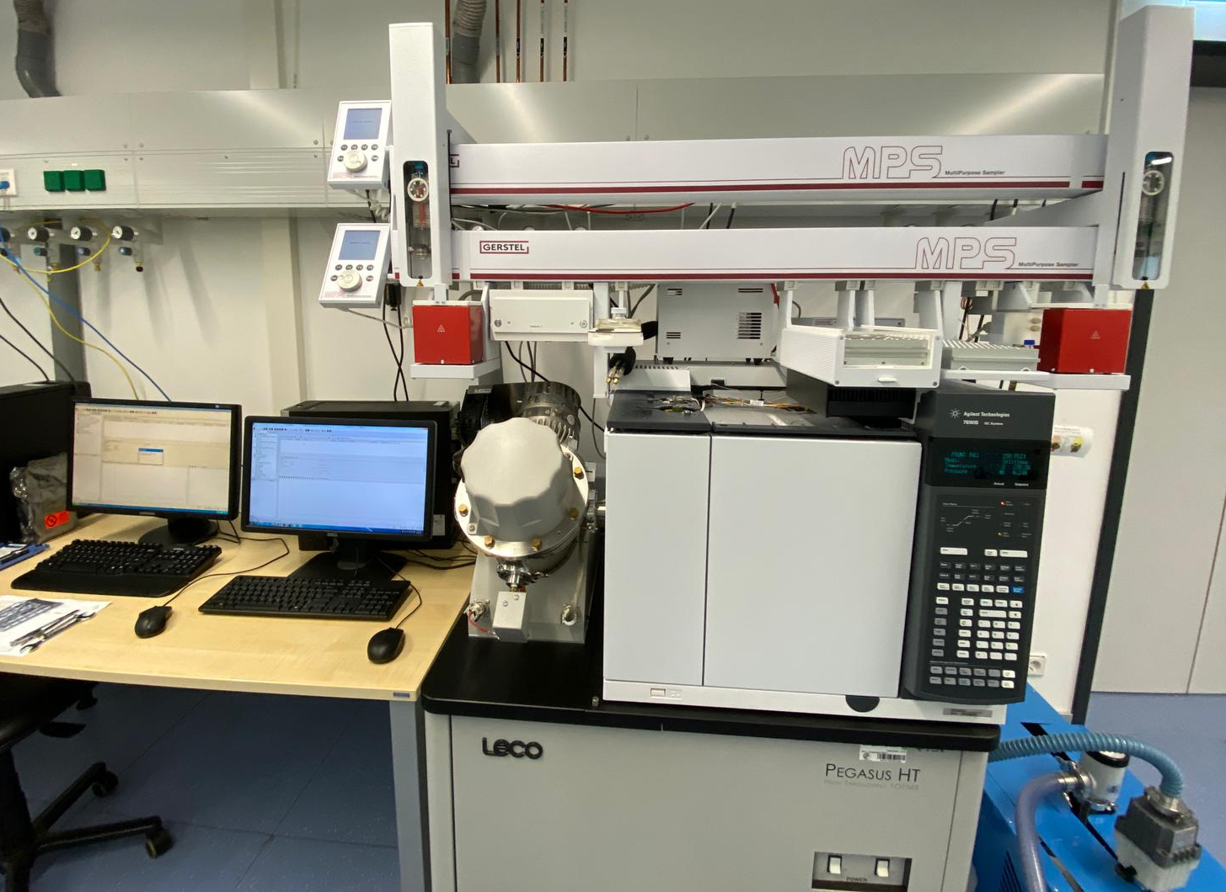
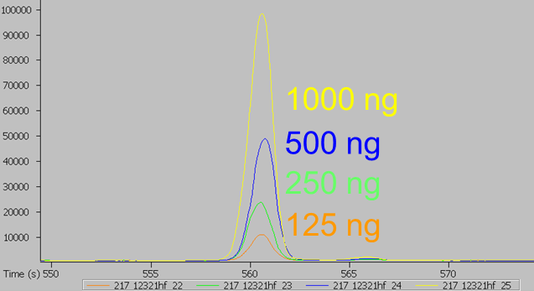
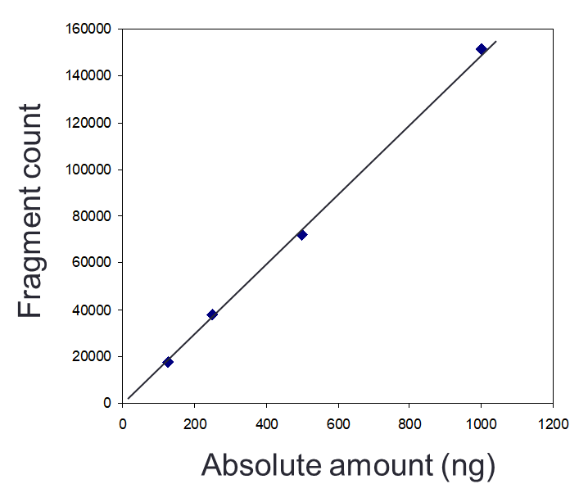
Metabolite profiling of cassava
Quantification by gas chromatography-mass spectrometry (GC-MS)
Optimization of GC-MS procedure for cassava samples
Suitable amount of starting material
Assessment of matrix effects
Assessment of freeze-drying effects
Preparation of standard chemicals for absolute quantification of metabolites
63 metabolites quantitatively detected
  Sugars, Organic acids, Amino acids, Secondary metabolites, Others

Slide 3
Main Research Avenues
1. Exploiting natural variation of African cassava germplasm
PYT 52
PYT 500
2. Metabolic engineering carbon pathways in cassava
mitoGS
AAP1
mitoGS/AAP1

Slide 4
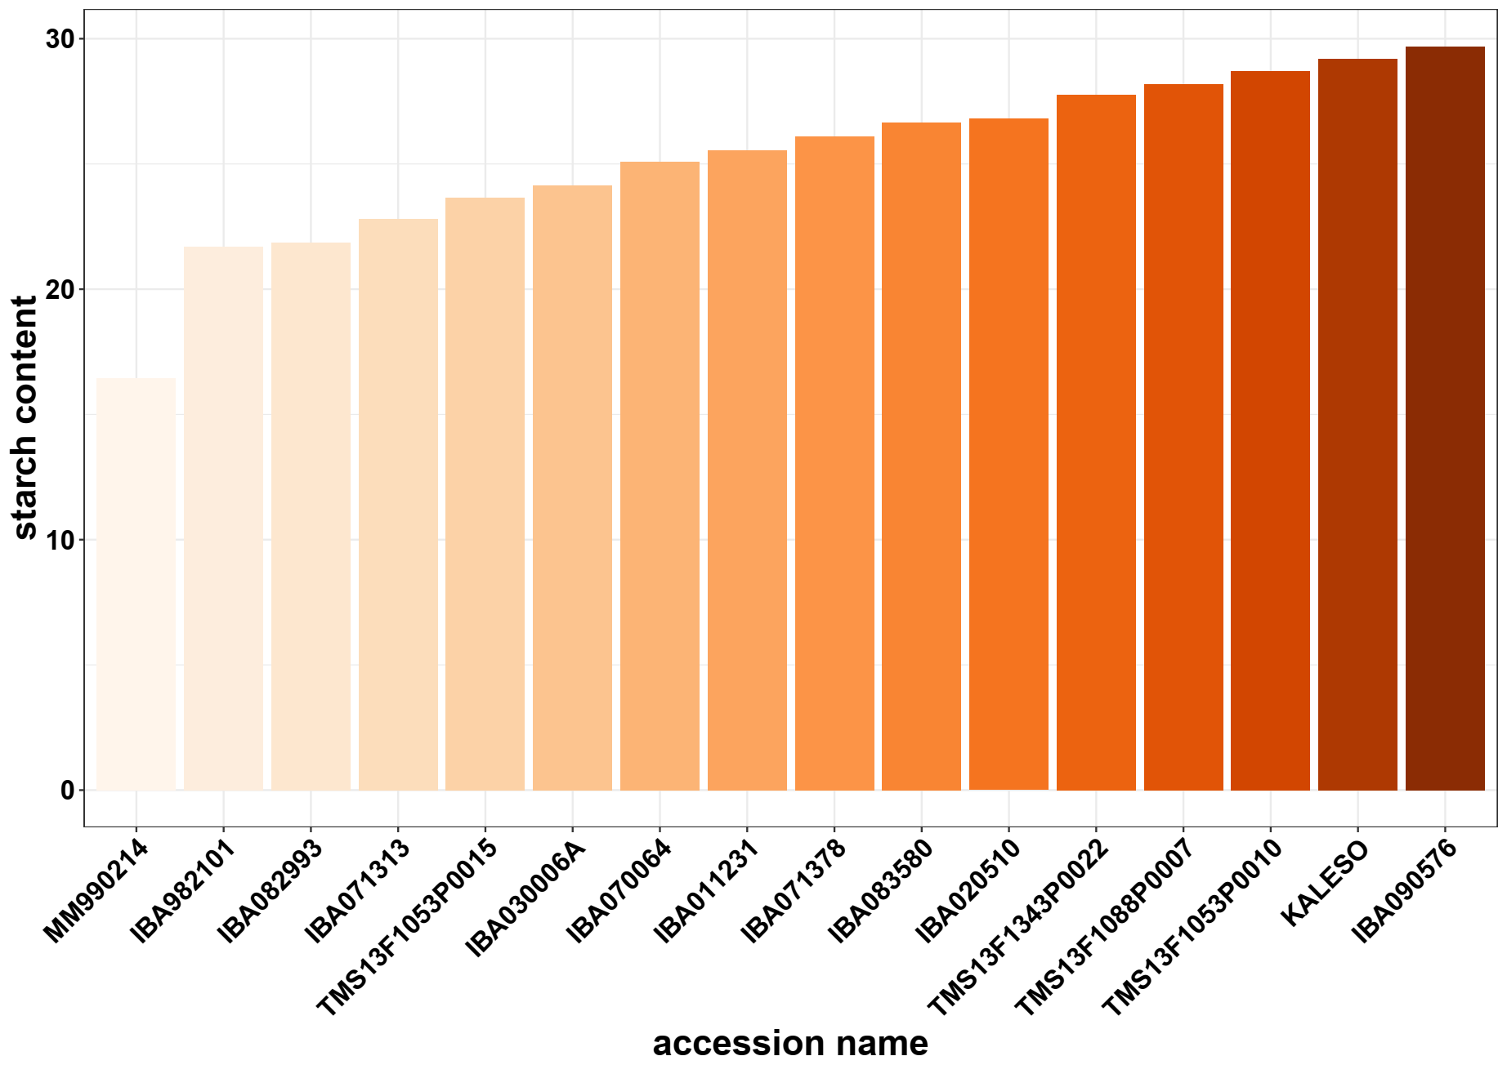
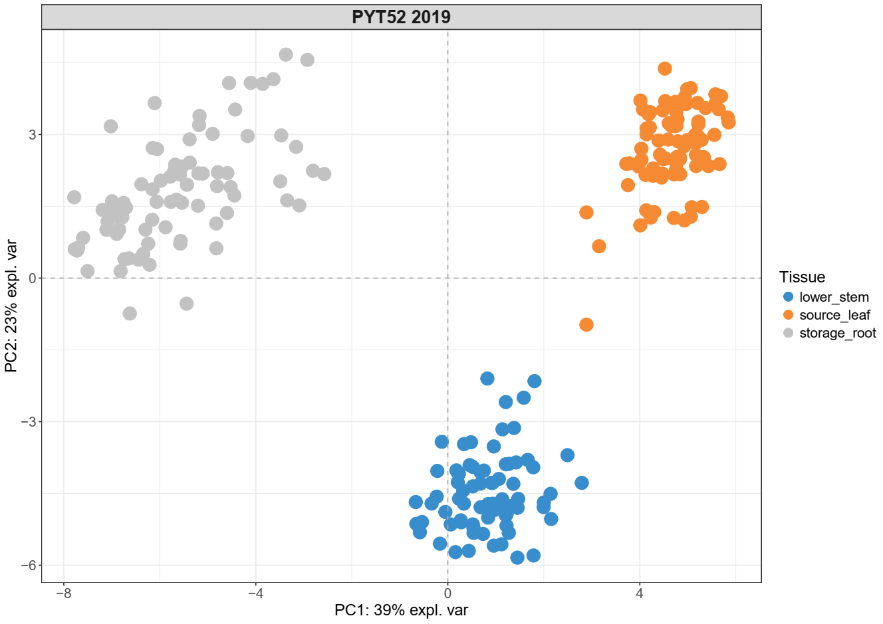
PYT 52 Nigeria
PYT 52 Nigeria
52 genotypes – 16 contrasting selected
2 replicates, 6 x 6 plot
Tissues
Source leaf
Lower stem (phloem-enriched fraction)
Storage root
High starch accumulating accessions show decrease in starch “building blocks” in storage roots
Starch content negatively correlates with other carbon sources in roots but not in stems and leaves
Not only enhanced starch synthesis but downregulation of starch degradation plays critical role on accumulating starch in storage roots
Selected: 16 genotypes
Starch content (% FW)
48 common metabolites
Source leaves
Storage
root
Lower
stem

Slide 5
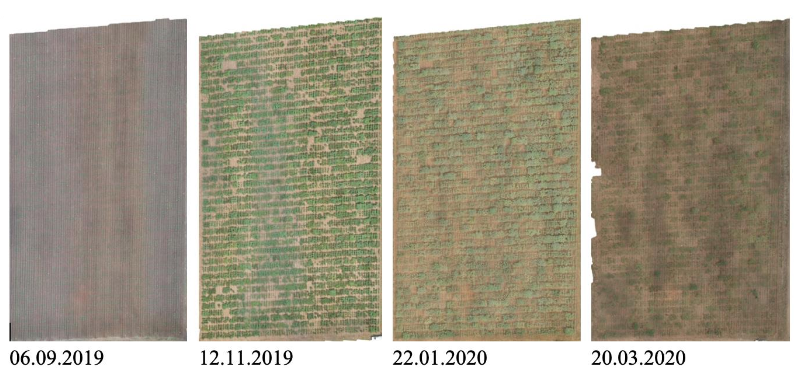
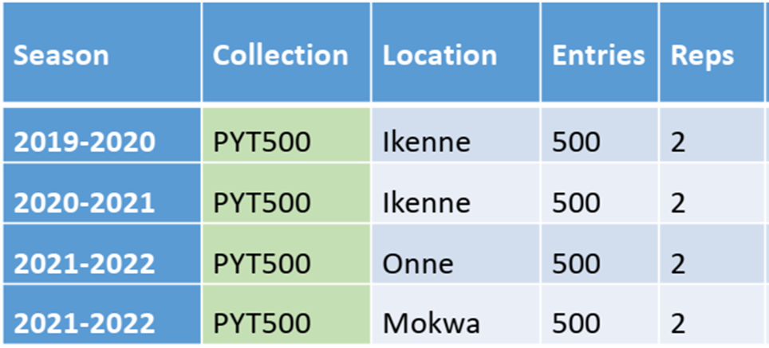
PYT 500, Ikenne
PYT 500
500 genotypes in total
3 seasons, 3 locations
10 plants per plot
2 plots = replicates
Harvest
2020/2021 season
254 genotypes harvested
2 plots = replicates
Tissues
Storage root

Slide 6

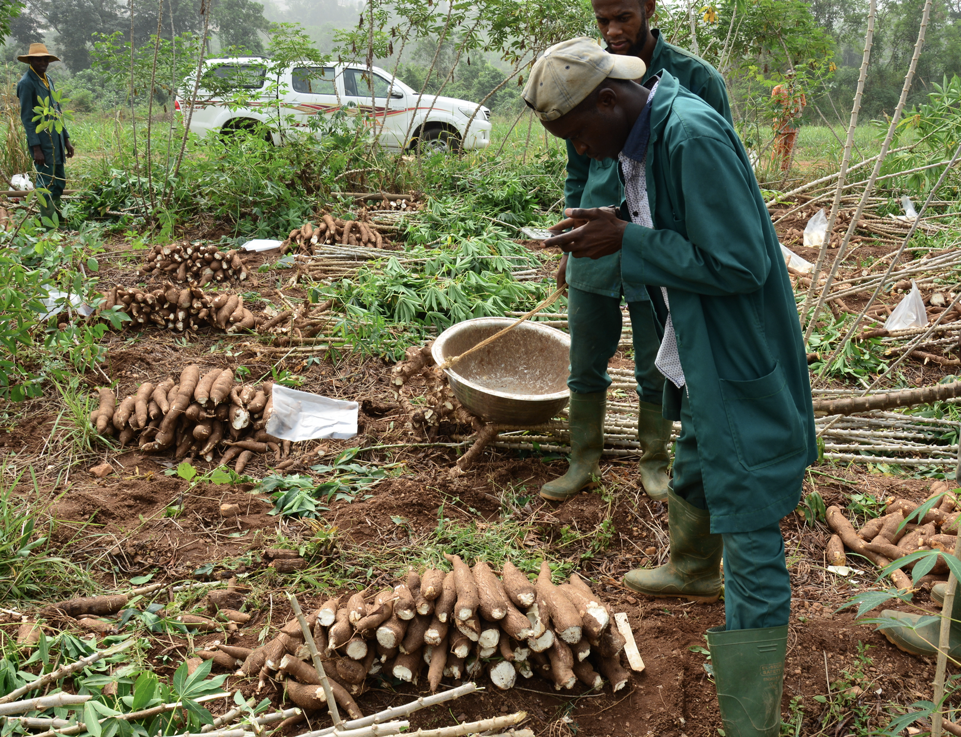
Complete phenotyping
Traits, phenotypic | Traits, disease | Traits, Products
A chromometer value of fresh root | cassava bacterial blight incidence 3-month evaluation | fufu dry weight in kg
B chromometer value of fresh root | cassava bacterial blight severity 3-month evaluation | fufu fibre weight in g
L chromometer of fresh root | cassava green mite severity first evaluation | fufu initial weight in kg
apical pubescence visual rating 0-2 | cassava green mite severity second evaluation | fufu peel weight in kg
branching habit visual observation 1-4 | cassava mosaic disease incidence 1-month evaluation | fufu peeled root weight in kg
branching level counting | cassava mosaic disease incidence 3-month evaluation | fufu pressed weight in kg
central leaf shape visual rating 1-10 | cassava mosaic disease severity 1-month evaluation | gari fried weight in kg
dry matter content percentage | cassava mosaic disease severity 3-month evaluation | gari initial weight in kg
ease of peeling root cortex visual rating 1-3 |  | gari mash weight in kg
first apical branch height measurement in cm |  | gari peel weight in kg
first fully expanded leaf color visual rating 1-9 |  | gari peeled root weight in kg
fresh root yield |  | gari pressed weight in kg
fresh shoot weight measurement in kg per plot |  | gari pulverised weight in kg
fresh storage root weight per plot |  | marketable root number counting
harvest index variable |  | non marketable root number counting
initial vigor assessment 1-7
number of planted stakes per plot counting
petiole color visual rating 1-9
plant architecture visual rating 1-5
plant height measurement in cm
plant stands harvested counting
proportion lodged plants in percentage
root neck length visual rating 0-7
root number per plot counting
rotted storage root counting
sprout count at nine-month
sprout count at one-month
sprout count at three-month
sprouting proportion
starch content percentage
staygreen visual scale 1-9
stem color visual scoring 1-4
storage root cortex color visual rating 1-4
storage root periderm color visual rating 1-4
storage root pulp color visual rating 1-3
storage root shape visual rating 1-6
storage root size visual rating 1-7
total carotenoid by chart 1-8
unexpanded apical leaf color visual rating 1-9

Slide 7
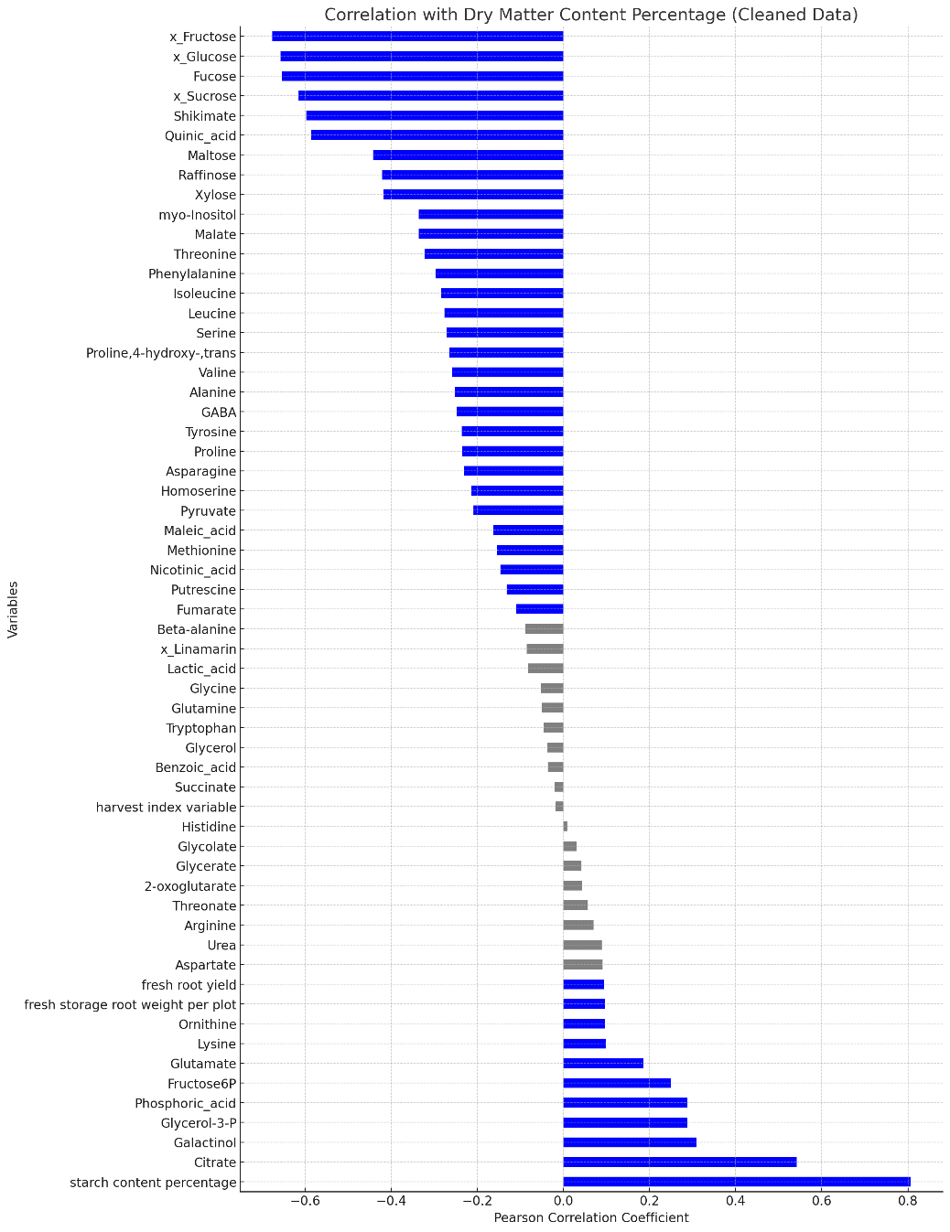
Correlation dry matter content
Dry matter content negative correlates (>0.6) with:
Sugars: fruc*, gluc*, suc*, fuc
Shikimate
Quinic acid
Similar results when working with a smaller panel of genotypes
(PYT 52)
Lamm et al. (2023). Plant Journal
Gutschker et al. (2023). bioRxiv
Correlations are robust and remain valid at larger scales
Pearson’s Correlation
Blue bars indicate a significant correlation (p <0.05)
*estimated values
Notes:
Nas excluded

Slide 8
Negative correlation
Dry matter (%)
Shikimate
Quinic acid
Biosynthesis of aromatic amino acids (phenylalanine, tyrosine, and tryptophan)
Possible alternative/temporary carbon storage
Precursor for chlorogenic acid – defense compounds
Trade-off between allocating resources to defence versus storage

Slide 9
Correlation dry matter content
Dry matter content positive correlates (>0.4) with:
Starch content (%)
Citrate
Pearson’s Correlation
Blue bars indicate significant correlation (p <0.05)
Notes:
Nas excluded

Slide 10
Positive correlation
Dry matter (%)
Citrate
Central to energy production and respiration, malate-citrate exchange in mitochondria/cytosol
Important in nutrient uptake

Slide 11
Energy Metabolism Module
Malate dehydrogenase (SlMDH)
Aconitase (SlACO)
Enzymes in the tricarboxylic acid cycle (TCA) cycle
Phenotypes associated with changes in redox status
Proof of concept in tomato
Antisense
Increased photosynthesis
Increased fruit yield
Reduction in root dry weight
Nunes-Nesi, et al. (2011). Plant Physiology
van der Merwe, et al. (2010). Plant Physiology

Slide 12
Main Research Avenues
1. Exploiting natural variation of African cassava germplasm
PYT 52
PYT 500
2. Metabolic engineering carbon pathways in cassava
mitoGS
AAP1
mitoGS/AAP1

Slide 13
Polytunnel, Germany 2022

Slide 14
WT and VC, polytunnel 2022
VC_4218
VC_4220
VC_4239
WT
WT

Slide 15
AAP1
Amino Acid Permease (AAP) from pea
(expression in phloem tissues, companion cells of leaves, stems and roots)
In Pea:
Increased yield per plant
Transgenic plants outperform WT plants under different nitrogen treatments
Perchlik, et al. (2017). Plant Physiol

Slide 16
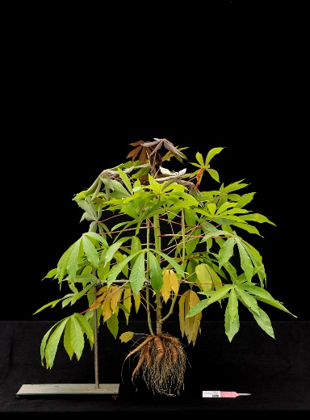
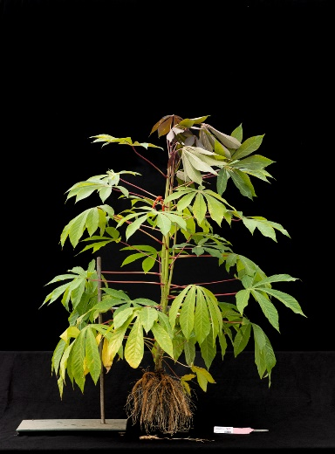
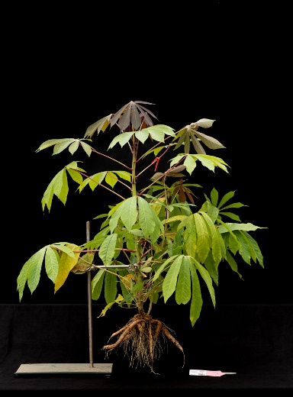
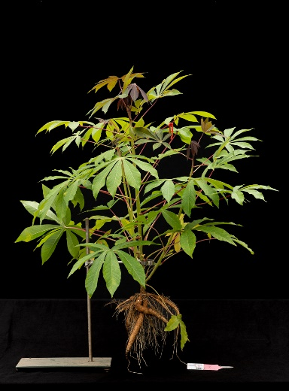
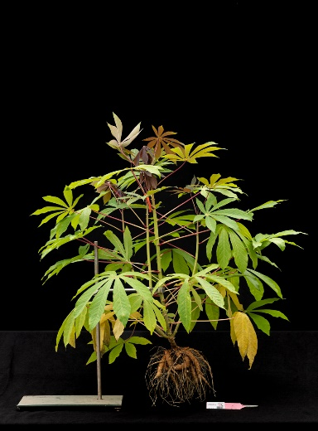
AAP1, polytunnel 2022
AAP1_4349
AAP1_4353
AAP1_4354
VC
WT
AAP1_4355
AAP1_4358
AAP1_4359

Slide 17
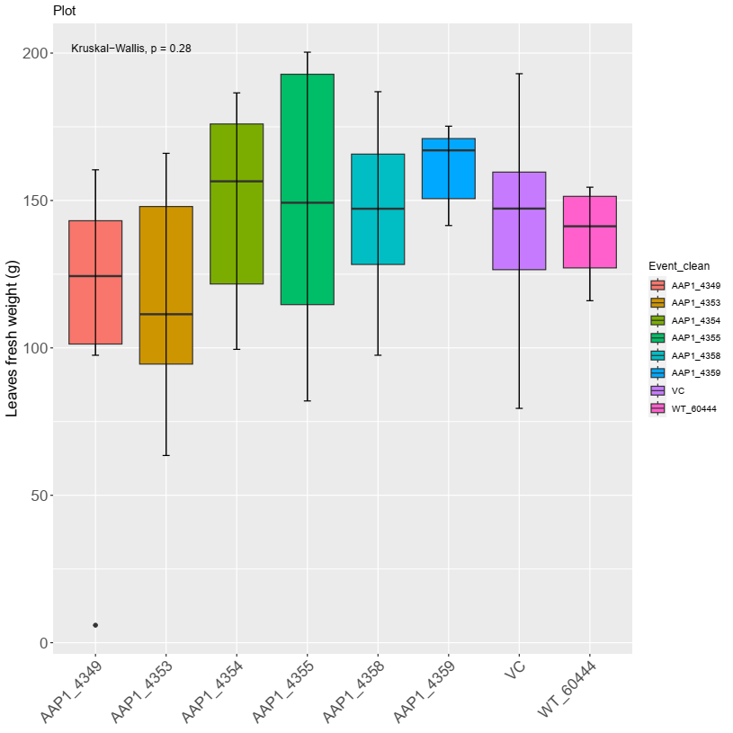
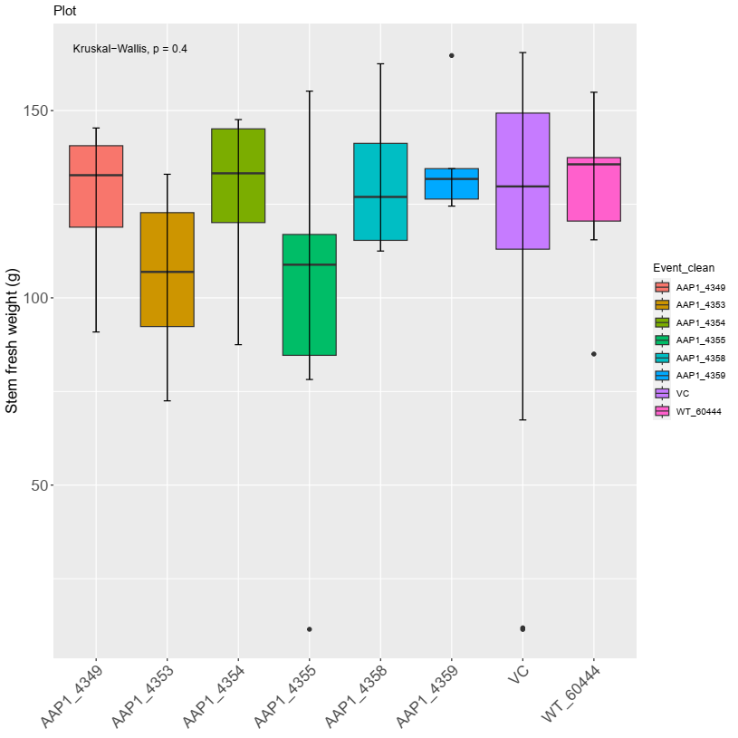
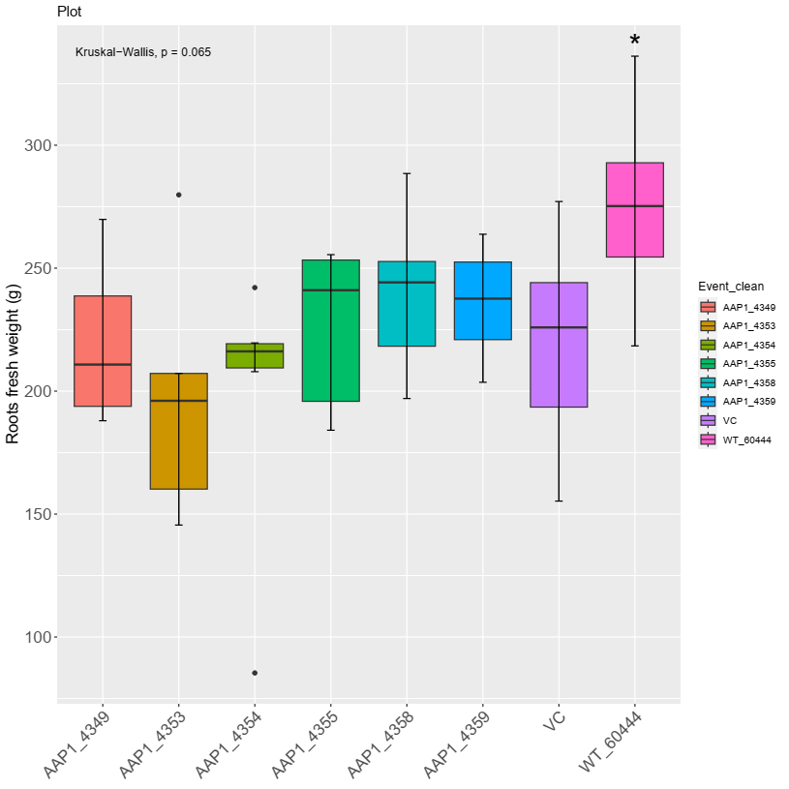
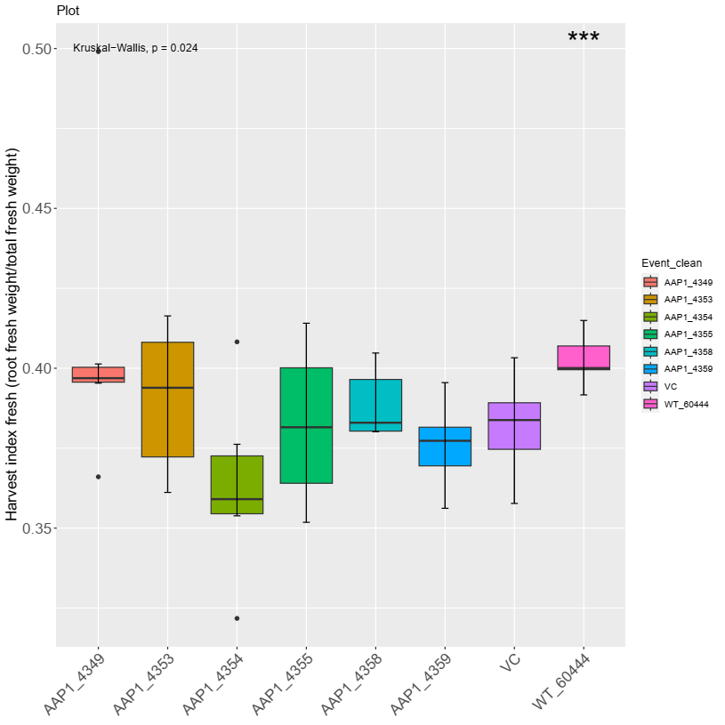
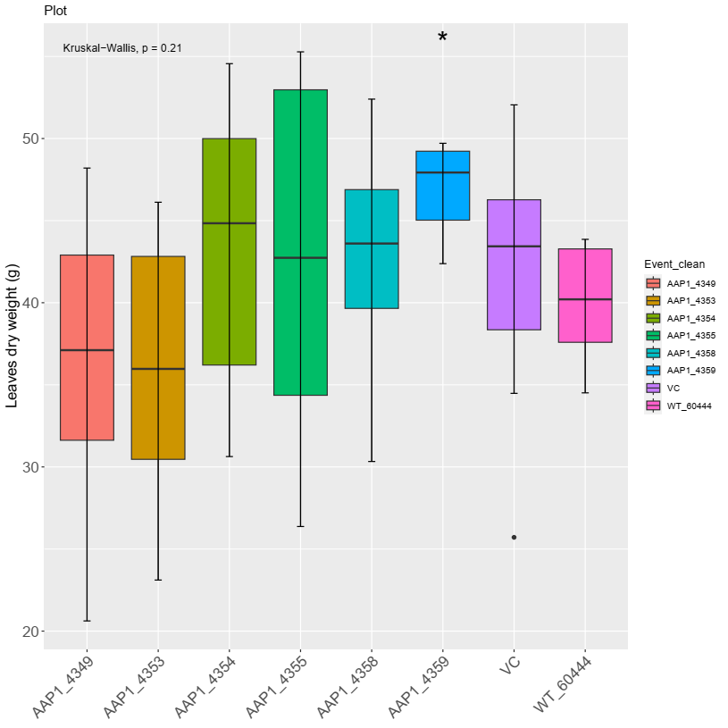
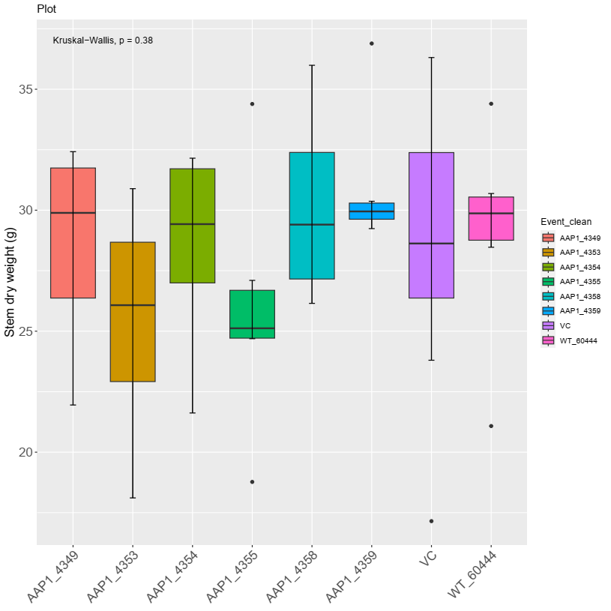
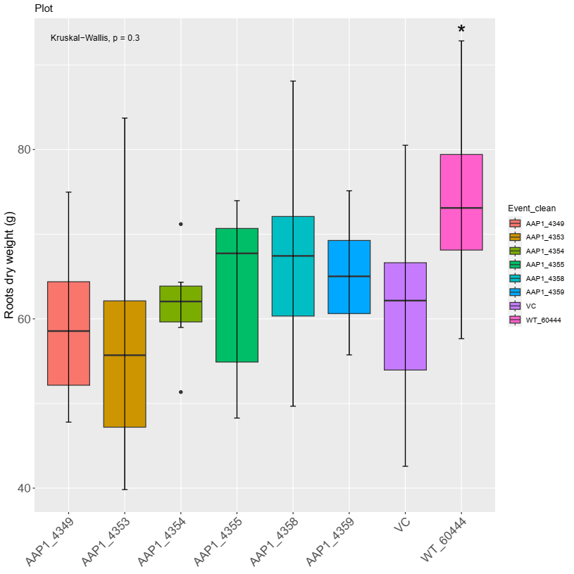
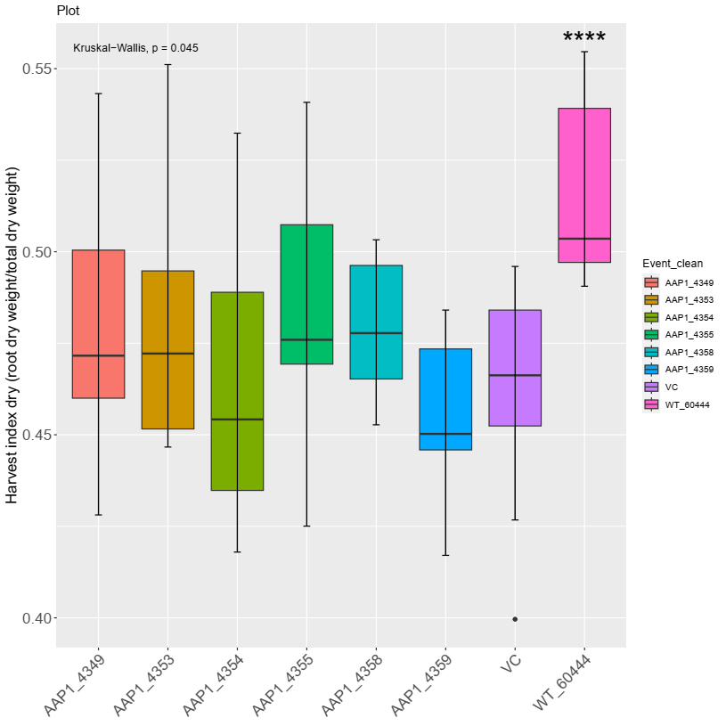
AAP1, polytunnel 2022
Growth parameters
Leaves fresh weight
Stem fresh weight
Root fresh weight
HI (fresh bases)
Leaves dry weight
Stem dry weight
Root dry weight
HI (dry bases)
No difference between VC and AAP1 lines
Penalty in root (fresh and dry) weight and HI compared to WT
AAP1_4359 higher leave dry weight compared to VC
Kruskal-Wallis test, comparison to VC,*: p ≤ 0.05, **: p ≤ 0.01, ***: p ≤ 0.001
Notes:
H:\MPI-MP_May2022\CassProject2022\NitrogenModule\230705_NonParametric_test

Slide 18
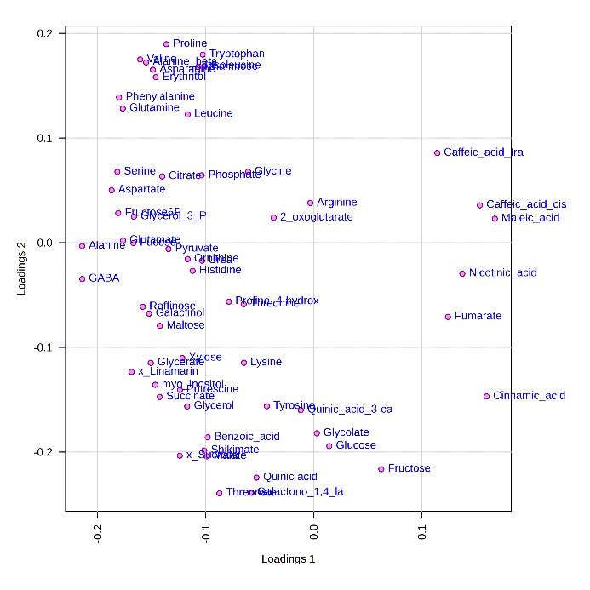
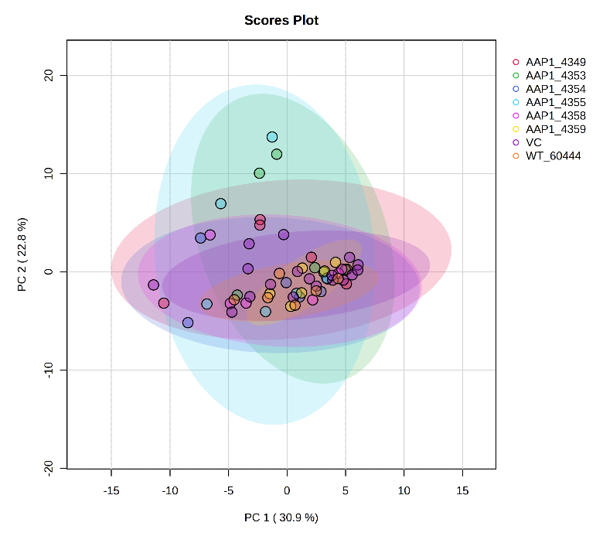
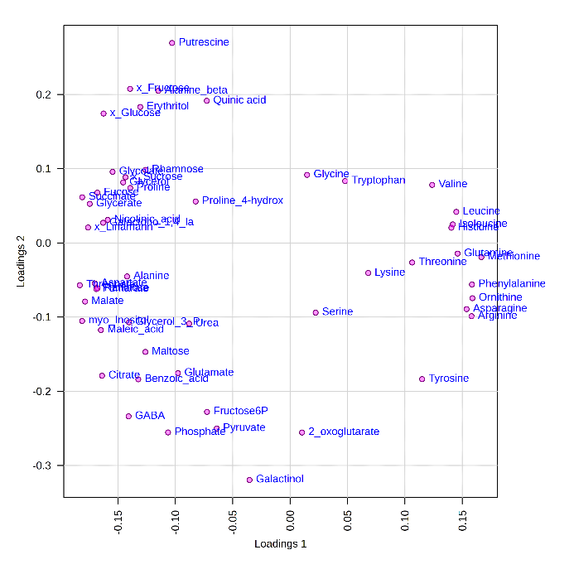
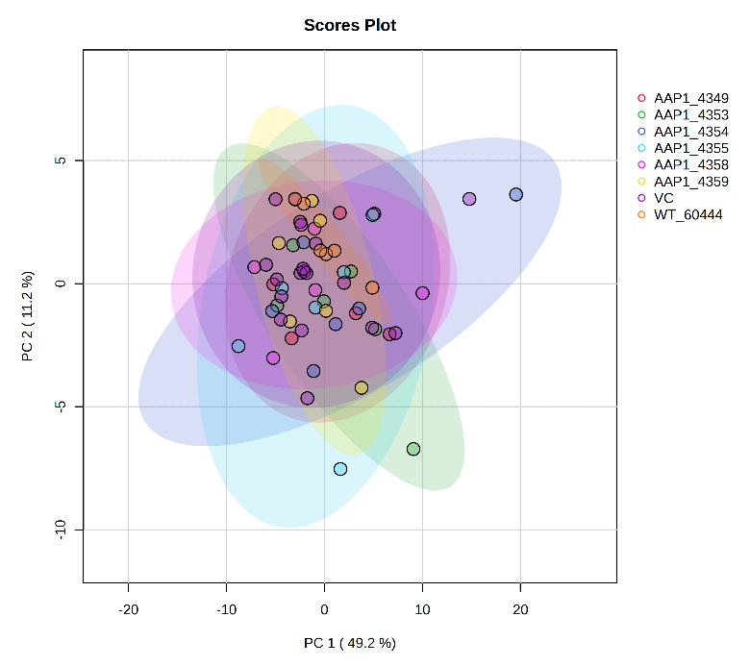
AAP1, polytunnel 2022
Metabolites
Leaves
Roots
Notes:
H:\MPI-MP_May2022\CassProject2022\NitrogenModule\Exp_N.Module_polytunnel_Jun22\MetaboAnalyst\GroupedVC

Slide 19
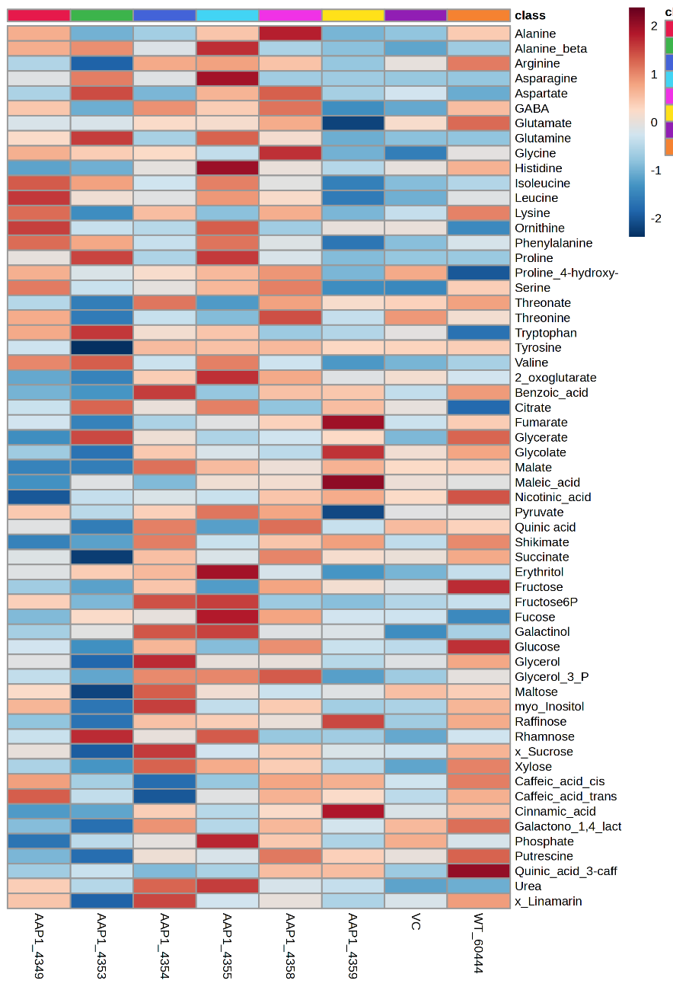
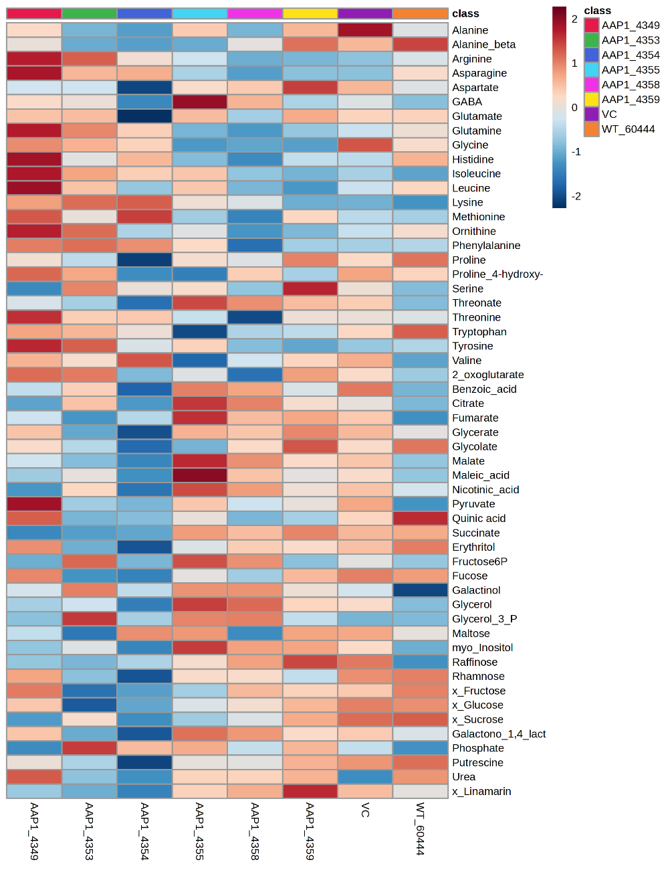
AAP1, polytunnel 2022
Metabolites
Leaves
Roots
Amino acids and derivatives
Amino acids and derivatives
Organic acids
Organic acids
Sugars and derivatives
Sugars and derivatives
Others
Others
Notes:
H:\MPI-MP_May2022\CassProject2022\NitrogenModule\Exp_N.Module_polytunnel_Jun22\MetaboAnalyst\GroupedVC

Slide 20
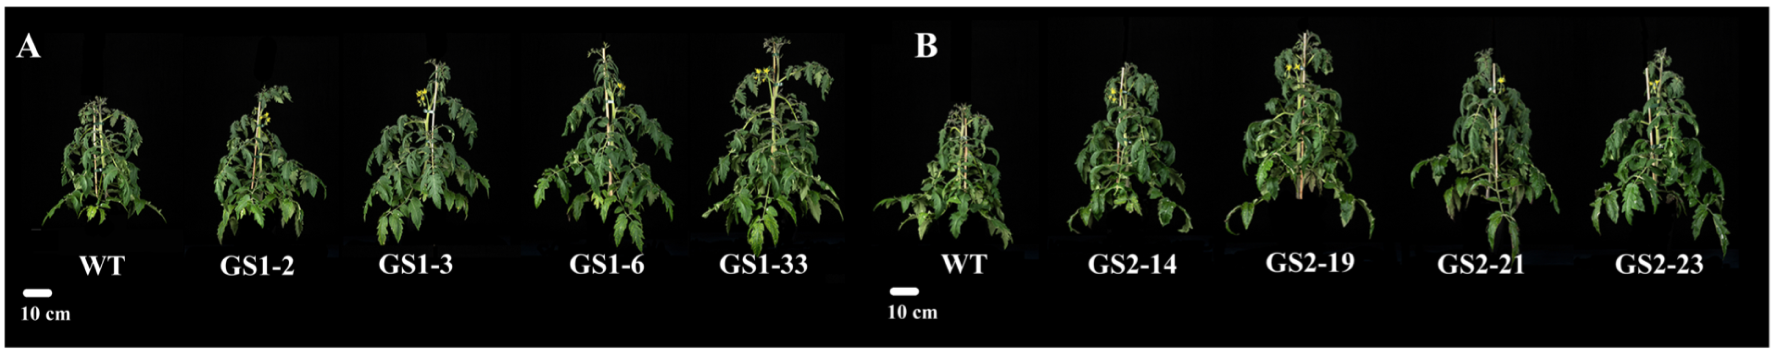
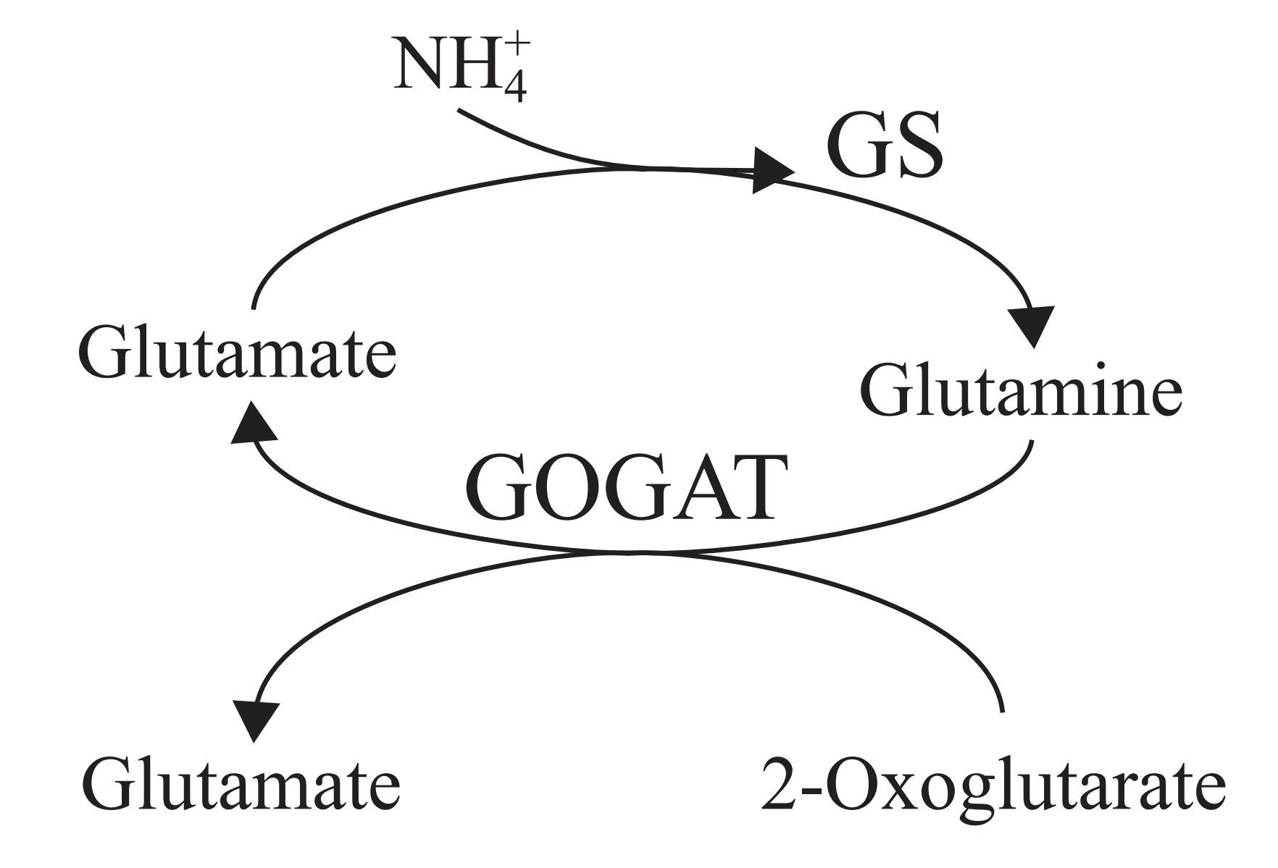
mitoGS
Glutamine synthetase (GS)
Tomato plants
Increase expression
GS1 (cytosolic) or
GS2 (plastidic) +
Leaf mesophyll-specific promoter (ribulose-bisphosphate carboxylase, RbcS) +
Mitochondrial transit peptide COX4ts (for mitochondrial localization)
Faster growth rate
Increase in fruit yield
Vallarino, et al. (2022). bioRxiv
Cheung, et al. (2014). Plant Physiology

Slide 21
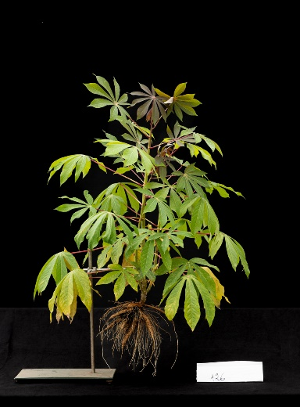
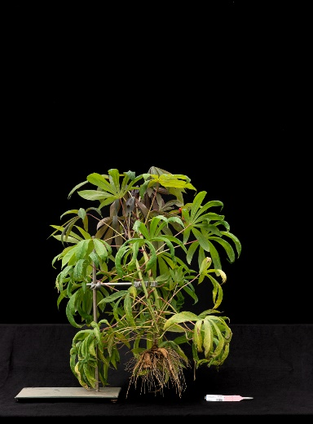


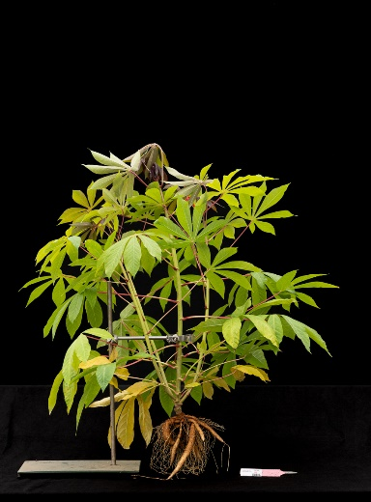
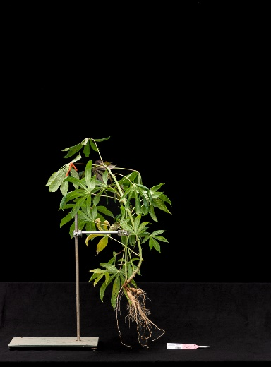
mitoGS, polytunnel 2022
mitoGS_4267
mitoGS_4268
mitoGS_4269
VC
WT
mitoGS_4272
mitoGS_4275
mitoGS_4277

Slide 22
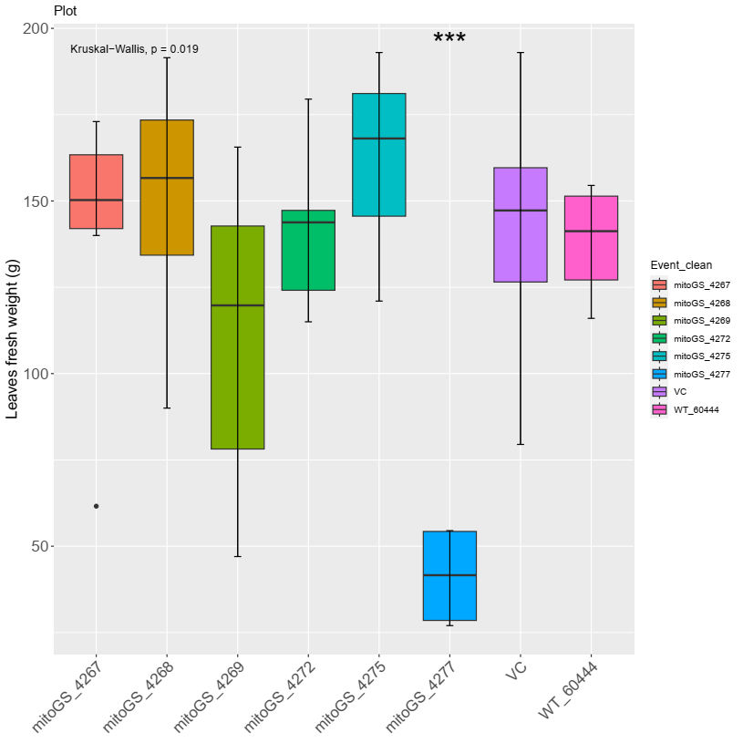
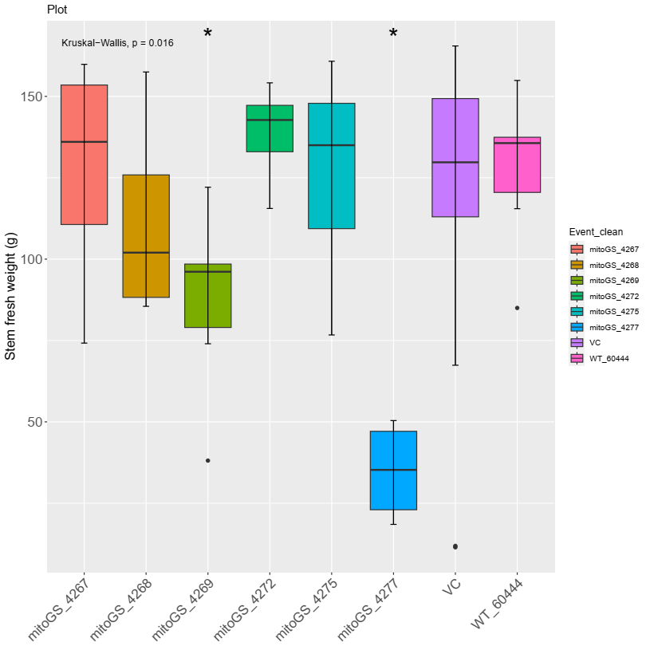
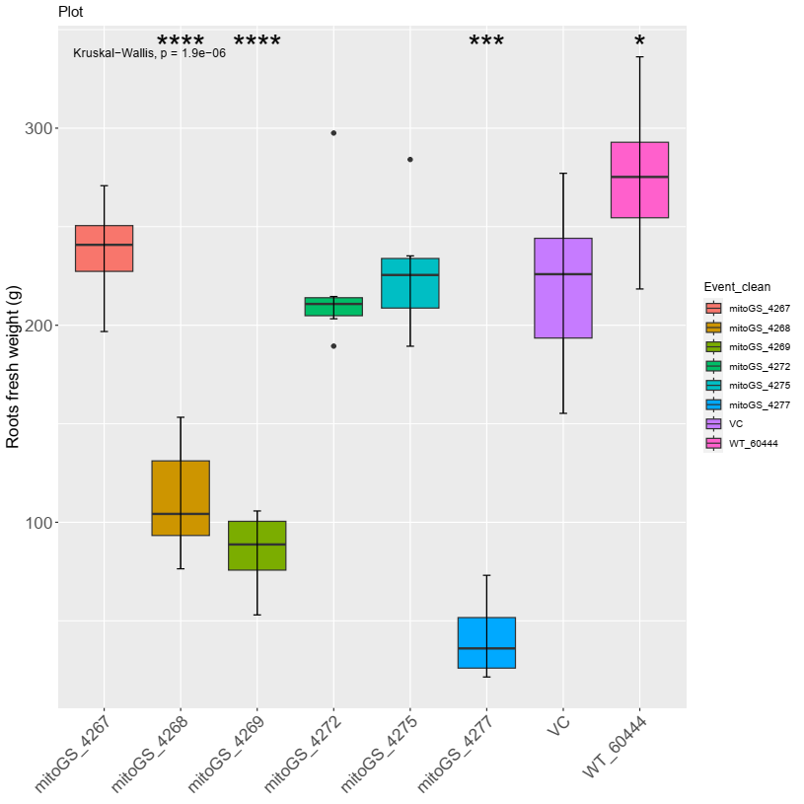
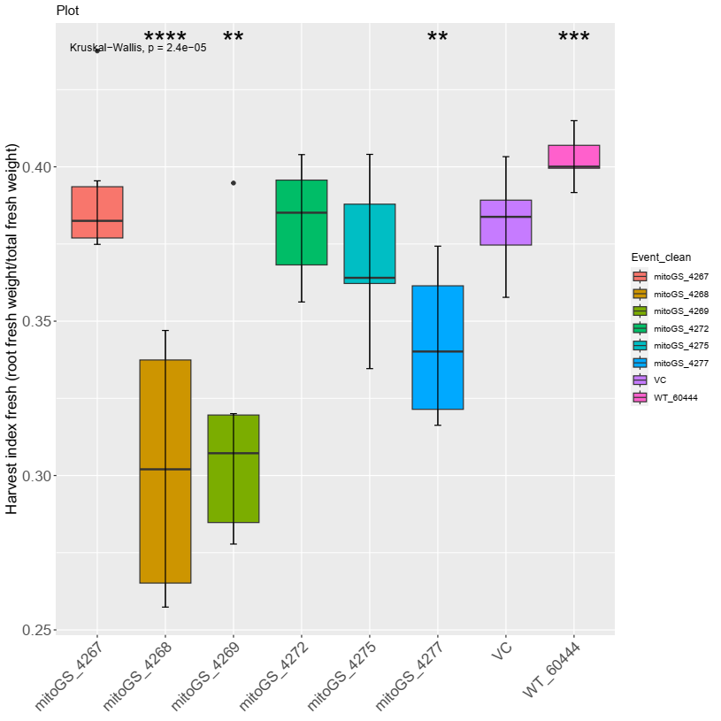
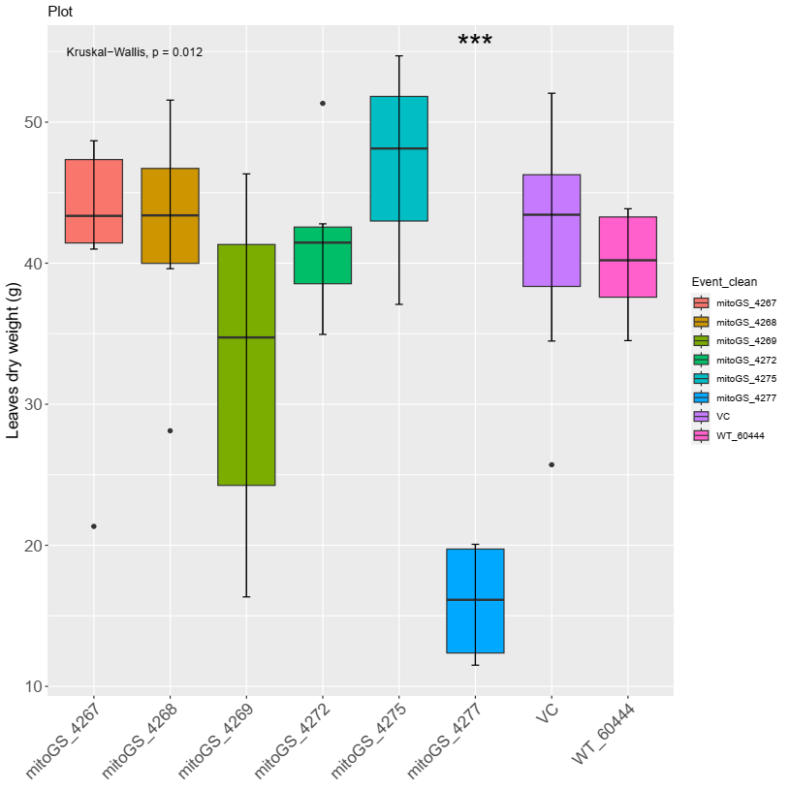
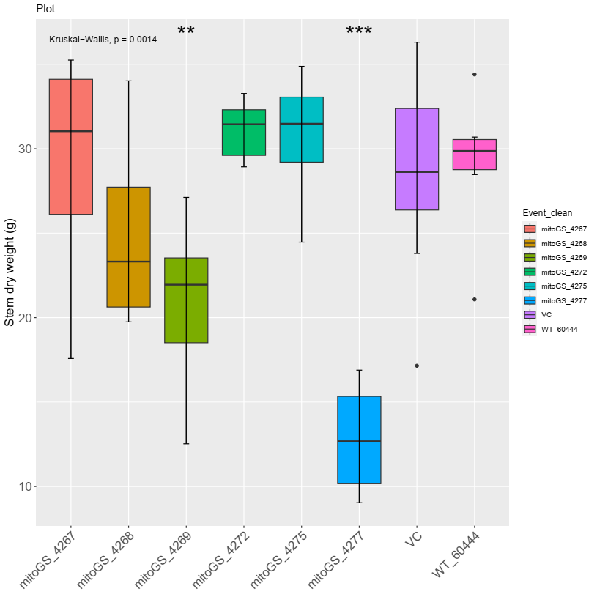
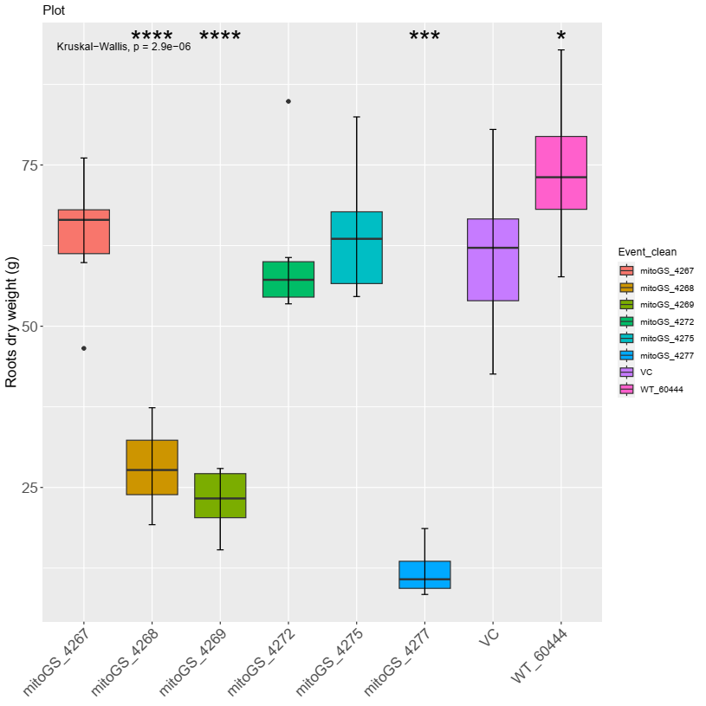
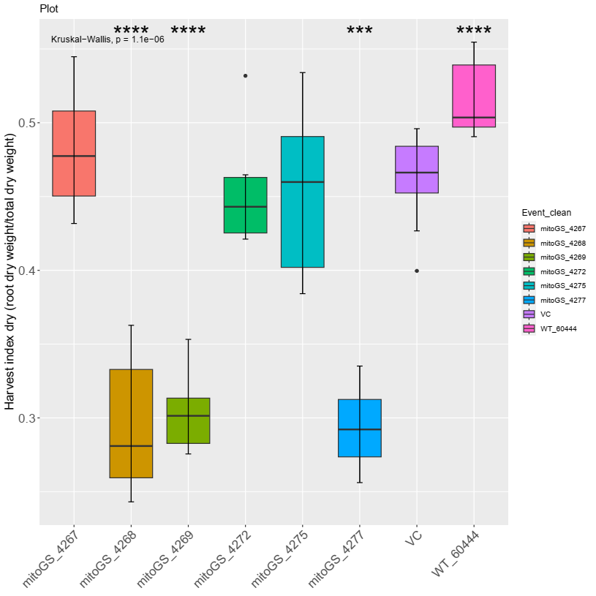
mitoGS, polytunnel 2022
Growth parameters
Leaves fresh weight
Stem fresh weight
Root fresh weight
HI (fresh bases)
Leaves dry weight
Stem dry weight
Root dry weight
HI (dry bases)
mitoGS_4277 consistently worse than VC
mitoGS_4268 and mitoGS_4269 with smaller root (fresh and dry) weight and consequent lower HI
Kruskal-Wallis test, comparison to VC,*: p ≤ 0.05, **: p ≤ 0.01, ***: p ≤ 0.001

Slide 23
mitoGS, polytunnel 2022
Growth parameters
Leaves fresh weight
Stem fresh weight
Root fresh weight
HI (fresh bases)
Leaves dry weight
Stem dry weight
Root dry weight
HI (dry bases)
mitoGS_4277 consistently worse than VC
mitoGS_4268 and mitoGS_4269 with smaller root (fresh and dry) weight and consequent lower HI
Kruskal-Wallis test, comparison to VC,*: p ≤ 0.05, **: p ≤ 0.01, ***: p ≤ 0.001

Slide 24
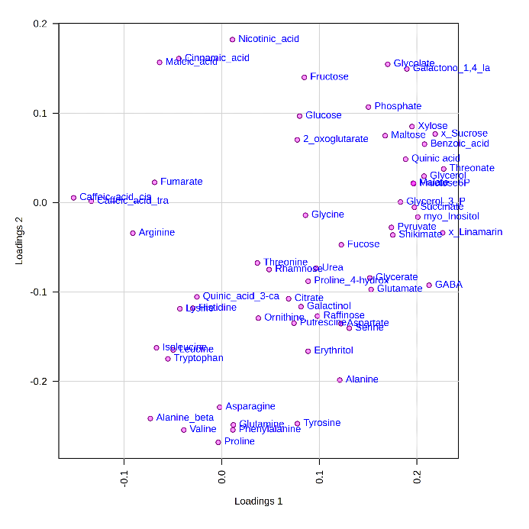
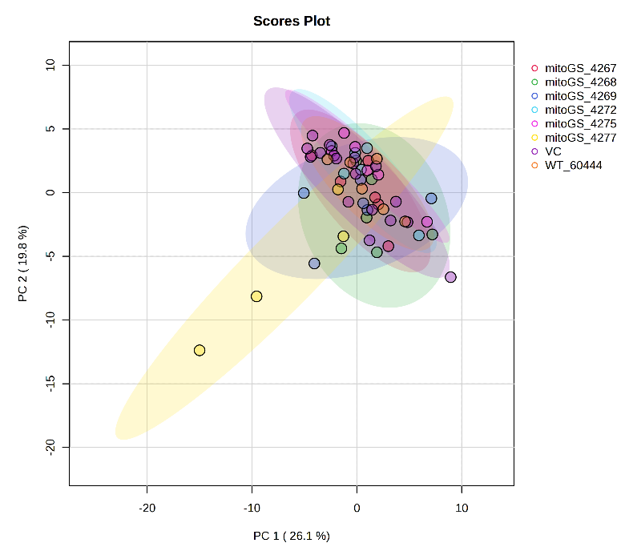
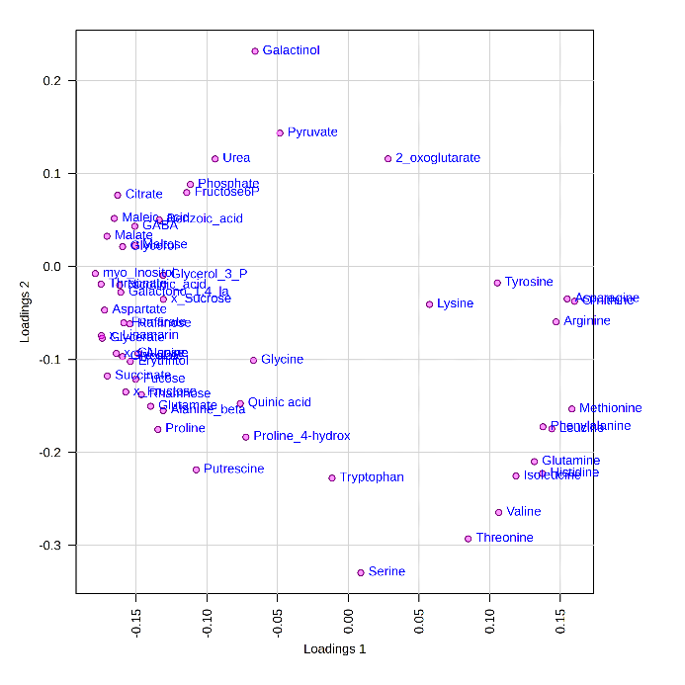
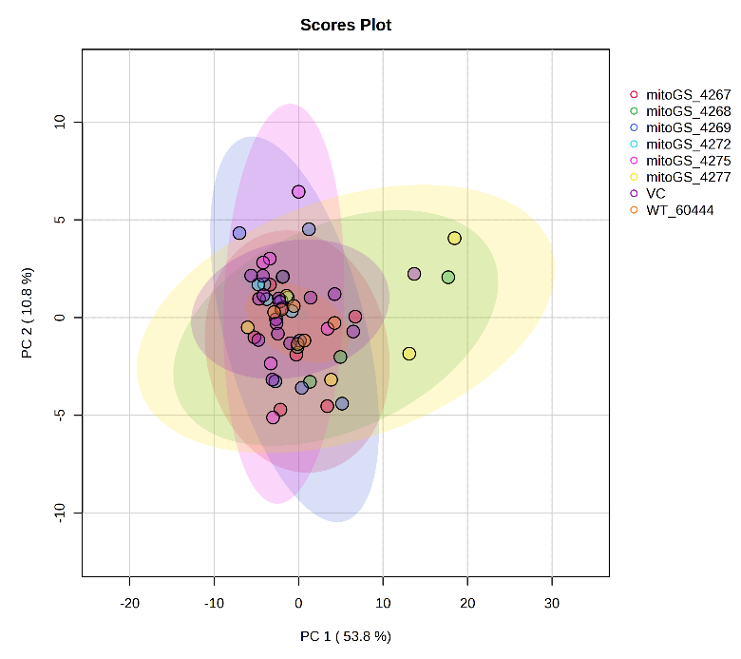
mitoGS, polytunnel 2022
Metabolites
Leaves
Roots

Slide 25
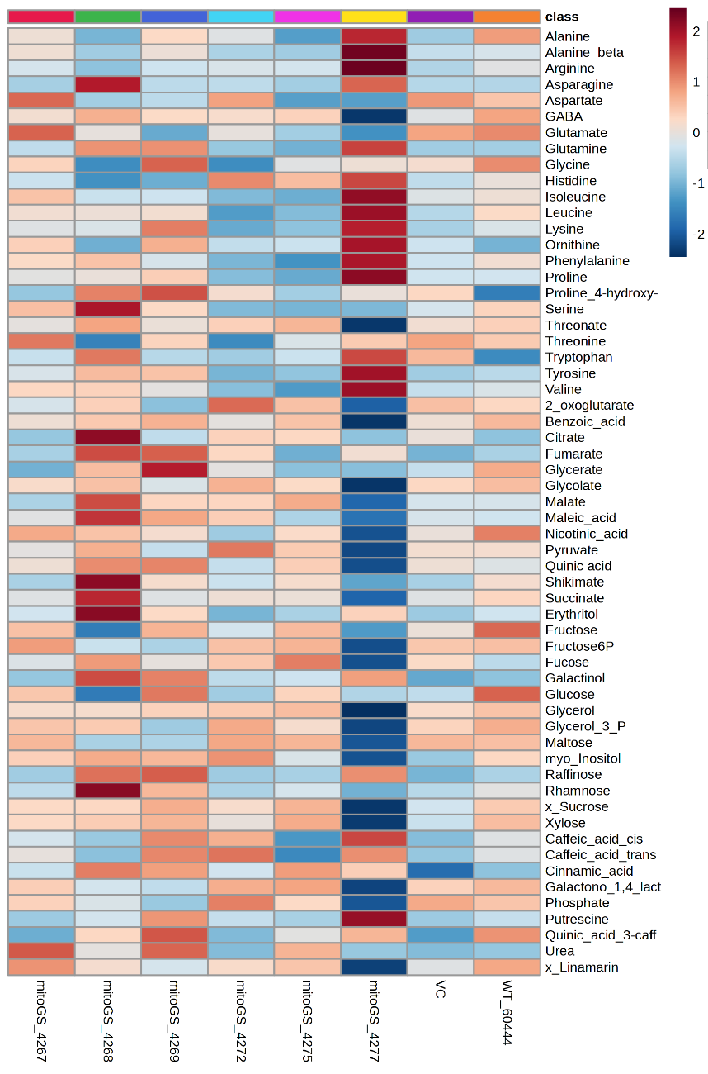
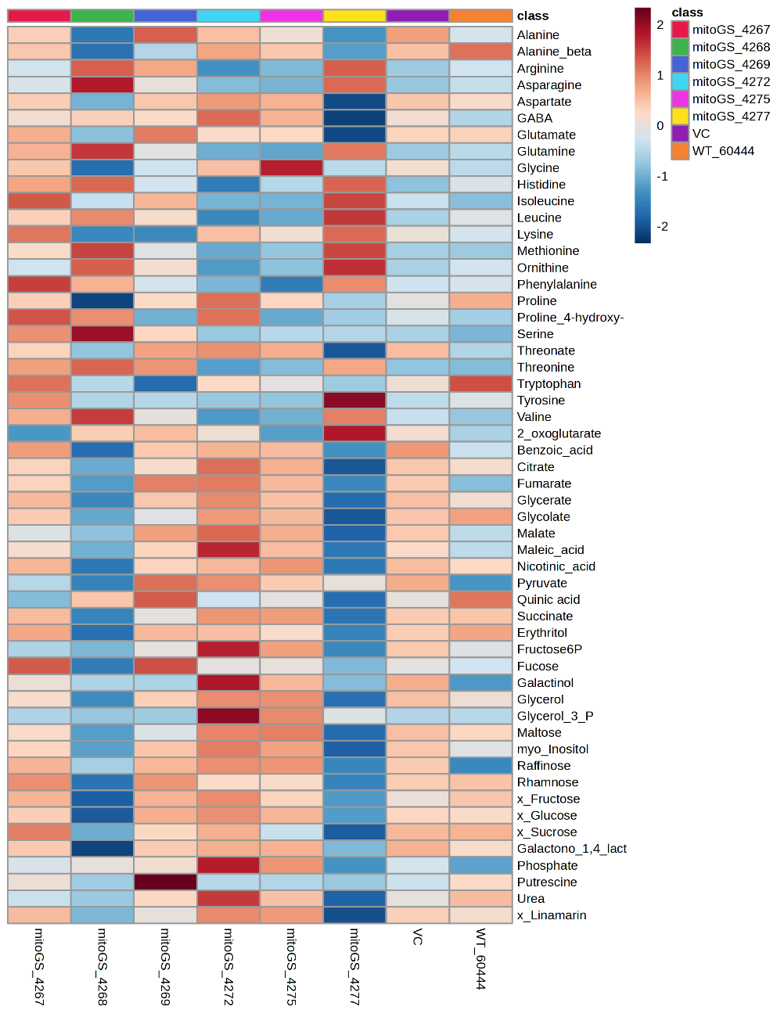
mitoGS, polytunnel 2022
Metabolites
Leaves
Roots
Amino acids and derivatives
Amino acids and derivatives
Organic acids
Organic acids
Sugars and derivatives
Sugars and derivatives
Others
Others

Slide 26
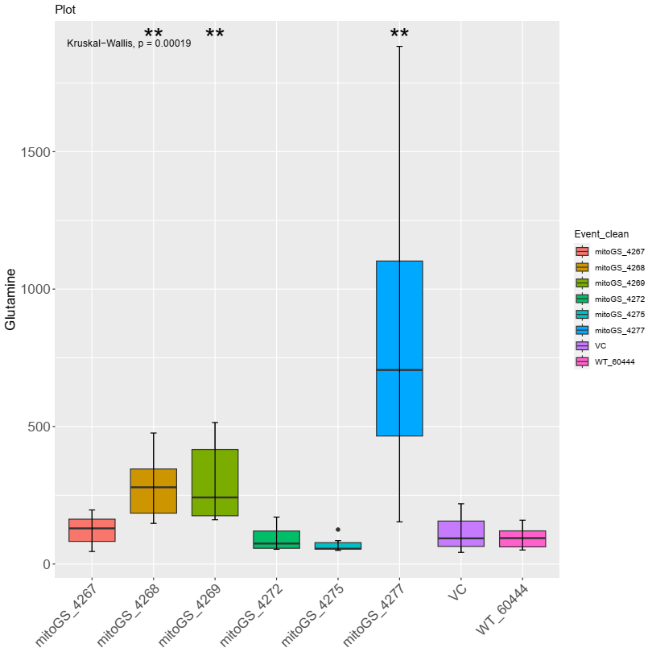
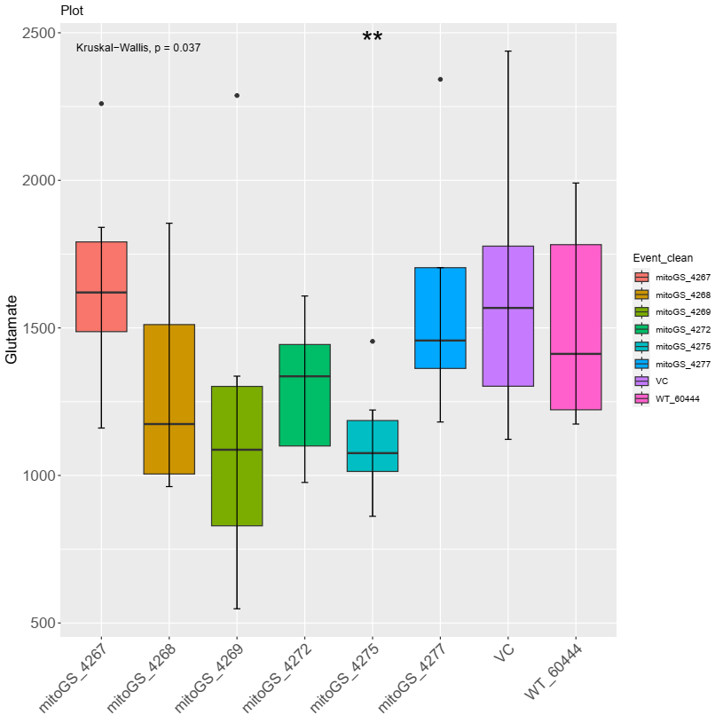

mitoGS, polytunnel 2022
GS/GOGAT cycle, leaves
Glutamine
VC
mitoGS_4277
Glutamate
2-oxoglutarate
Root dry weight

Slide 27

mitoGS, polytunnel 2022
GS/GOGAT cycle
Ammonium sources:
uptake from the soil by roots
nitrate reduction
photorespiration
lignin biosynthesis
senescence-induced N remobilization
N₂ fixation in legumes
Regulation of GS-GOGAT:
nitrogen availability
plant's nitrogen status
Light
Redox regulation
C/N balance
Marino, D., et al. (2022) New Phytol

Slide 28






mitoGS + AAP1, polytunnel 2022
GS+AAP1_
4435
GS+AAP1_
4440
GS+AAP1_
4448
VC
WT
GS+AAP1_
4455
GS+AAP1_
4459
GS+AAP1_
4461

Slide 29








mitoGS + AAP1, polytunnel 2022
Growth parameters
mitoGS+AAP1 lines consistently worse than VC, specially for root weight and HI
Kruskal-Wallis test, comparison to VC,*: p ≤ 0.05, **: p ≤ 0.01, ***: p ≤ 0.001

Slide 30




mitoGS + AAP1, polytunnel 2022
Metabolites leaves
Leaves
Roots

Slide 31


mitoGS + AAP1, polytunnel 2022
Metabolites
Leaves
Roots
Amino acids and derivatives
Amino acids and derivatives
Organic acids
Organic acids
Sugars and derivatives
Sugars and derivatives
Others
Others

Slide 32
Outlook
PYT 52
Lamm CE, et al. (2023). Plant Journal
Gutschker, et al. (2023). Biorxiv
Complete set: manuscript preparation
2. PYT 500, root samples
Further data analysis
3. AAP1/mitoGS plants
Polytunnel 2022
Further data analysis
Field Taiwan 2022 intermediate and final harvest
GCMS waiting list
Polytunnel 2024
AAP1, detail analysis
4. Energy metabolism transgenic plants
  Malate dehydrogenase (MDH)
  Aconitase (ACO)

Slide 33


Acknowledgements
CASS project
Germany:
FAU Erlangen
TU Kaiserslautern
Forschungszentrum Jülich
Nigeria:
IITA Ibadan
NRCRI Umudike
Switzerland: ETH Zürich
Taiwan: NCHU
UK: University of Cambridge
USA: Cornell University
www.cass-research.org
MPIMP
AG Fernie
Alisdair Fernie
Ruimei Lee
David Medeiros
Ismail Dahmani
Ina Krahnert
José Vallarino
Green team
AG Stitt
Mark Stitt
Armin Schlereth
… and you for your attention!

Slide 34








Thank you

Slide 36
Main Research Avenues
2. Metabolic engineering carbon pathways in cassava
mitoGS
AAP1
mitoGS+AAP1
Polytunnel, Germany 2022
Field, Taiwan 2022
Intermediate harvest, July 2022 (arrival Feb 2023)
Final harvest, December 2022 (arrival Aug 2023)
Field, Nigeria 2022
Plants died
Field, Taiwan 2023
Final harvest, December 2023
More replicates

Slide 37
Possible hypothesis
Messed up C/N balance in the mitoGS and double transgenics. Plants invest a lot in aa and starve in terms of carbon the rest
  GS from tomato bypasses translational and posttranslational regulations
  GS activity from tomato is inherently higher compared to cassava, so overexpression is not even needed
  Source limitation because of not enough light and/or short growth period

Slide 38

Nitrogen-rich amino acids
Among the 20 amino acids constituting proteins, six amino acids contain more than one nitrogen atom in each molecule. They were tryptophan (W), asparagine (N), glutamine (Q), lysine (K), histidine (H), and arginine (R).
Trovato M, Funck D, Forlani G, Okumoto S, Amir R (2021) Editorial: Amino Acids in Plants: Regulation and Functions in Development and Stress Defense. Front Plant Sci 12:772810. doi:10.3389/fpls.2021.772810

Slide 39


Slide 40

PYT 500
Progress:
Samples processing: Done
Grinding and distribution: Done
Sent to Erlangen and Kaiserslautern
Aliquoting for GC-MS: Done
Extraction for GC-MS: Done
Running on the GC-MS: Done (24.08.2023)
Data analysis!
Frosty
Thanks Ruimei, Armin, Ina and Nigeria team!!

Slide 41
Supplemental info
AAP1

Slide 42

AAP1
p134GG_#2-18_pCoYMV::PsAAP1
Functional cassettes
Promoter – Commelina Yellow mottle Virus (CoYMV)
  strong promoter in vascular and reproductive tissues (Medberry et al., 1992)
  and active in the companion cells of leaves, stems and roots (Matsuda et al., 2002).
5’-UTR – Pisum Sativum Amino Acid Permease 1 (PsAAP1)
CDS – Pisum Sativum Amino Acid Permease 1 (PsAAP1)
3’-UTR-terminator – Pisum Sativum Amino Acid Permease 1 (PsAAP1)
Selectable marker cassette
Promoter – Agrobacterium tumefaciens Nopaline Synthase (AtuNOS)
CDS – Hygromycin Phosphotransferase2 (Hpt2)
Terminator – Cauliflower Mosaic Virus 35S
Figure 6 Representative GUS staining pattern of four pCoYMV promoter-reporter lines. (A) Source leaf (Inlay = Close-up), (B) Sink leaf (Inlay = Close-up), (C) Emerging leaves, (D) Petiole cross-section (Inlay = Close-up), (E) Upper stem cross-section (Inlay = Close-up), (F) Lower stem cross-section (Inlay = Close-up), (G) Storage root cross-section (Inlay = Close-up), (H) Fibrous roots (Inlay = Root tip).
Zierer etal., 2022 Front Plant Sci

Slide 43




AAP1
Expression, intermediate harvest Taiwan 2022

Slide 44
Amino Acid Permease (AAP)
Amino Acid Permease (AAP)
  Multigene family
  Organ-specific expression
  Low transport selectivity
Arabidopsis: AAP1 is seed-specific
Vicia faba: AAP1 is expressed in embryonic storage parenchyma cells
Pea: AAP1 and AAP2 is expressed in seed coats
    epidermal transfer cells
    storage parenchyma cells
    vegetative organs
Notes:
Weigelt, K., Küster, H., Radchuk, R., Müller, M., Weichert, H., Fait, A., Fernie, A.R., Saalbach, I. and Weber, H. (2008) Increasing amino acid supply in pea embryos reveals specific interactions of N and C metabolism, and highlights the importance of mitochondrial metabolism. Plant J., 55, 909-926.

Slide 45


AAP1 from Vicia faba
AAP1 from Vicia faba - broad bean, fava bean
Overexpression in seeds of pea (Pisum sativum) and Vicia narbonensis
Increase in seed total nitrogen
Increase in sink strength for amino acids (more [14C]-glutamine uptake)
Stimulation of nitrogen root uptake (application of [¹⁵N]-labeled ammonia to the roots)
No change in seed yield per plant
Vicia faba
Vicia narbonensis
AAP1ox seeds
growth chamber
Rolletschek, et al. (2005). Plant Physiol
Götz, et al. (2007). J Exp Bot
Weigelt, et al. (2008). Plant J
Notes:
Rolletschek, H., Hosein, F., Miranda, M., Heim, U., Götz, K.P., Schlereth, A., Borisjuk, L., Saalbach, I., Wobus, U. and Weber, H. (2005) Ectopic expression of an amino acid transporter (VfAAP1) in seeds of Vicia narbonensis and pea increases storage proteins. Plant Physiol., 137, 1236-1249.
Götz KP, Staroske N, Radchuk R, Emery RJ, Wutzke KD, Herzog H, Weber H (2007) Uptake and allocation of carbon and nitrogen in Vicia narbonensis plants with increased seed sink strength achieved by seed-specific expression of an amino acid permease. J Exp Bot 58: 3183-3195
Decrease seed weight in field conditions, but plants
Weigelt, K., Küster, H., Radchuk, R., Müller, M., Weichert, H., Fait, A., Fernie, A.R., Saalbach, I. and Weber, H. (2008) Increasing amino acid supply in pea embryos reveals specific interactions of N and C metabolism, and highlights the importance of mitochondrial metabolism. Plant J., 55, 909-926.

Slide 46





AAP1 construct
AAP1 in Arabidopsis
The aap2 plants outperformed wild-type plants with respect to growth, seed yield and carbon storage pools, and nitrogen use efficiency in both high and deficient nitrogen environments. (Perchlik and Tegeder 2018 Plant Physiol)
But reduced seed protein levels (Zhang et al., 2010)
Notes:
Perchlik, M. and M. Tegeder (2018). "Leaf amino acid supply affects photosynthetic and plant nitrogen use efficiency under nitrogen stress." Plant Physiology 178(1): 174-188.
Zhang, L., et al. (2010). "Altered xylem-phloem transfer of amino acids affects metabolism and leads to increased seed yield and oil content in Arabidopsis." Plant Cell 22(11): 3603-3620.

Slide 47

AAP1 construct
AAP1 in Oryza sativa
OsAAP1 gene is highly expressed in rice axillary buds, leaves, and young panicles, and that the OsAAP1 protein is localized to both the plasma membrane and the nuclear membrane.
OE lines exhibited increased filled grain numbers as a result of enhanced tillering,
RNAi and CRISPR (Osaap1) knockout lines showed the opposite phenotype.
In addition, OsAAP1-OE lines had higher concentrations of neutral and acidic amino acids, but lower concentrations of basic amino acids in the straw.
Notes:
Ji, Y., Huang, W., Wu, B., Fang, Z. and Wang, X. (2020) The amino acid transporter AAP1 mediates growth and grain yield by regulating neutral amino acid uptake and reallocation in Oryza sativa. J. Exp. Bot., 71, 4763-4777.

Slide 48



AAP1 in pea
AAP1 from pea (Pisum sativum)
Simultaneous overexpression in pea targeting amino
acids source-sink partitioning via
import into the seed (cotyledon epidermis)
and phloem loading (sieve element-companion cell)
Increase in biomass
Increase in seed and leaves total nitrogen
Increase in total free amino acid levels in the phloem exudate and in the xylem sap
Increase in photosynthetic rate
Increased yield per plant
Under different N treatments
Perchlik, et al. (2017). Plant Physiol
Zhang, et al. (2015). Plant J

Slide 49
Supplemental info
mitoGS

Slide 50

mitoGS
p134GG_#2-14_pSlRBCS2::COX4-SlGScyt
Functional cassettes
mitoGS
Promoter – Solanum lycopersicum Ribulose Biphosphate Carboxylase Small Subunit 2 (pSlRBCS2)
5’-UTR – Solanum lycopersicum Ribulose Biphosphate Carboxylase Small Subunit 2 (pSlRBCS2)
5’-Targeting signal – Saccharomyces cerevisiae Cytochrome c Oxidase 4 (ScCOX4)
5’-CDS – Solanum lycopersicum Glutamine Synthase cytosolic (SlGScyt.)
3’-UTR-terminator – Cauliflower Mosaic Virus 35S
Selectable marker cassette
Promoter – Agrobacterium tumefaciens Nopaline Synthase (AtuNOS)
CDS – Hygromycin Phosphotransferase2 (Hpt2)
Terminator – Cauliflower Mosaic Virus 35S
Although no dedicated promoter-GUS lines were created for the promoters of SlRBCS2 and AtRBCS1A, they appeared very active in source leaf tissues in transcript studies. In addition, pSlRBCS2 also appeared to be specific for this tissue.
Zierer etal., 2022 Front Plant Sci

Slide 51
Glutamine synthetase (GS)
GS/GOGAT cycle
Glutamine synthetase (GS)
Glutamate synthetase (GOGAT)
Incorporation of inorganic nitrogen
into organic molecules
GS1: cytosol
encoded by multiple genes
primary NH₄⁺ assimilation, N remobilization and translocation
GS2: plastid
generally encoded by a single gene
reassimilation of photorespiratory NH₄⁺, and NH₄⁺ from nitrite reduction
Increasing expression of GS is in general beneficial, associated with N use and stress tolerance
Notes:
photorespiration acting as an electron-sink
that would dissipate excessive reducing power, thus protecting
against the production of reactive oxygen species and conferring
photoprotection

Slide 52

mitoGS
Glutamine synthetase (GS)
Flux balance analysis (FBA) model
Tomato plants
Increase expression
GS1 (cytosolic) or GS2 (plastidic) +
Leaf mesophyll-specific promoter (ribulose-bisphosphate carboxylase, RbcS) +
Mitochondrial transit peptide COX4ts (for mitochondrial localization)
Early flowering and fruit set
Faster growth rate
Increased fruit yield
Vallarino, et al. 2022, bioRxiv
Notes:
Vallarino, J.G., Shameer, S., Zhang, Y., Ratcliffe, R.G., Sweetlove, L.J. and Fernie, A.R. (2022) Leaf specific overexpression of a mitochondrially-targeted glutamine synthetase in tomato increased assimilate export resulting in earlier fruiting and elevated yield. bioRxiv, 2022.2006.2028.497938.

Slide 53

mitoGS
Expression, intermediate harvest Taiwan 2022

Slide 54
GS/GOGAT cycle
Enzymes and Nitrogen Cycling
John A. Berges, Margaret R. Mulholland, in Nitrogen in the Marine Environment (Second Edition), 2008
2.2.2.3 Enzyme regulation and interpretation of activity assays
GOGAT activity does not appear to be as heavily regulated as GS activity, or perhaps it is just less studied (Florencio et al., 1987; Muro-Pastor et al., 2005). However, GOGAT does appear to be regulated by light and metabolite sensing systems in higher plants (Suzuki and Knaff, 2005)
Functions of macronutrients☆
Malcolm J. Hawkesford, ... Philip J. White, in Marschner's Mineral Nutrition of Plants (Fourth Edition), 2023
6.1.4.2 Ammonium assimilation
Ammonium is a central intermediate in plant N metabolism. As well as uptake from the soil by roots, ammonium is constantly generated in plant tissues by processes such as nitrate reduction, photorespiration, lignin biosynthesis, senescence-induced N remobilization, and N2 fixation in legumes (Joy, 1988). Irrespective of the source of ammonium, or the organ in which it is assimilated (roots, root nodules, and leaves), the key enzymes involved are glutamine synthetase (GS) and glutamate synthase (GOGAT; glutamine-oxoglutarate aminotransferase). Both enzymes are present in roots, in chloroplasts, and in N2-fixing microorganisms, and assimilation of most if not all ammonium derived from ammonium uptake, N2 fixation, nitrate reduction, and photorespiration is mediated by the GS-GOGAT pathway. In this pathway the amino acid glutamate acts as the acceptor for ammonium, and the amide glutamine is formed (Fig. 6.9). The net reaction is:
Sign in to download full-size image
Figure 6.9. Model of ammonium assimilation via the glutamine synthetase-glutamate synthase cycle. Pathways at low (1) and high (2) ammonium supply.
(6.2)Glutamate+2-oxoglutarate+NH4+→glutamine+H+
GS exists in multiple enzyme forms located in the cytosol and in plastids (Bernard et al., 2008). Cytosolic GS assimilates ammonium into glutamine for transport and distribution throughout the plant. During leaf senescence, cytosolic GS fulfills a key function in the assimilation and recycling of ammonium generated in various catabolic processes (Masclaux-Daubresse et al., 2010). This role is particularly important after anthesis and during grain development and filling in cereals, when N is remobilized to the reproductive sinks (Thomsen et al., 2014). Several isoenzymes of the cytosolic GS1 gene family are abundantly expressed in roots and can be classified into high-affinity or low-affinity subtypes differing in Vmax values (Ishiyama et al., 2004). Some isoenzymes play a redundant role under low ammonium supply and others dominate under high external ammonium supply (Konishi et al., 2018). This dynamic regulation may contribute to the homeostatic control of glutamine synthesis in roots. In arabidopsis shoots, separate isoforms of cytosolic GS play distinct roles for seed yield structure and for coping with ammonium toxicity (Guan et al., 2015; 2016). The same is the case in maize, where the Gln1–3 and Gln1–4 genes affect kernel number and kernel size, respectively, with a specific impact on grain production (Martin et al., 2006).
In chloroplasts, light-stimulated nitrate reduction and enhanced ammonium assimilation are coordinated through the import of 2-oxoglutarate from the stroma and export of glutamate from the stroma of chloroplasts into the cytoplasm, thus preventing high ammonium concentrations. Chloroplast GS is activated by high pH and high concentrations of Mg and ATP, and all three factors are increased in the chloroplast stroma upon illumination. In cytosol and chloroplasts, GS is also subject to posttranslational regulation by phosphorylation and subsequent interactions with proteins (Finnemann and Schjoerring, 2000; Lima et al., 2006).
The other enzyme involved in ammonium assimilation, glutamate synthase (GOGAT), catalyzes the transfer of the amide group (–NH2) from glutamine to 2-oxoglutarate, which is a product of the tricarboxylic acid (TCA) cycle. The conversion of glutamine to glutamate takes place in plastids that have two isoforms of GOGAT. One form accepts electrons from reduced ferredoxin (from photosystem I), the other from NADPH from respiration. The ferredoxin-linked GOGAT isoform dominates in leaves, particularly in the chloroplasts of phloem companion cells in leaf veins (Masclaux-Daubresse et al., 2007), whereas the NADPH isoform is prevalent in roots (Tabuchi et al., 2007). Both forms contain an Fe-S cluster that transfers electrons during the reductive synthesis of two glutamate molecules from one 2-oxoglutarate and one glutamine molecule. One of the two molecules of glutamate produced is required for the maintenance of the ammonium assimilation cycle and the other can be transported from the sites of assimilation and utilized elsewhere for the biosynthesis of proteins. When the ammonium supply is high, both glutamate molecules can act as ammonium acceptors, and one molecule of glutamine leaves the cycle (Fig. 6.9). Two Fd-GOGAT genes (GLU1 and GLU2) have been characterized in higher plants, with GLU1 playing a major role in the assimilation of ammonium derived from photorespiration, whereas the GLU2 gene may play a major role in the primary N assimilation in roots (Suzuki and Knaff, 2005).

Slide 55
GS1 and GS2
Marino, D., et al. (2022) New Phytol

Slide 56
Marino, D., et al. (2022) New Phytol

