Slide 1
CASS
RESEARCH
CASSAVA SOURCE-SINK INNOVATION
Gas exchange measurement from cassava
Silas Wungrampha
National Chung Hsing University, Taichung

Slide 2
CASS
Experimental design and Licor parameter for measuring gas exchange
RESEARCH
CASSAVA SOURCE-SINK INNOVATION
Three constructs: C2-8 (AtAKTv_{ar}), C2-16 (AlaAT), and C56 (GPT-NTT) and WTs from ETH and FAU
To capture overall photosynthesis performance of each lines between 8:30 AM and 5 PM, measurements were spread over seven days
Licor environment parameters
CO₂ (reference): 420, 300, 200, 100, 50, 0, 420, 420, 600, 800, 1000, 1300, 1600, 1800, and 1900 PPM (15 points): takes about 70 minutes
Fan speed: 10,000 rpm
Low rate: 600 μmol s⁻¹
Light intensity: 1000 (earlier), change to 1200 μmolm⁻²s⁻¹ after we replace the Single Light Source to Multiphase Flash Fluorometer
Relative humidity: 55-75% (weather dependent)
Temperature of leaf: 28-32ºC (weather dependent)

Slide 3
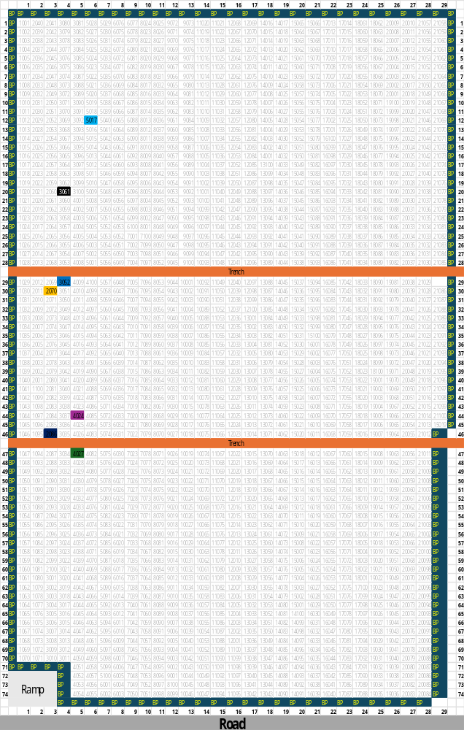
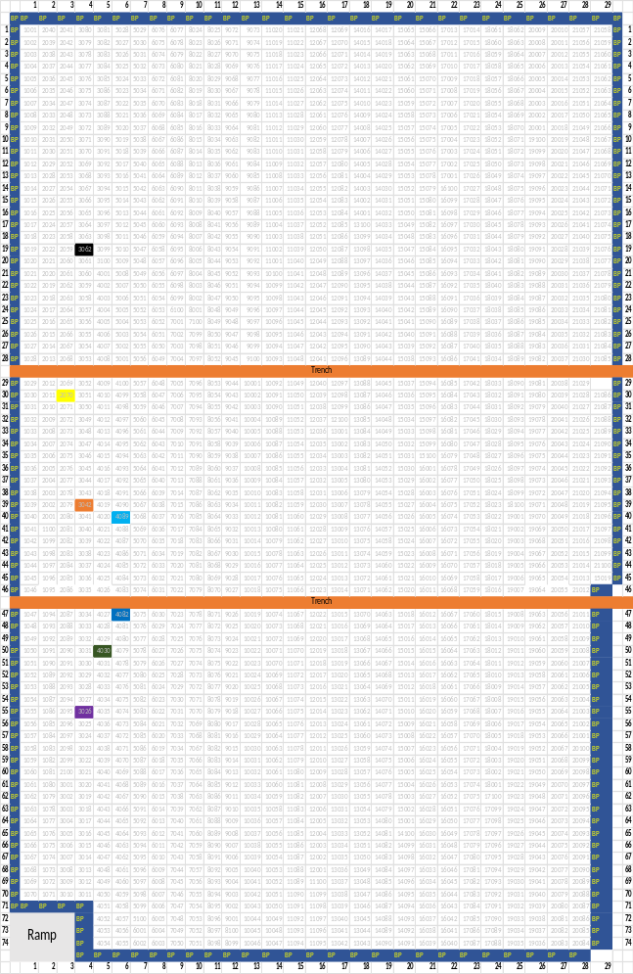
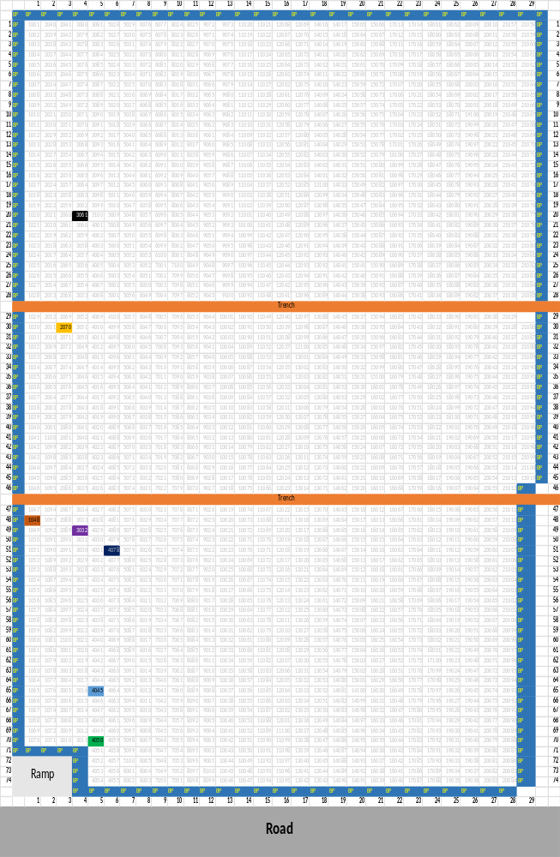
Position of AtAKT2_{var}, GTP-NTT, AlaAT transgenic lines, and wildtype selected for gas exchange measurement in WF2
CASS
RESEARCH
CASSAVA SOURCE-SINK INNOVATION
C2_8-4255
C2_8-4261
C2_8-4262
C2_8-4266
C2_8-4265
TMS60444
TMS60444-ETH
C56-4838
C56-4839
C56-4844
C56-4845
C56-4847
TMS60444
TMS60444-ETH
C2_16-4808
C2_16-4809
C2_16-4810
C2_16-4812
C2_16-4813
TMS60444
TMS60444-ETH
Position of the AtAKT_{var} and WT (ETH and FAU)
Position of the GPT-NTT and WT (ETH and FAU)
Position of AlaAT and WT (ETH and FAU)
Plants chosen from the best growing area of WF2

Slide 4
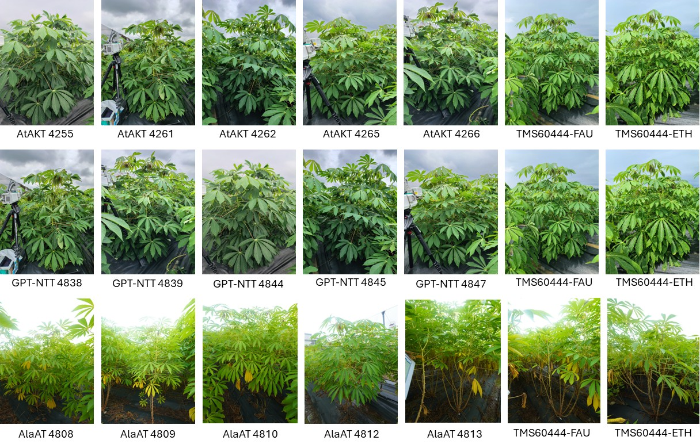
CASS
Selected plants and its growth parameter during measurement
RESEARCH
CASSAVA SOURCE-SINK INNOVATION

Slide 5
CASS
Experimental design for measuring gas exchange from AtAKT2_{var}, GTP-NTT, and AlaAT
RESEARCH
CASSAVA SOURCE-SINK INNOVATION
Time (tentative) | Day 1 | Day 2 | Day 3 | Day 4-1 | Day 4-2 | Day 5 | Day 6 | Day 7
8:30 - 9:45 AM | C8-4255 | WT-ETH | WT-FAU | C8-4266 | Rain | C8-4265 | C8-4262 | C8-4261
9:45 - 11:00 AM | C8-4261 | C8-4255 | WT-ETH | WT-FAU |  | C8-4266 | C8-4265 | C8-4262
11 AM - 12:15 PM | C8-4262 | C8-4261 | C8-4255 | WT-ETH | WT-ETH | WT-FAU | C8-4266 | C8-4265
12:15 - 01:30 PM | C8-4265 | C8-4262 | C8-4261 | C8-4255 | C8-4255 | WT-ETH | WT-FAU | C8-4266
01: 30 - 2:45 PM | C8-4266 | C8-4265 | C8-4262 | C8-4261 | C8-4261 | C8-4255 | WT-ETH | WT-FAU
02:45 - 04 PM | WT-FAU | C8-4266 | C8-4265 | Rain | C8-4262 | C8-4261 | C8-4255 | WT-ETH
04 -05:15 PM | WT-ETH | WT-FAU | C8-4266 |  | C8-4265 | C8-4262 | C8-4261 | C8-4255
Time (tentative) | Day 1 | Day 2 | Day 3 | Day 4 | Day 5 | Day 6 | Day 7
8:30 - 9:45 AM | C16-4808 | WT ETH | WT FAU | C16- 4813 | C16- 4812 | C16- 4810 | C16- 4809
9:45 - 11:00 AM | C16-4809 | C16- 4808 | WT ETH | WT FAU | C16- 4813 | C16- 4812 | C16- 4810
11 AM - 12:15 PM | C16-4810 | C16- 4809 | C16- 4808 | WT ETH | WT FAU | C16- 4813 | C16- 4812
12:15 - 01:30 PM | C16- 4812 | C16- 4810 | C16- 4809 | C16- 4808 | WT ETH | WT FAU | C16- 4813
01: 30 - 2:45 PM | C16- 4813 | C16- 4812 | C16- 4810 | C16- 4809 | C16- 4808 | WT ETH | WT FAU
02:45 - 04 PM | WT FAU | C16- 4813 | C16- 4812 | C16- 4810 | C16- 4809 | C16- 4808 | WT ETH
04 -05:15 PM | WT ETH | WT FAU | C16- 4813 | C16- 4812 | C16- 4810 | C16- 4809 | C16- 4808
Time (tentative) | Day 1 | Day 2 | Day 3 | Day 4 | Day 5 | Day 6 | Day 7.1 | Day 7.2
8:30 - 9:45 AM | C56-4844 | WT-ETH | WT-FAU | C56-839 | C56-4847 | C56 4845 | C56-4838 | C56-4838
9:45 - 11:00 AM | C56-4838 | C56-4844 | WT-ETH | WT-FAU | C56-4839 | C56-4847 | C56-4845 | C56-4845
11 AM - 12:15 PM | C56-4845 | C56-4838 | C56-4844 | WT-ETH | WT-FAU | C56-4839 | C56-4847 | C56-4847
12:15 - 01:30 PM | C56-4847 | C56-4845 | C56-4838 | C564844 | WT-ETH | WT-FAU | C56-4839 | C56-4839
01: 30 - 2:45 PM | C56-4839 | C56-4847 | C56-4845 | C56-4838 | C56-4844 | WT-ETH | WT-FAU | WT-FAU
02:45 - 04 PM | WT-FAU | C56-4839 | C56-4847 | C56-4845 | C56- 4838 | C56-4844 | WT-ETH | WT-ETH
04 -05:15 PM | WT-ETH | WT-FAU | C56-4839 | C56-4847 | C56- 4845 | C56- 4838 | C56-4844 | C56-4844
Light blue box: Rain during measurement
Day 7.1 during C56 measurement: Insecticide spray led to abnormal gas exchange data as most of the

Slide 6
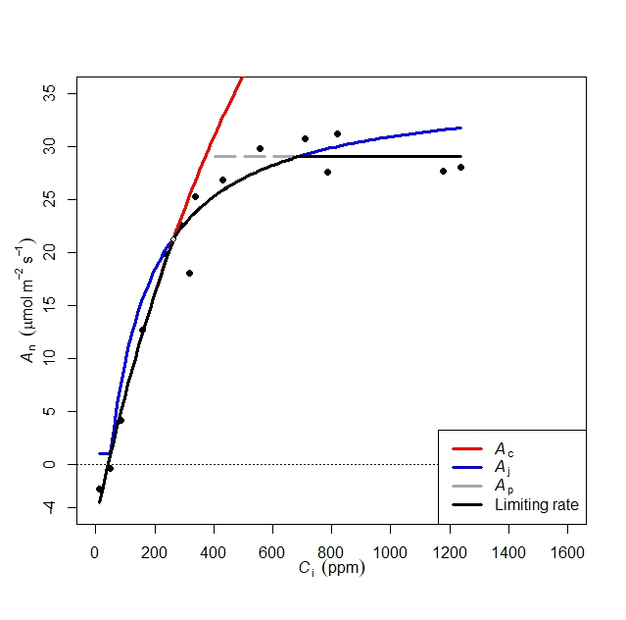
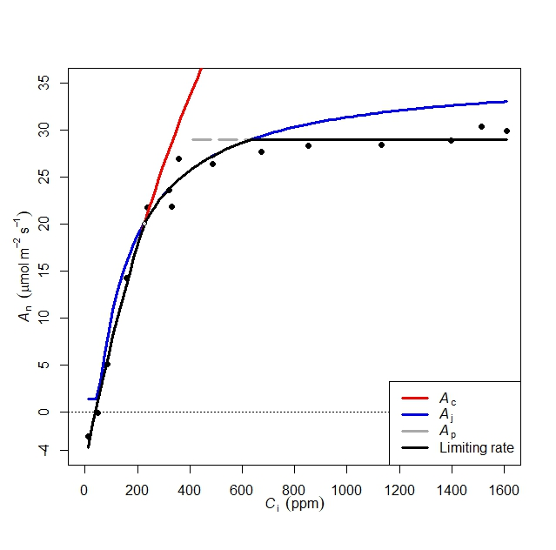
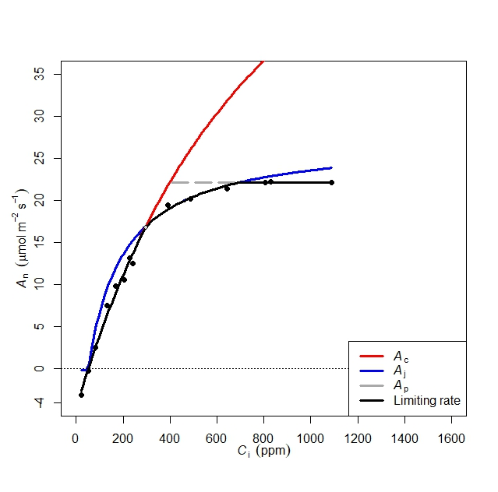
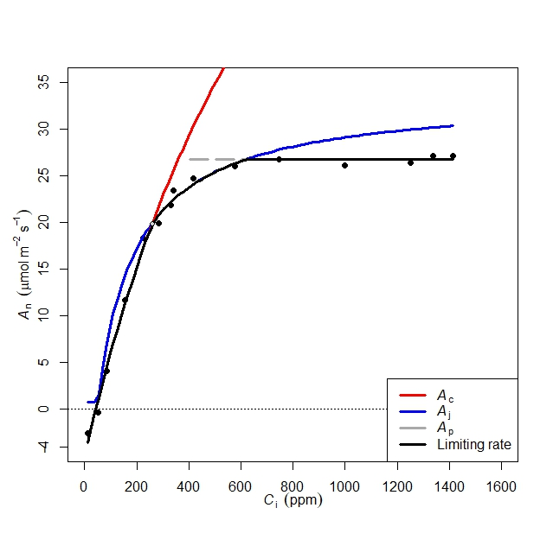
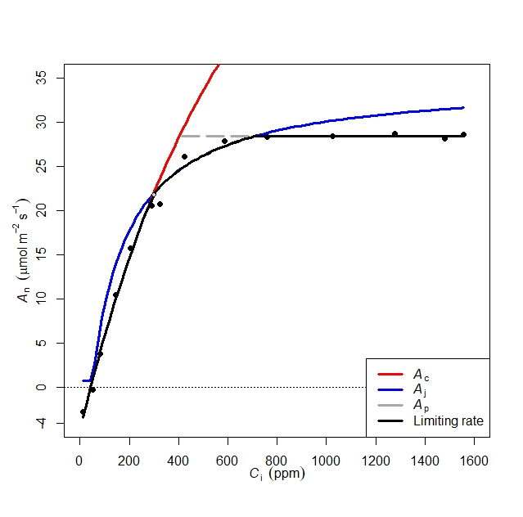
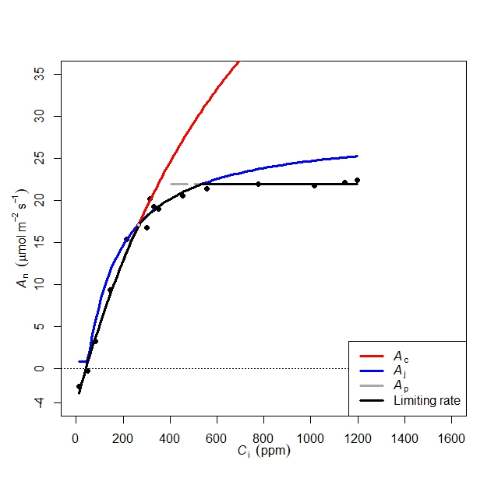
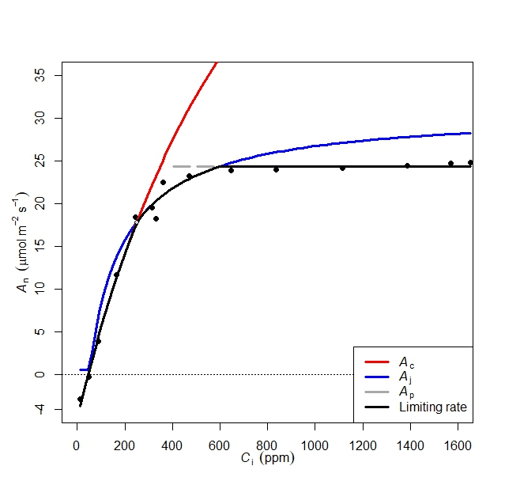
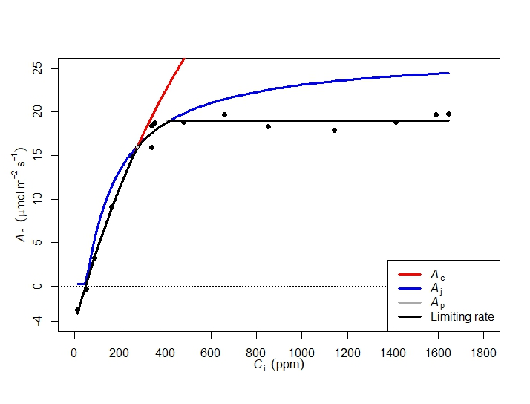
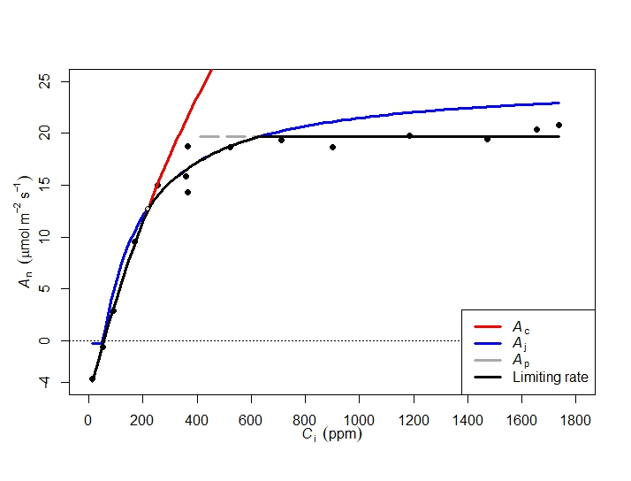
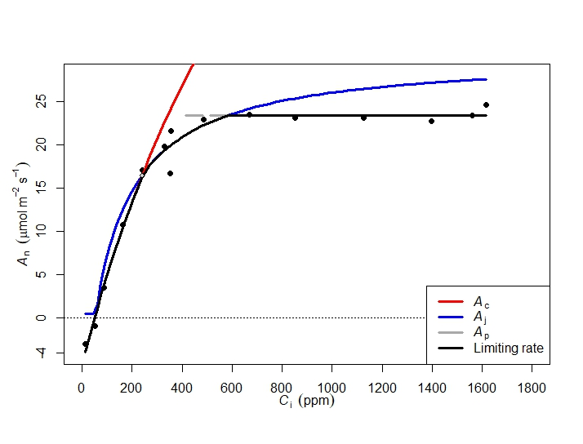
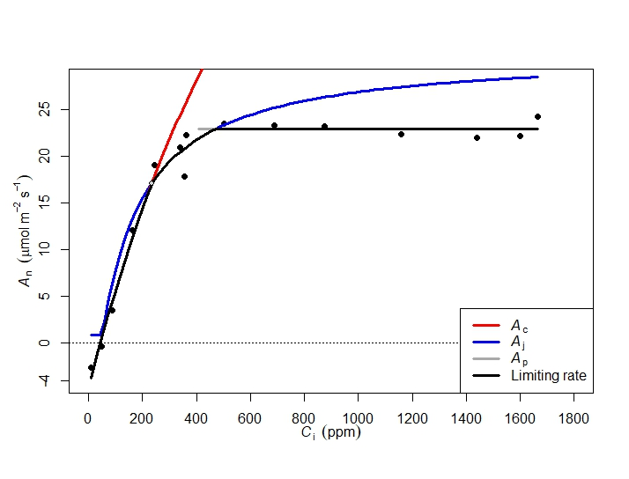
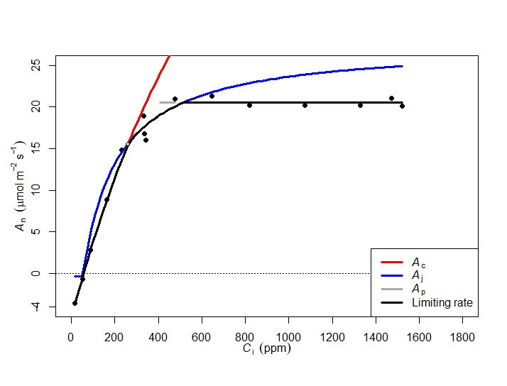
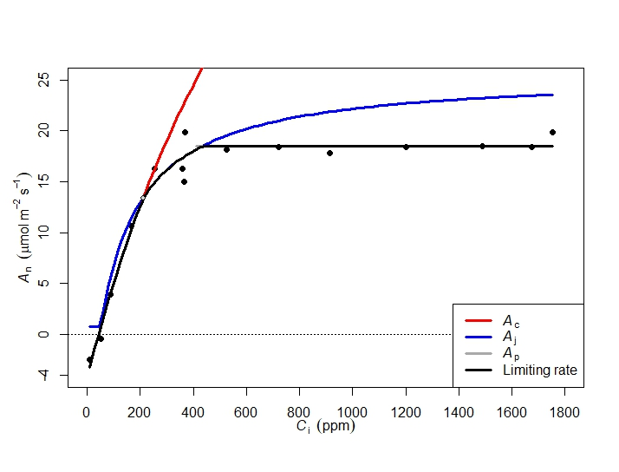
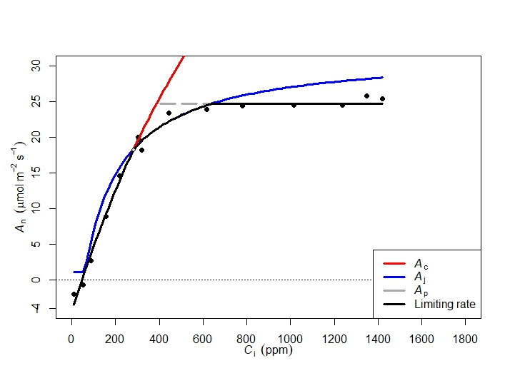
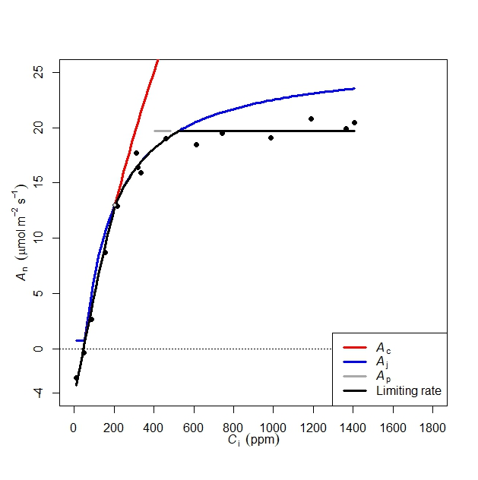
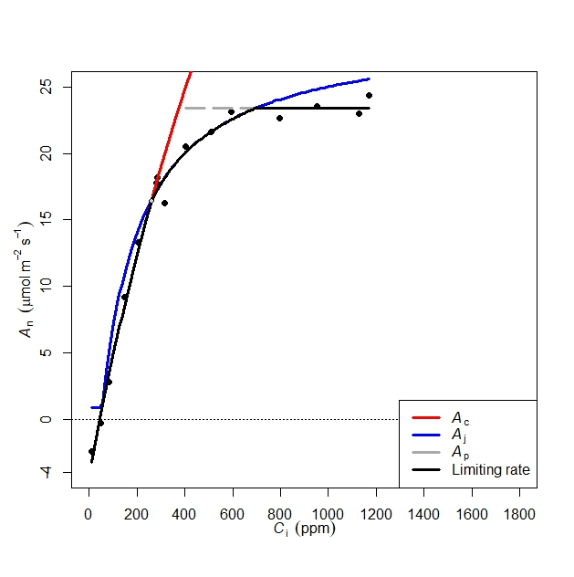
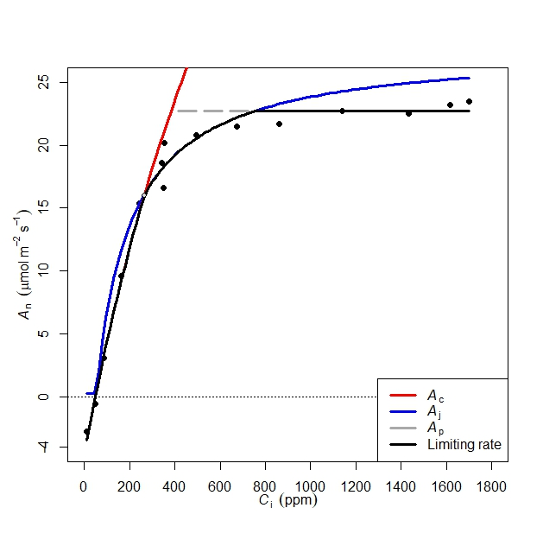

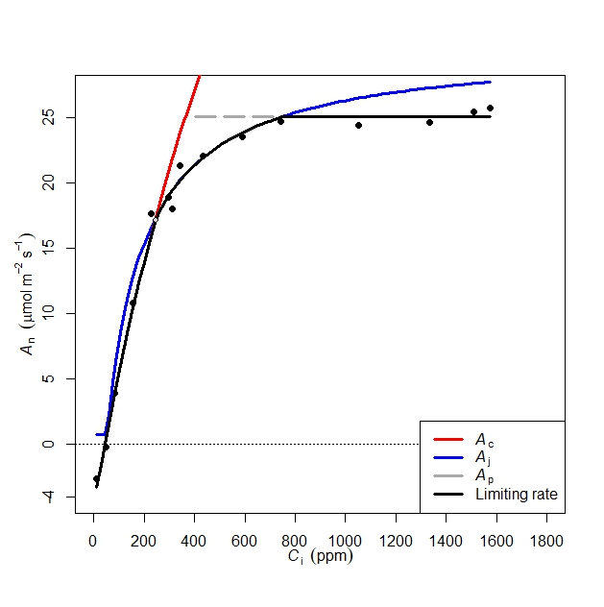
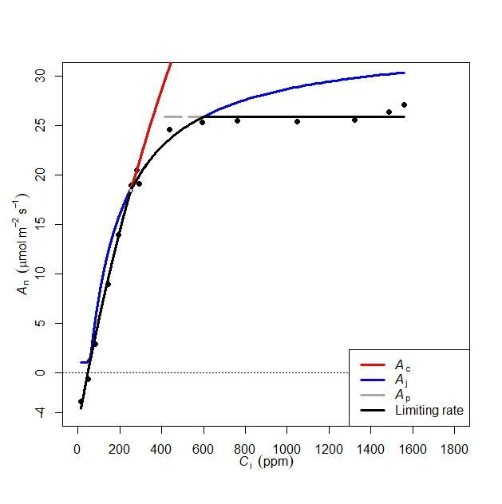
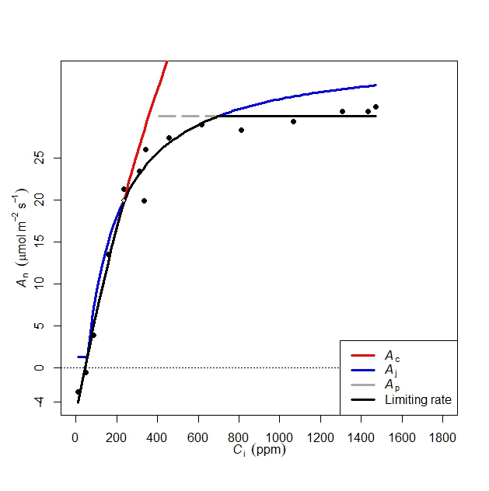
CASS
ACi curves reveal line-specific limits in RuBisCO activity, RuBP regeneration, and TPU among AtAKT2_{var}, GTP-NTT, and AlaAT transgenics
RESEARCH
CASSAVA SOURCE-SINK INNOVATION
35
30
25
20
15
A (μmol m⁻² s⁻¹)
10
5
0
AtAKT-4255
AtAKT-4261
AtAKT-4262
AtAKT-4265
AtAKT-4266
TMS60444-ETH
TMS60444
-4
25
20
15
10
A (μmol m⁻² s⁻¹)
5
0
-4
GPT-NTT 4838
GPT-NTT 4839
GPT-NTT 4844
GPT-NTT 4845
GPT-NTT 4847
TMS60444-ETH
TMS60444
25
20
15
10
A (μmol m⁻² s⁻¹)
5
0
-4
AlaAT 4808
AlaAT 4809
AlaAT 4810
AlaAT 4812
AlaAT 4813
TMS60444-ETH
TMS60444
0
400
800
1200
1600
0
400
800
1200
1600
0
400
800
1200
1600
0
400
800
1200
0
400
800
0
400
800
0
1600
1200
1600
1200
1600
400
800
1200
1600
Ci (ppm)
Ci (ppm)
Ci (ppm)
Ci (ppm)
Ci (ppm)
Ci (ppm)
Ci (ppm)

Slide 7
CASS
AtAKT_{var} lines exhibit enhanced RuBisCO activity, RuBP regeneration, and TPU under fluctuating CO₂ and saturated light compared to vector control and wild type
RESEARCH
CASSAVA SOURCE-SINK INNOVATION
F(11, 65) = 5.43
p> 0.0001
F(11, 65) = 3.03
p> 0.01
F(11, 65) = 1.29
p> 0.25
F(11, 65) = 2.99
p> 0.01
F(11, 65) = 4.74
p> 0.0001

Slide 8
CASS
Some pStGBSS1::PsGPT2 + pStB33::AtNTT1 lines exhibit enhanced RuBisCO activity, RuBP regeneration, and TPU under fluctuating CO₂ and saturated light compared to wild type
RESEARCH
CASSAVA SOURCE-SINK INNOVATION
F(6, 48) = 30.17
p> 0.0001
F(6, 48) = 5.2
p> 0.001
F(6, 48) = 1.28
p> 0.28
F(6, 48) = 0.8
p> 0.57
F(6, 48) = 2.74
p> 0.02

Slide 9
CASS
pOsAnt::HvAlaAt lines show no significant difference in gas exchange parameters compared to wild type
RESEARCH
CASSAVA SOURCE-SINK INNOVATION
F(5, 23) = 4.11
p> 0.05
F(6, 27) = 3.31
p> 0.01
F(6, 27) = 6.7
p> 0.001
F(6, 27) = 1.47
p> 0.2
F(6, 27) = 1.17
p> 0.3

Slide 10
CASS
Gas exchange in WT varies significantly across cycles, reflecting influence of plant age and climatic conditions
RESEARCH
CASSAVA SOURCE-SINK INNOVATION
*
***
***
***
**
***
**
**
***
*
**
**
***
F=(2,20)2.15, p=0.05
(F=(2,20) 45, p=0.0001)
F=(2,20) 3.8, p=0.04
F=(2,20) 49.6, p=0.001
F=(2,20) 8.03, p=0.002
F=(2,20) 82.6, p=0.0001
Gas exchange of the wildtype (WT), measured across three cycles (each spanning one week), was compared to assess differences in the parameters. Significant variation was observed between cycles, indicating that gas exchange is dynamic and influenced by plant age and climatic conditions. This leads to the conclusion that, for accurate assessment, VC must be measured concurrently in each cycle. p < 0.1 = * ; p <0.01 = ** ; p < 0.001 = ***

Slide 11
CASS
Future plan
RESEARCH
CASSAVA SOURCE-SINK INNOVATION
In the coming year, measurement of the gas exchange will start from mid-week of April to August until we can reach the 5th leaf of the plant
Rather than comparing the transgenic lines with wildtypes it will be compared with vector controls or, one VC and one WT
In addition to gas exchange, Chlorophyll a fluorescence of cassava will be measured using HandyPEA. As the measurement of Chl a fluorescence takes a very short time, we will try to cover other potential transgenic plants

Slide 12
Thank you

