Slide 1
Cassava Source-Sink Project
Improving cassava yield to support smallholder farmers in Sub-Saharan Africa
Metabolic engineering of carbon and nitrogen pathways to enhance cassava yield
Laise Rosado-Souza
AG Fernie
CASS Project Meeting
07.10.2024

Slide 2
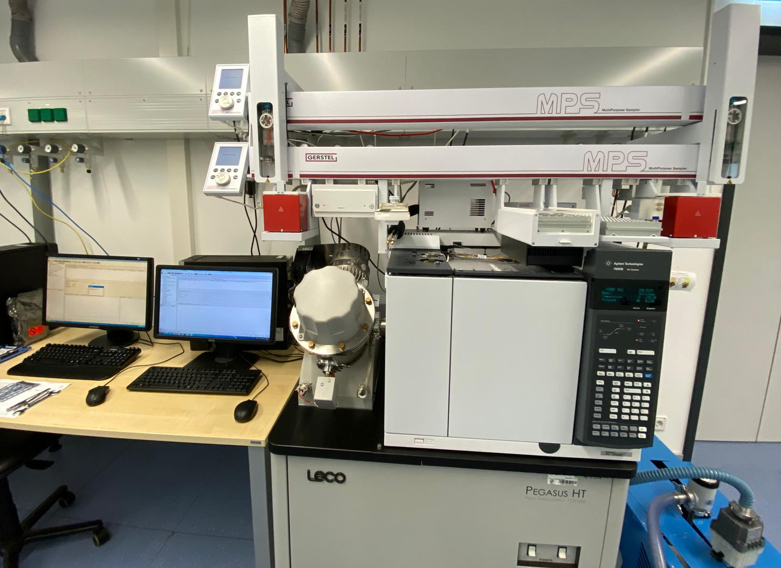
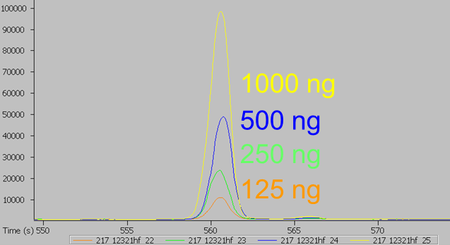
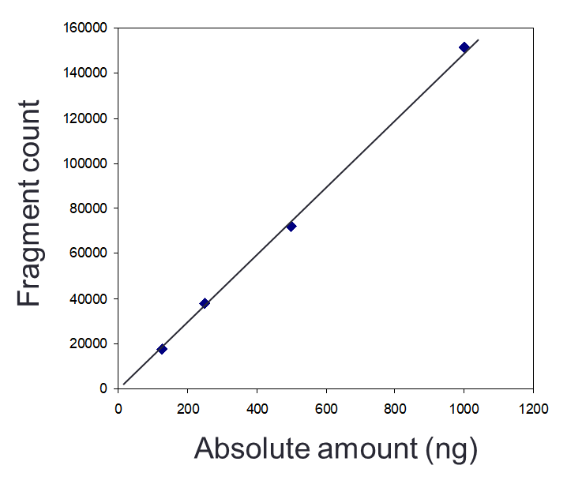
Metabolite profiling of cassava
Quantification by gas chromatography-mass spectrometry (GC-MS)
Optimization of GC-MS procedure for cassava samples
Suitable amount of starting material
Assessment of matrix effects
Assessment of freeze-drying effects
Preparation of standard chemicals for absolute quantification of metabolites
63 metabolites quantitatively detected
  Sugars, organic acids, amino acids, specialized metabolites, others

Slide 3
Main Research Avenue
1. Metabolic engineering carbon pathways in cassava
Polytunnel, Germany 2022
AAP1
mitoGS
mitoGS/AAP1
Polytunnel, Germany 2024
AAP1

Slide 4
Main Research Avenue
1. Metabolic engineering carbon pathways in cassava
Polytunnel, Germany 2022
AAP1
mitoGS
mitoGS/AAP1
Polytunnel, Germany 2024
AAP1

Slide 5
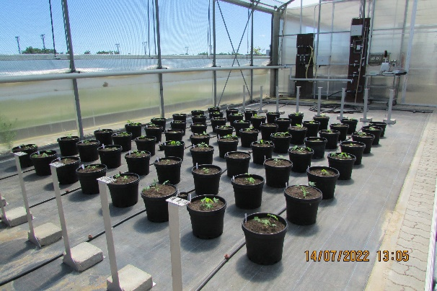
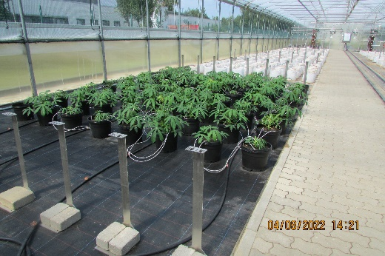
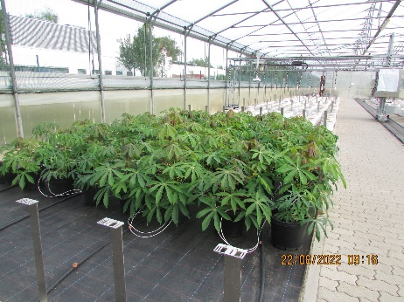
Polytunnel, Germany 2022
Genotypes:
WT 60444
Vector control (6 lines)
AAP1 (6 lines)
mitoGS (6 lines)
mitoGS+AAP1 (6 lines)
Full nutrition substrate
~3 months old plants
10L pot

Slide 6
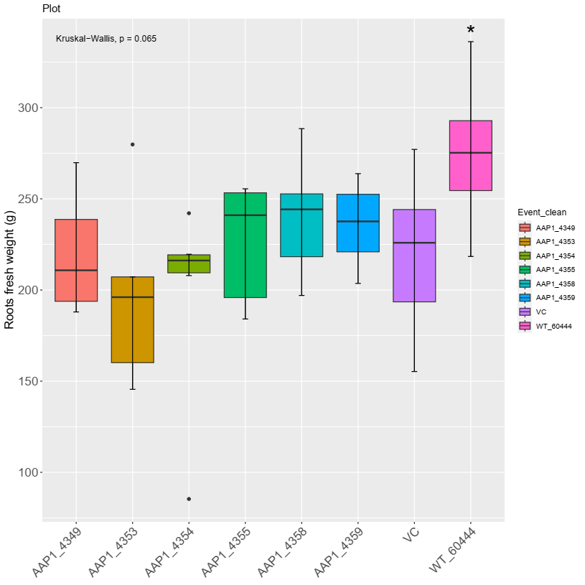
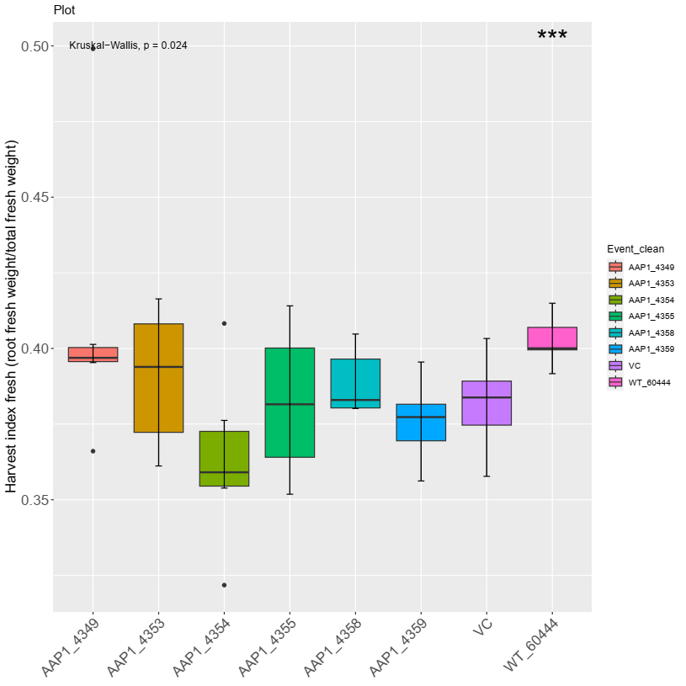
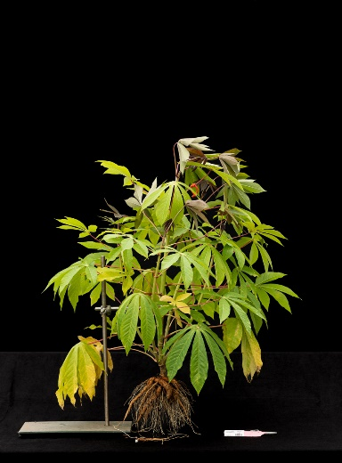
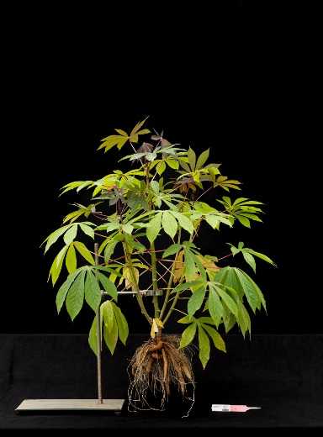
VC, Germany 2022
Root fresh weight
HI (fresh bases)
VC_4220
WT
Penalty in root (fresh and dry) weight and HI compared to WT

Slide 7
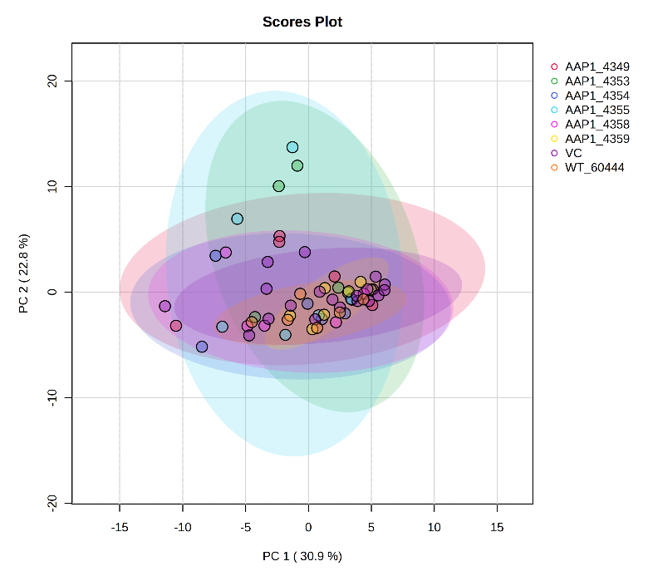
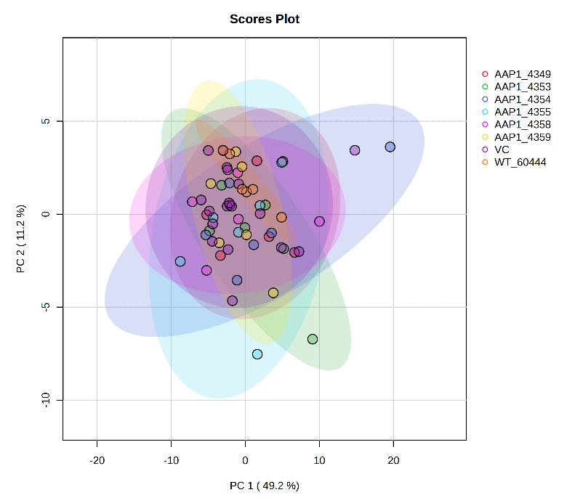
VC, Germany 2022
Root fresh weight
HI (fresh bases)
VC_4220
WT
Leaves
Roots
Penalty in root (fresh and dry) weight and HI compared to WT
Metabolically very similar

Slide 8
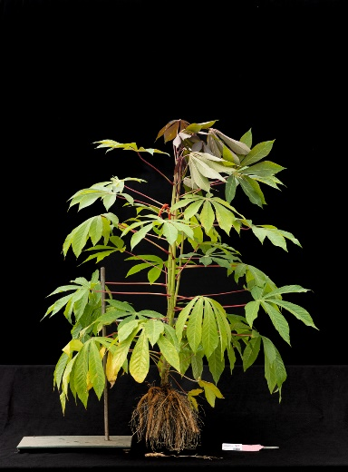
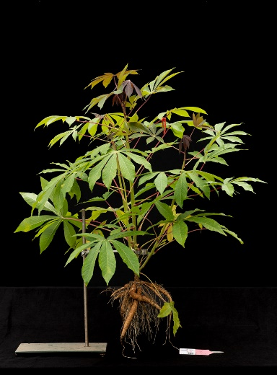
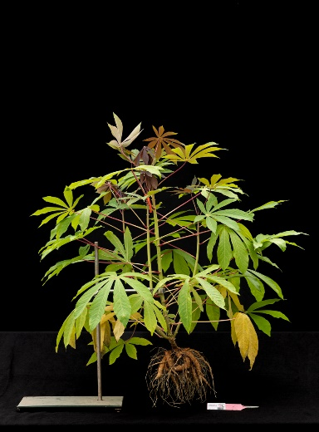
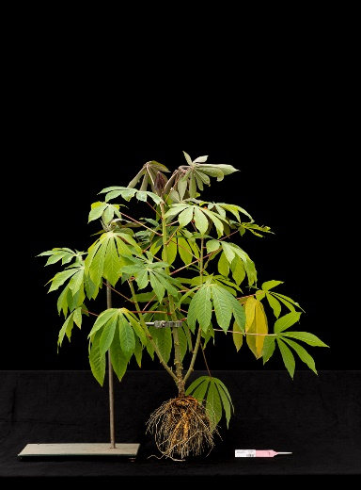
Amino Acid Permease 1 (AAP1)
Amino Acid Permease (AAP) from pea
(expression in phloem tissues, companion cells of leaves, stems and roots)
In Pea:
Increased yield per plant
Transgenic plants outperform WT plants under different nitrogen treatments
AAP1_4354
AAP1_4358
AAP1_4359
VC
WT
Notes:
Perchlik, et al. (2017). Plant Physiol

Slide 9
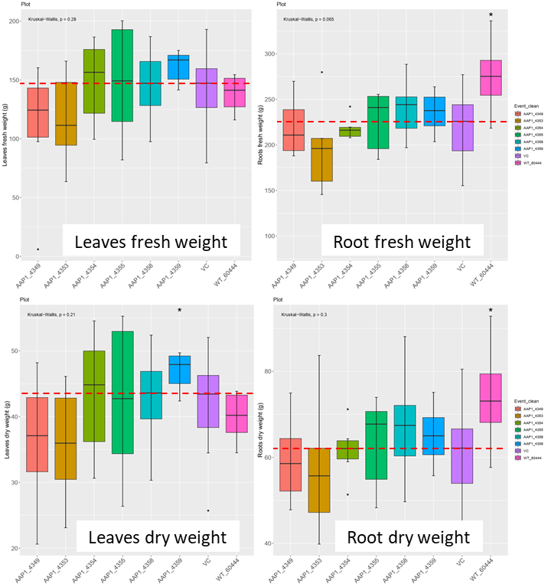
AAP1, polytunnel 2022
No difference between VC and AAP1 lines
Penalty in root (fresh and dry) weight and HI compared to WT
AAP1_4359 higher leave dry weight compared to VC
Kruskal-Wallis test, comparison to VC,*: p ≤ 0.05, **: p ≤ 0.01, ***: p ≤ 0.001
Notes:
H:\MPI-MP_May2022\CassProject2022\NitrogenModule\230705_NonParametric_test

Slide 10
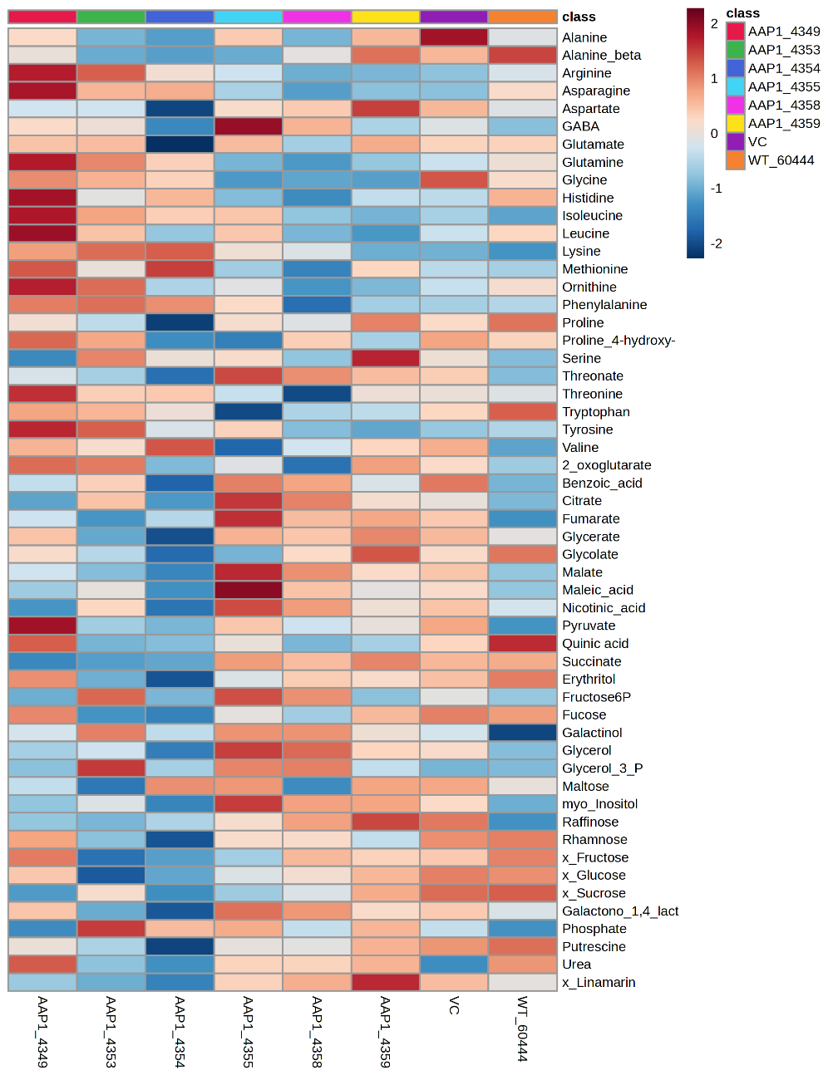
AAP1, polytunnel 2022
Roots
Roots
Amino acids and derivatives
Organic acids
Metabolically, AAP1 is very similar to VC and WT for leaves and root tissues
Sugars and derivatives
Others
Kruskal-Wallis test, comparison to VC,*: p ≤ 0.05, **: p ≤ 0.01, ***: p ≤ 0.001
Notes:
H:\MPI-MP_May2022\CassProject2022\NitrogenModule\Exp_N.Module_polytunnel_Jun22\MetaboAnalyst\GroupedVC

Slide 11
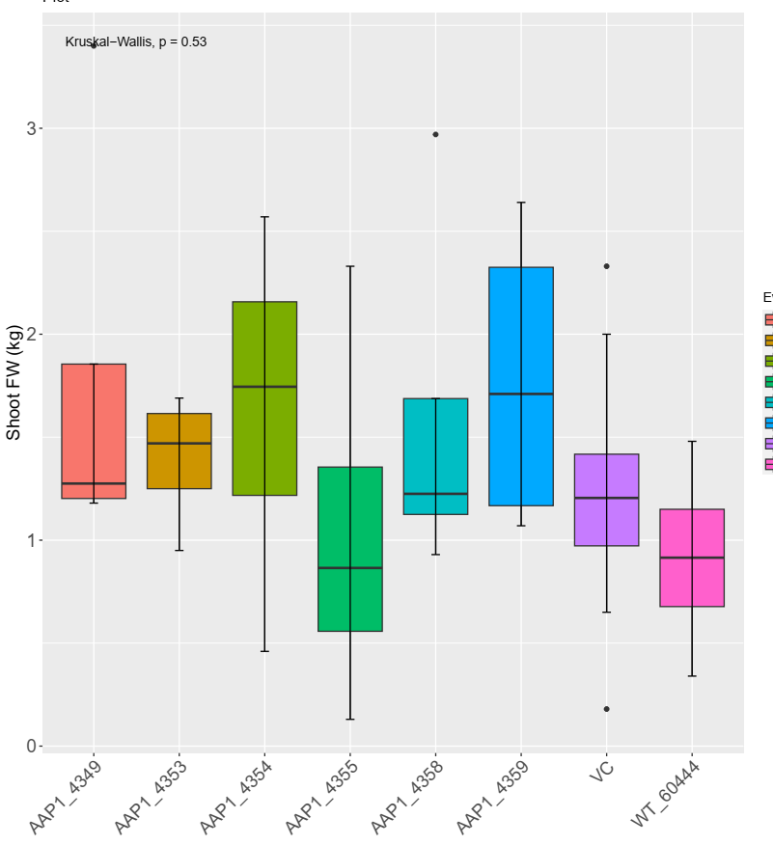
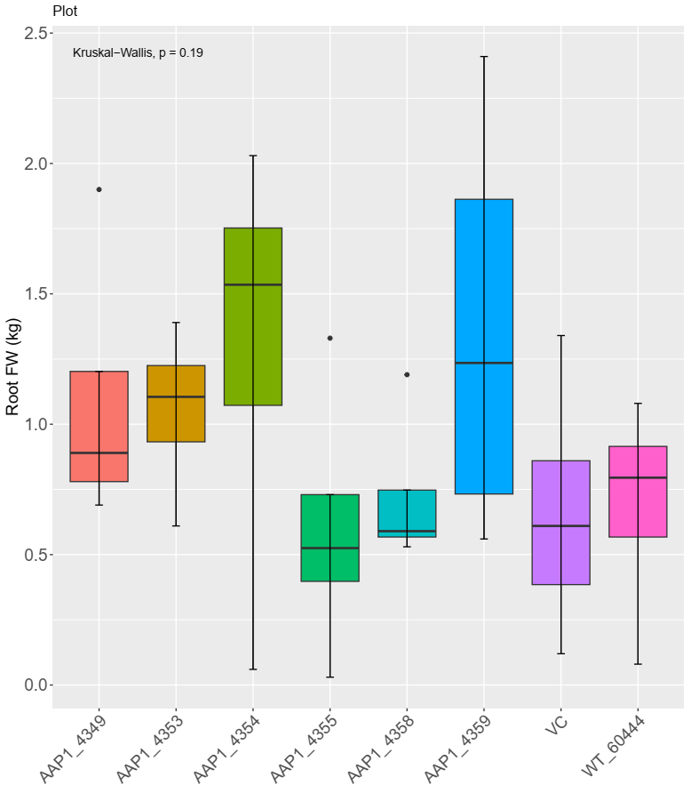
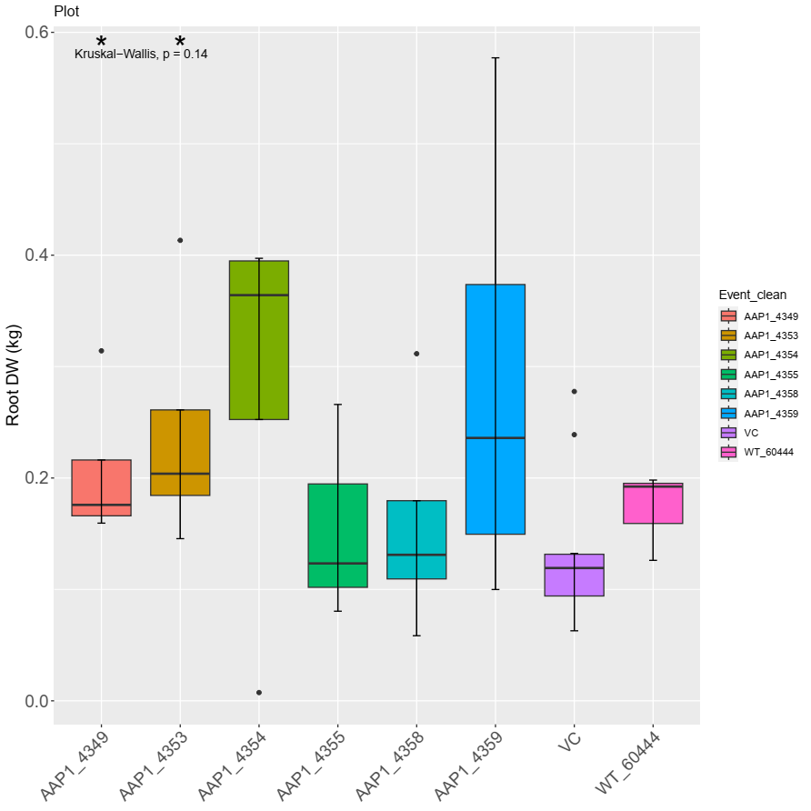
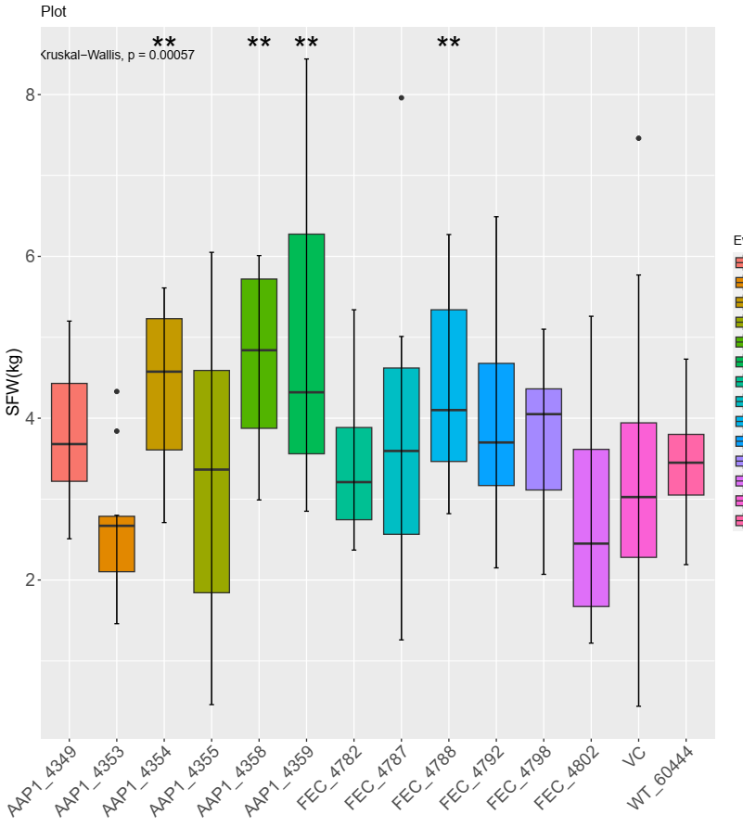
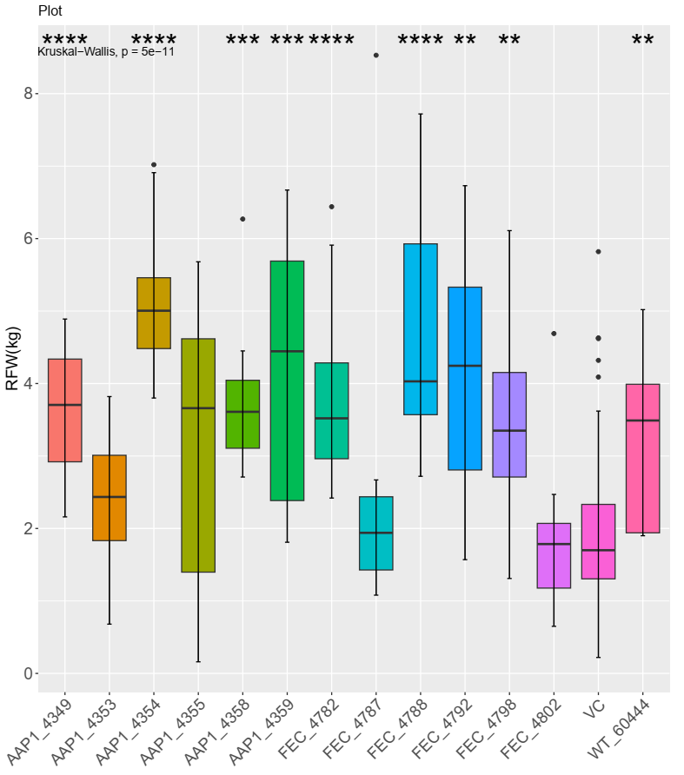
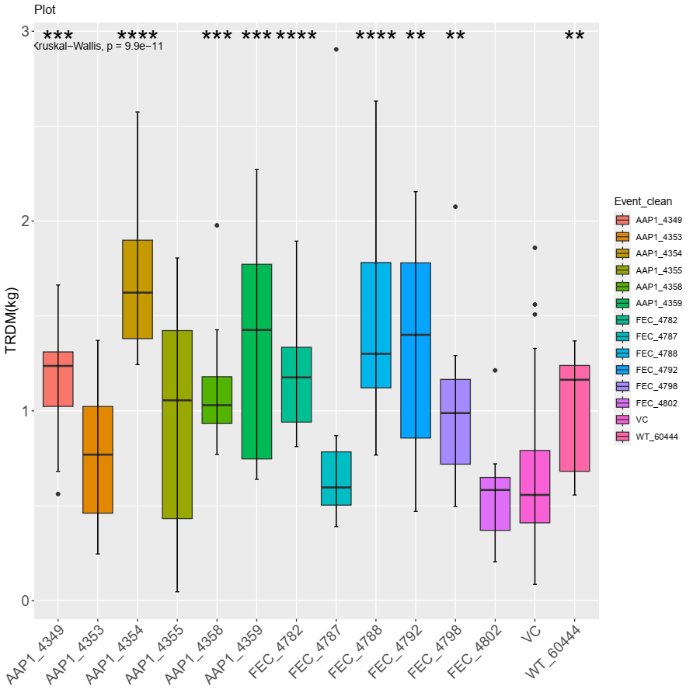
AAP1, Taiwan 2022
Shoot fresh weight
Root fresh weight
Root dry weight
Intermediate
Harvest
AAP1_4349
AAP1_4353
Final
Harvest
AAP1_4349
AAP1_4354
AAP1_4358
AAP1_4359
Kruskal-Wallis test, comparison to VC,*: p ≤ 0.05, **: p ≤ 0.01, ***: p ≤ 0.001
Notes:
And what I did was to combine this info, and select the most relevant lines in the hope of stressing them further to see if we are able to increase the differences.

Slide 12
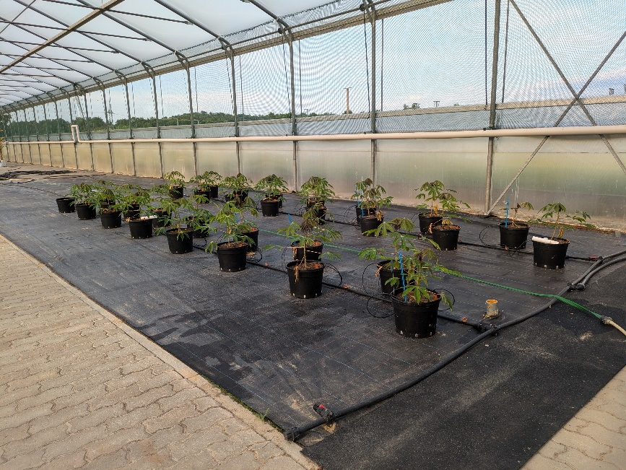
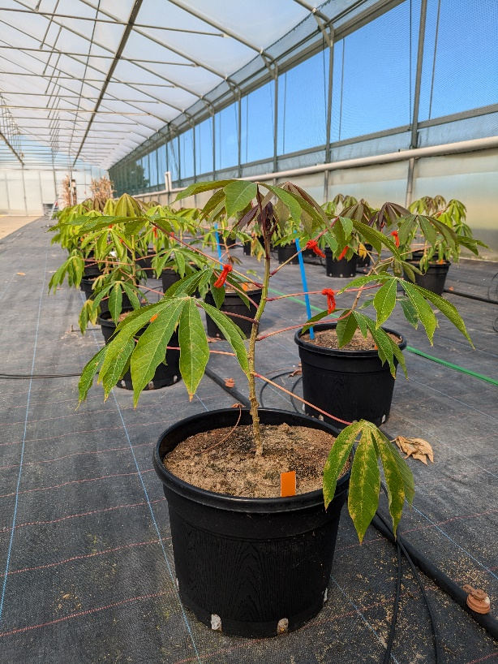
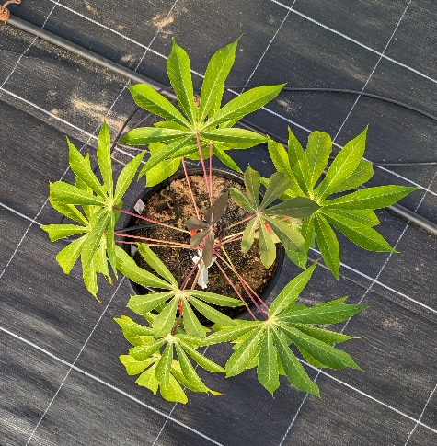
Polytunnel, Germany 2024
Genotypes:
WT 60444
Vector control (3 lines)
AAP1 (3 lines)
  AAP1_4354
  AAP1_4358
  AAP1_4359
Low nutrition soil
(local sandy soil from A horizon)
~3 months old plants
10L pot

Slide 13
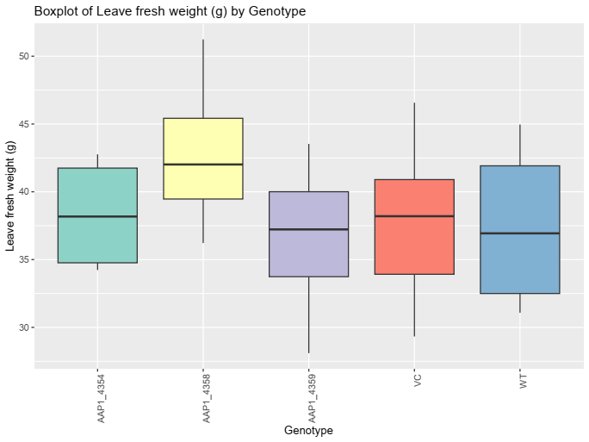
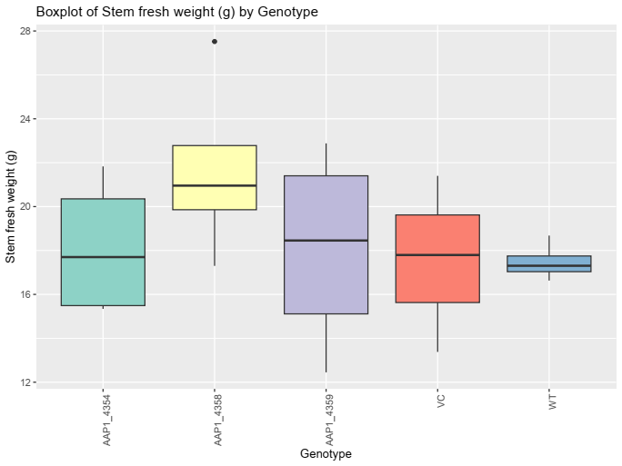
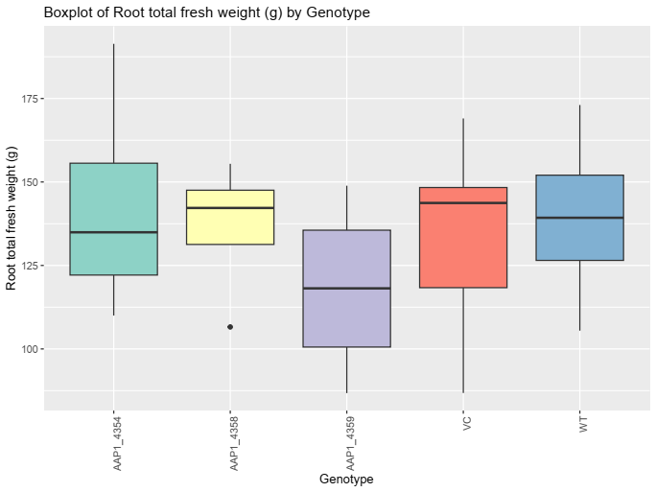
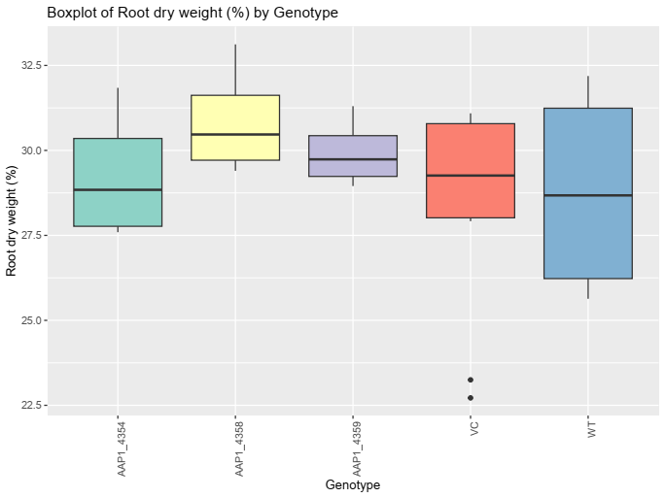
Polytunnel, Germany 2024
Leaves fresh weight
Root fresh weight
Root fresh weight
Root dry weight (%)
No significant difference:
Height
Stem diameter
Leaves, stem root fresh weight
Root dry weight
AAP1 lines and VC catch up with the WT under nutrient limiting condition
Kruskal-Wallis test, comparison to VC,*: p ≤ 0.05, **: p ≤ 0.01, ***: p ≤ 0.001

Slide 14
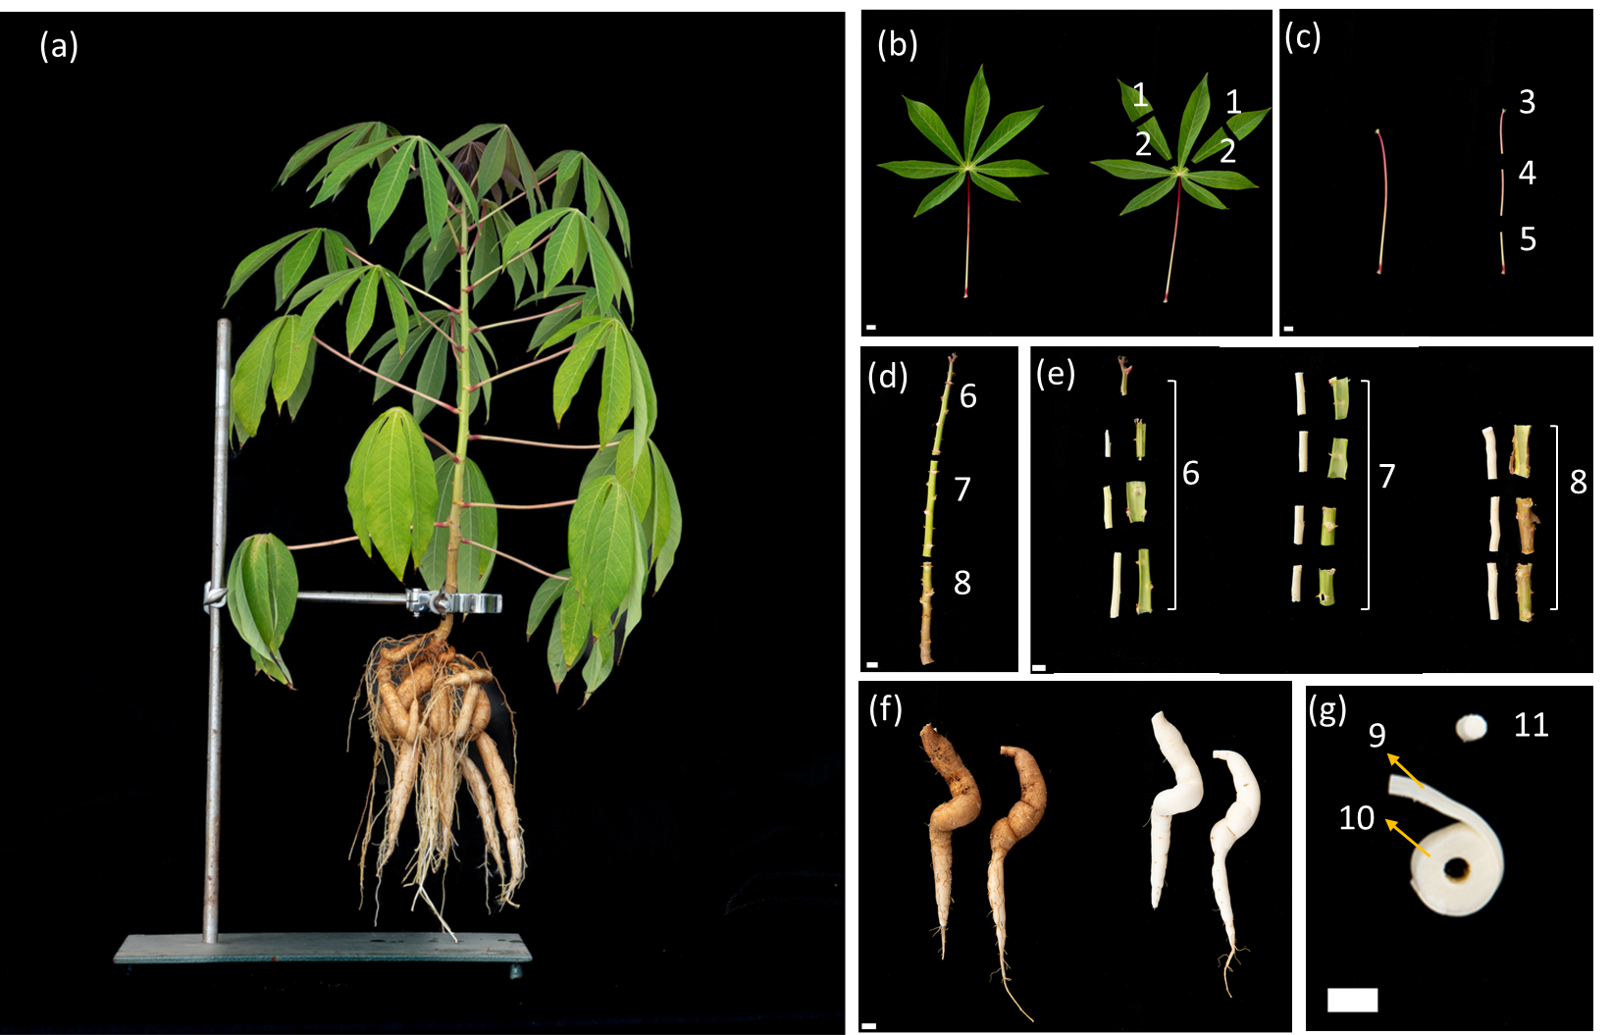

Polytunnel, Germany 2024

Slide 15
New protocols, metabolic modeling
Glutamine synthetase (GS) activity
  Leaves 50mg FW
  Stem
  Root 100mg FW
  Freeze-dried tissue to be tested
Notes:
Kajiwara & Maeda, 1983
Ferreira etal., 2022

Slide 16

New protocols, metabolic modeling
Glutamine synthetase (GS) activity
  Leaves 50mg FW
  Stem
  Root 100mg FW
  Freeze-dried tissue to be tested
Total lipids
  Leaves 20mg DW
  Stem 20mg DW
  Root
Notes:
Kajiwara & Maeda, 1983
Ferreira etal., 2022

Slide 17
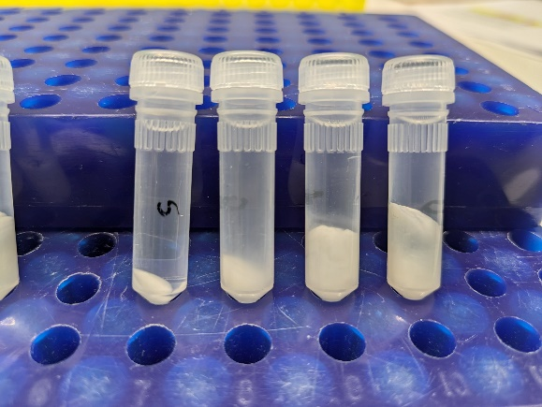
New protocols, metabolic modeling
Glutamine synthetase (GS) activity
  Leaves 50mg FW
  Stem
  Root 100mg FW
  Freeze-dried tissue to be tested
Total lipids
  Leaves 20mg DW
  Stem 20mg DW
  Root
Cell wall residue
  Leaves 20mg DW
  Stem 20mg DW
  Root
Starch gelatinization
Notes:
Kajiwara & Maeda, 1983
Ferreira etal., 2022

Slide 18
Outlook
1. AAP1/mitoGS plants
Polytunnel 2022
Further data analysis
Field Taiwan 2022 intermediate and final harvest
GCMS waiting list
Polytunnel 2024
AAP1, sample processing and GCMS
2. New protocols
Fine tuning required
3. WT experiment harvest with ETH

Slide 19



Acknowledgements
CASS project
Germany:
FAU Erlangen
RPTU Kaiserslautern
Forschungszentrum Jülich
Nigeria:
IITA Ibadan
NRCRI Umudike
Switzerland: ETH Zürich
Taiwan: NCHU
Finland: University of Helsinki
UK: University of Cambridge
University of Oxford
USA: BTI
MPIMP
AG Fernie
Alisdair Fernie
Anahita Karbasi
Baran Pamukci
Ruimei Li
David Medeiros
Armin Schlereth
Green team
International /Travel office
… and you for your attention!

Slide 20


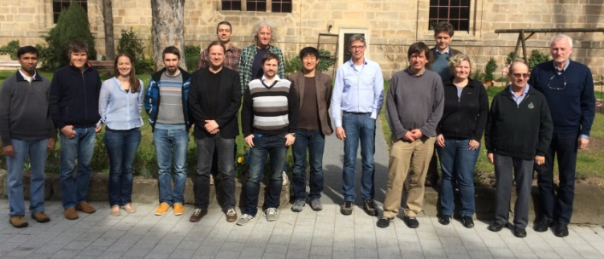
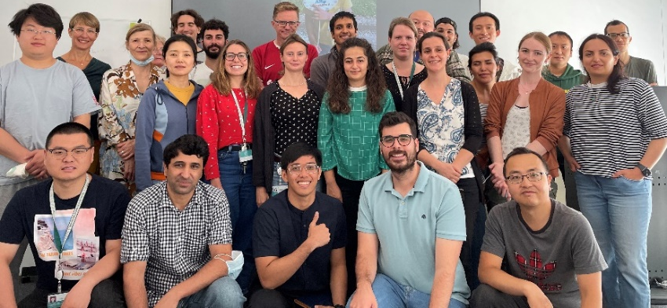

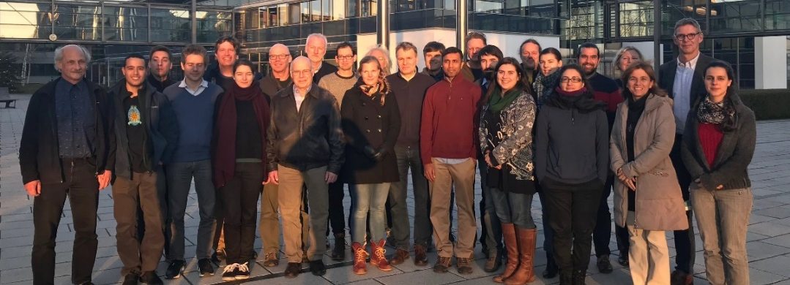
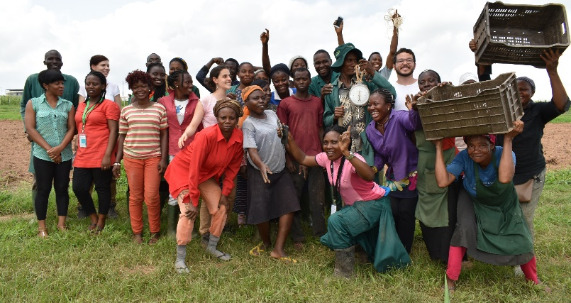
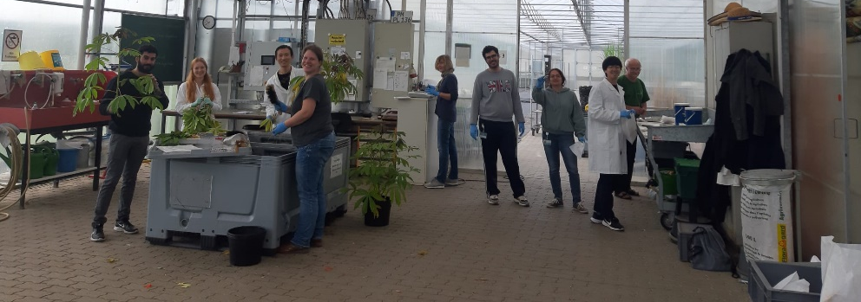
Thank you

Slide 22
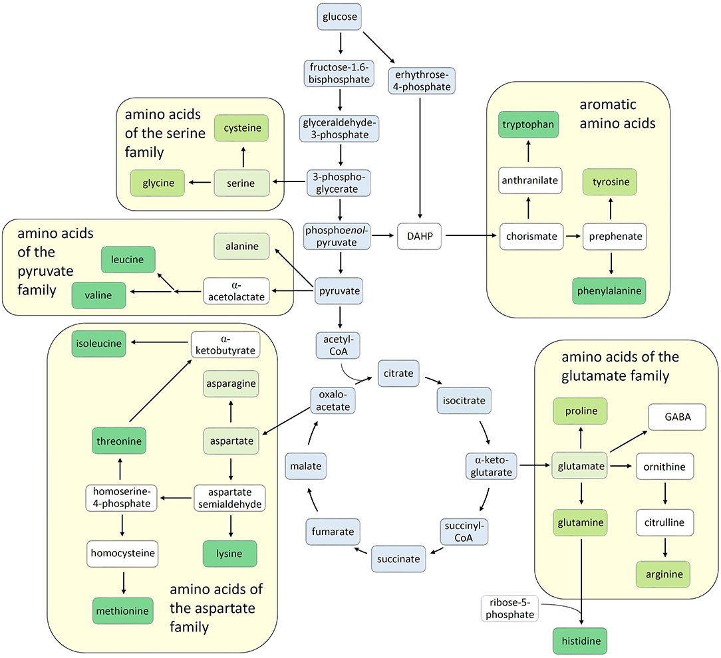
Nitrogen-rich amino acids
Among the 20 amino acids constituting proteins, six amino acids contain more than one nitrogen atom in each molecule. They were tryptophan (W), asparagine (N), glutamine (Q), lysine (K), histidine (H), and arginine (R).
Trovato M, Funck D, Forlani G, Okumoto S, Amir R (2021) Editorial: Amino Acids in Plants: Regulation and Functions in Development and Stress Defense. Front Plant Sci 12:772810. doi:10.3389/fpls.2021.772810

Slide 23
Supplemental info
AAP1

Slide 24
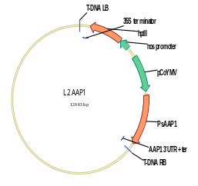
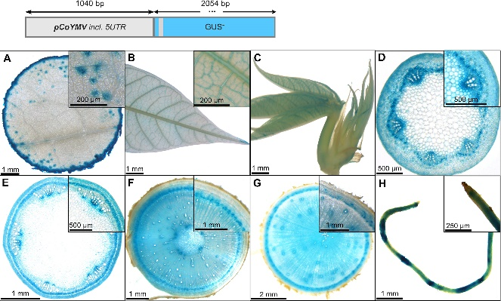
AAP1
p134GG_#2-18_pCoYMV::PsAAP1
Functional cassettes
Promoter – Commelina Yellow mottle Virus (CoYMV)
  strong promoter in vascular and reproductive tissues (Medberry et al., 1992)
  and active in the companion cells of leaves, stems and roots (Matsuda et al., 2002).
5’-UTR – Pisum Sativum Amino Acid Permease 1 (PsAAP1)
CDS – Pisum Sativum Amino Acid Permease 1 (PsAAP1)
3’-UTR-terminator – Pisum Sativum Amino Acid Permease 1 (PsAAP1)
Selectable marker cassette
Promoter – Agrobacterium tumefaciens Nopaline Synthase (AtuNOS)
CDS – Hygromycin Phosphotransferase2 (Hpt2)
Terminator – Cauliflower Mosaic Virus 35S
Figure 6 Representative GUS staining pattern of four pCoYMV promoter-reporter lines. (A) Source leaf (Inlay = Close-up), (B) Sink leaf (Inlay = Close-up), (C) Emerging leaves, (D) Petiole cross-section (Inlay = Close-up), (E) Upper stem cross-section (Inlay = Close-up), (F) Lower stem cross-section (Inlay = Close-up), (G) Storage root cross-section (Inlay = Close-up), (H) Fibrous roots (Inlay = Root tip).
Zierer etal., 2022 Front Plant Sci

Slide 25
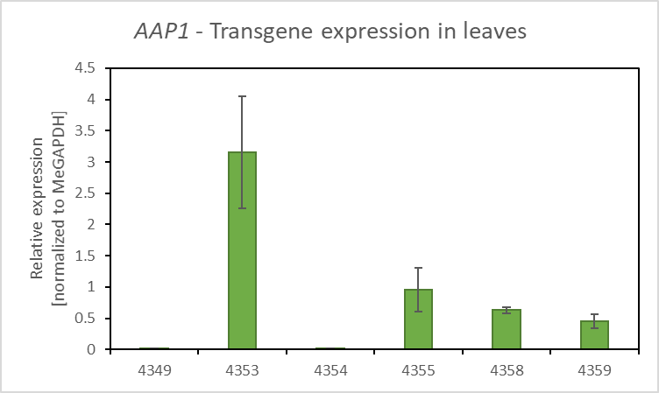
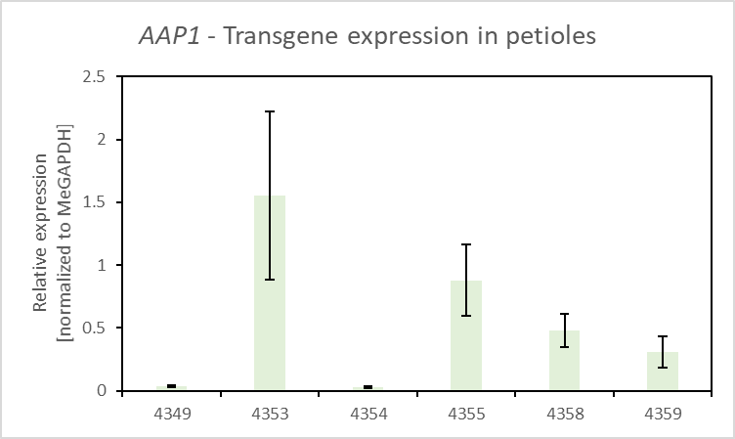
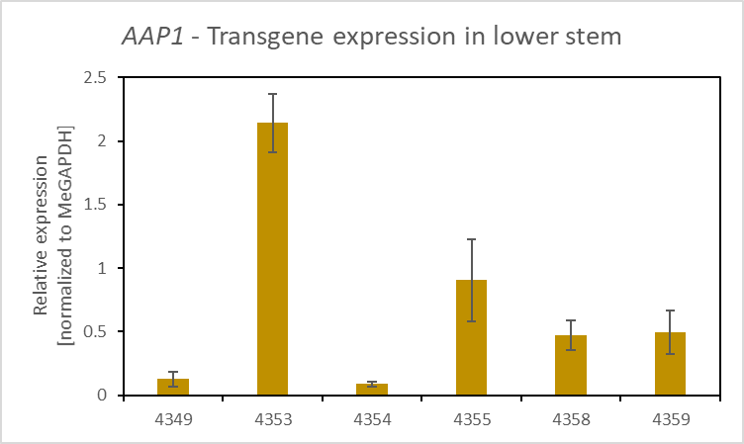
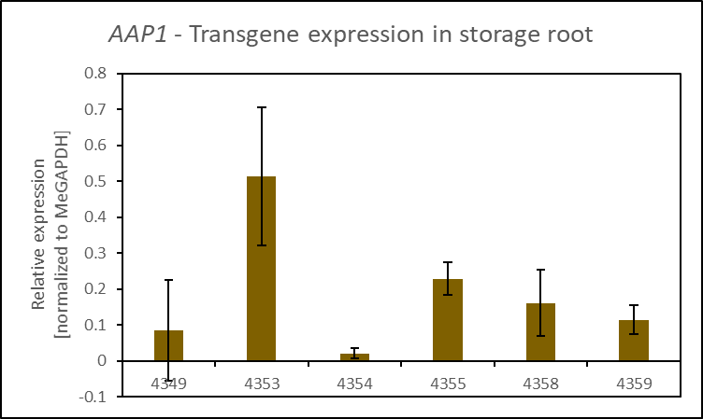
AAP1
Expression, intermediate harvest Taiwan 2022

Slide 26
Amino Acid Permease (AAP)
Amino Acid Permease (AAP)
  Multigene family
  Organ-specific expression
  Low transport selectivity
Arabidopsis: AAP1 is seed-specific
Vicia faba: AAP1 is expressed in embryonic storage parenchyma cells
Pea: AAP1 and AAP2 is expressed in seed coats
    epidermal transfer cells
    storage parenchyma cells
    vegetative organs
Notes:
Weigelt, K., Küster, H., Radchuk, R., Müller, M., Weichert, H., Fait, A., Fernie, A.R., Saalbach, I. and Weber, H. (2008) Increasing amino acid supply in pea embryos reveals specific interactions of N and C metabolism, and highlights the importance of mitochondrial metabolism. Plant J., 55, 909-926.

Slide 27
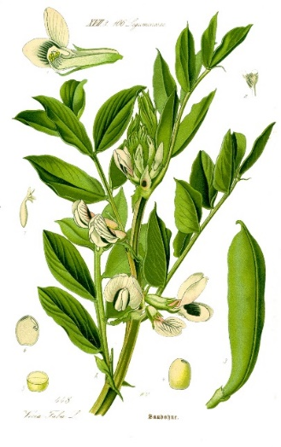
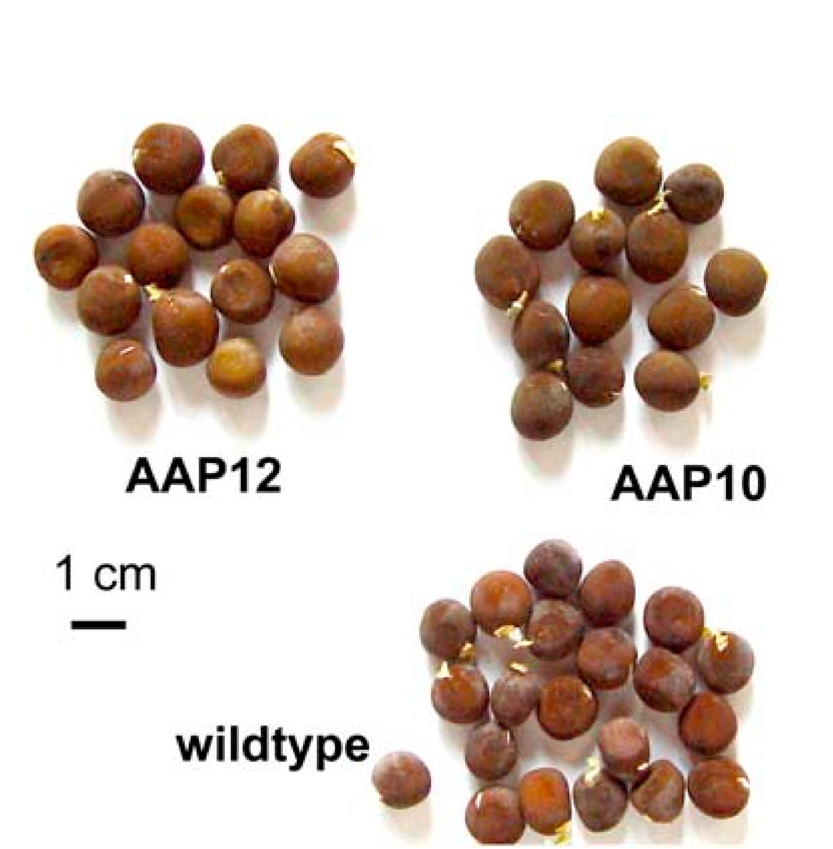
AAP1 from Vicia faba
AAP1 from Vicia faba - broad bean, fava bean
Overexpression in seeds of pea (Pisum sativum) and Vicia narbonensis
Increase in seed total nitrogen
Increase in sink strength for amino acids (more [14C]-glutamine uptake)
Stimulation of nitrogen root uptake (application of [¹⁵N]-labeled ammonia to the roots)
No change in seed yield per plant
Vicia faba
Vicia narbonensis
AAP1ox seeds
growth chamber
Rolletschek, et al. (2005). Plant Physiol
Götz, et al. (2007). J Exp Bot
Weigelt, et al. (2008). Plant J
Notes:
Rolletschek, H., Hosein, F., Miranda, M., Heim, U., Götz, K.P., Schlereth, A., Borisjuk, L., Saalbach, I., Wobus, U. and Weber, H. (2005) Ectopic expression of an amino acid transporter (VfAAP1) in seeds of Vicia narbonensis and pea increases storage proteins. Plant Physiol., 137, 1236-1249.
Götz KP, Staroske N, Radchuk R, Emery RJ, Wutzke KD, Herzog H, Weber H (2007) Uptake and allocation of carbon and nitrogen in Vicia narbonensis plants with increased seed sink strength achieved by seed-specific expression of an amino acid permease. J Exp Bot 58: 3183-3195
Decrease seed weight in field conditions, but plants
Weigelt, K., Küster, H., Radchuk, R., Müller, M., Weichert, H., Fait, A., Fernie, A.R., Saalbach, I. and Weber, H. (2008) Increasing amino acid supply in pea embryos reveals specific interactions of N and C metabolism, and highlights the importance of mitochondrial metabolism. Plant J., 55, 909-926.

Slide 28
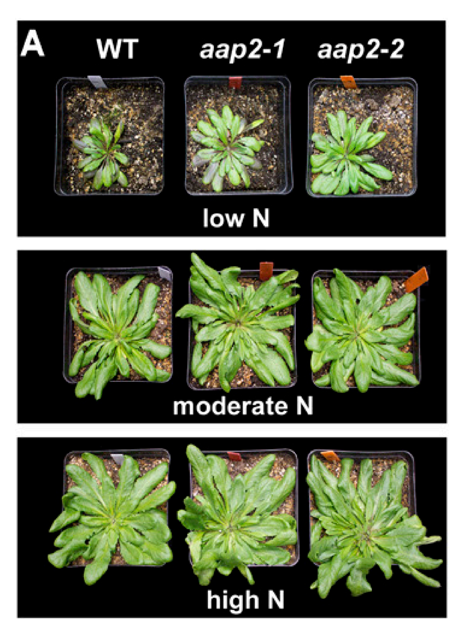
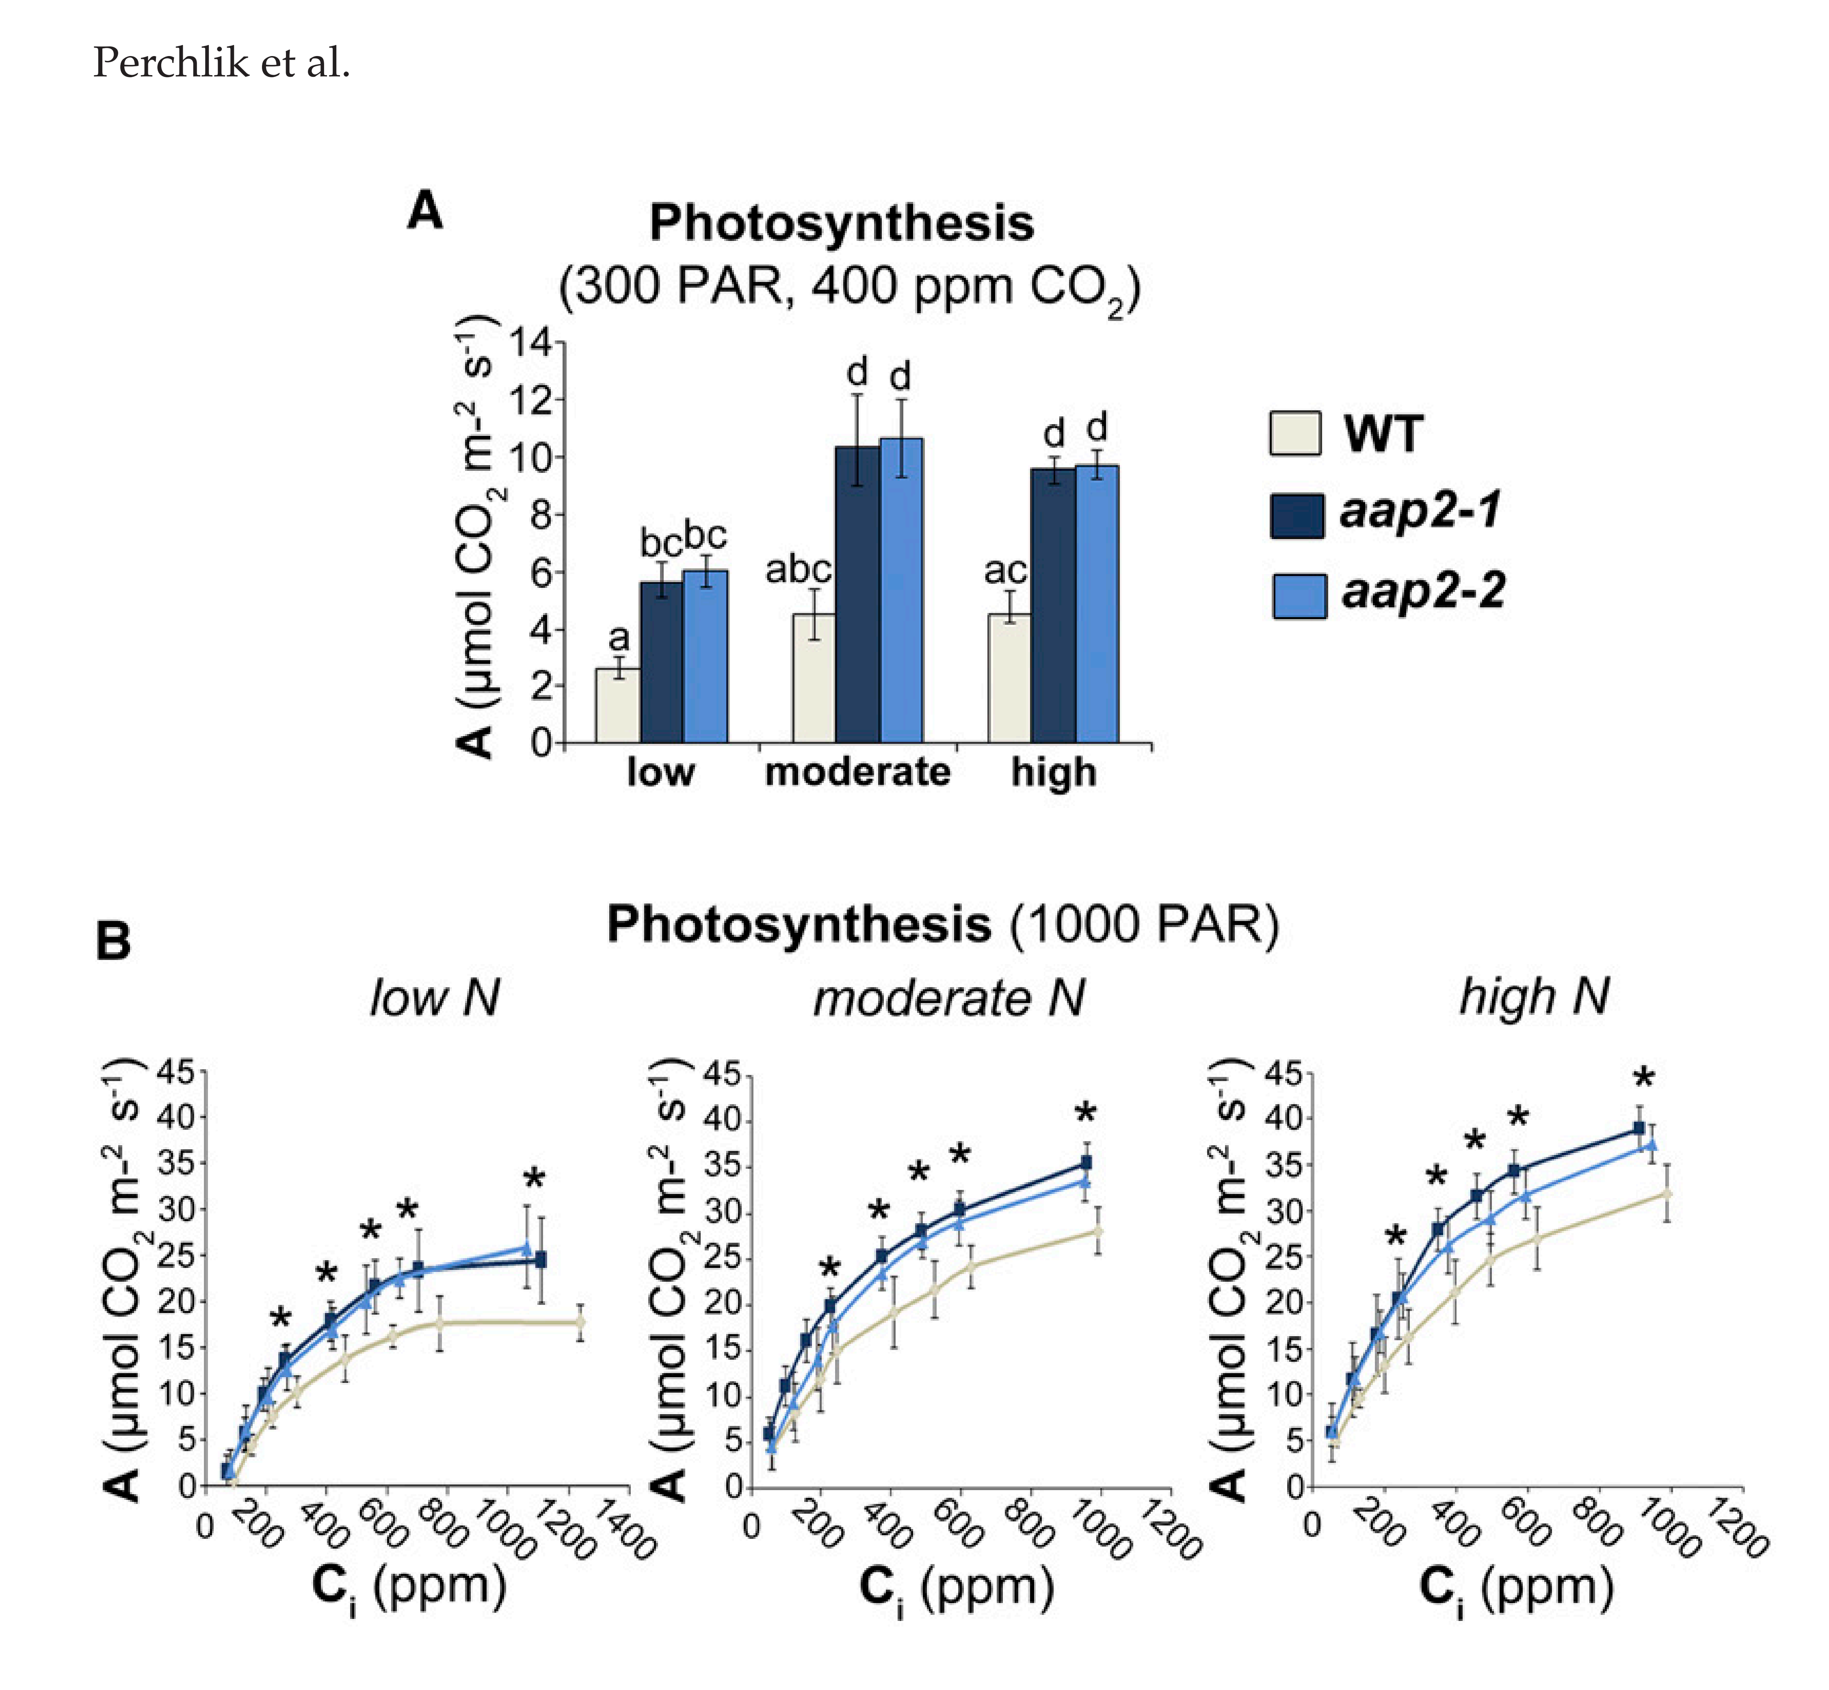
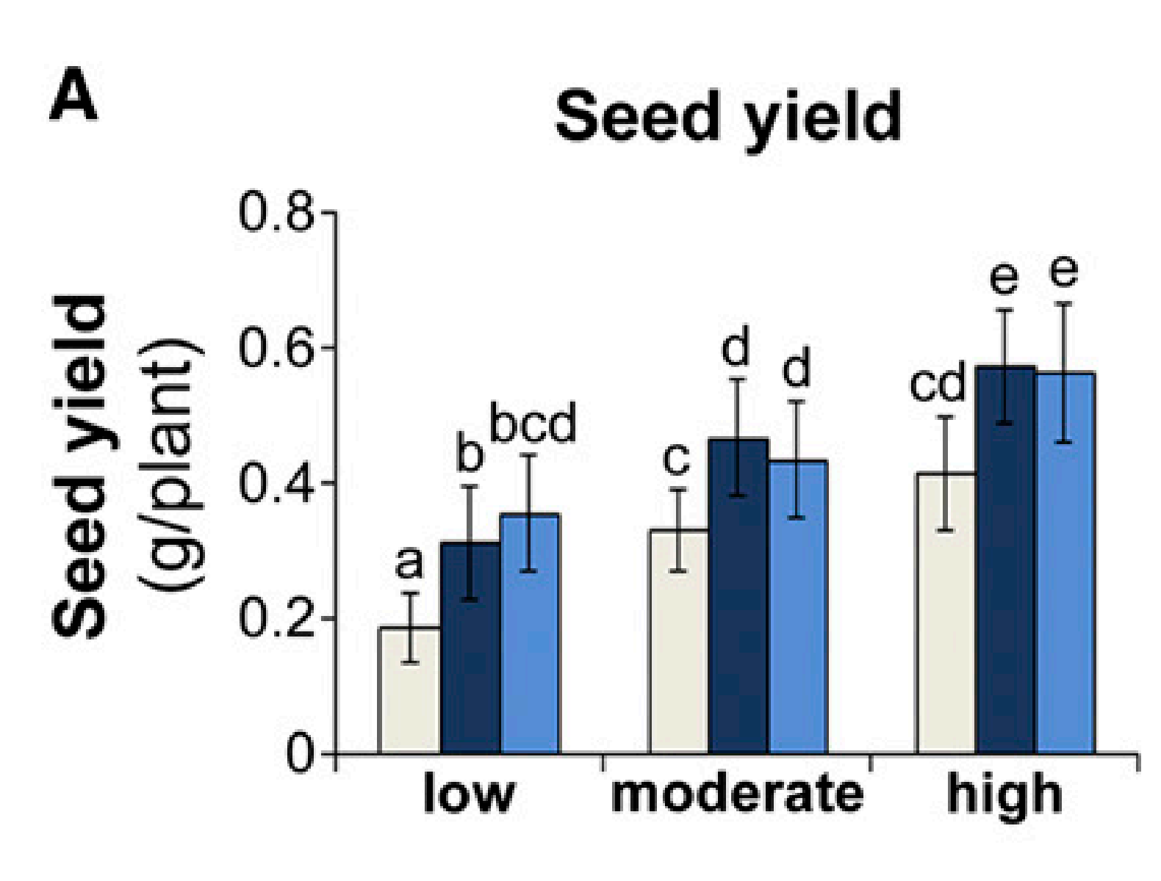


AAP1 construct
AAP1 in Arabidopsis
The aap2 plants outperformed wild-type plants with respect to growth, seed yield and carbon storage pools, and nitrogen use efficiency in both high and deficient nitrogen environments. (Perchlik and Tegeder 2018 Plant Physiol)
But reduced seed protein levels (Zhang et al., 2010)
Notes:
Perchlik, M. and M. Tegeder (2018). "Leaf amino acid supply affects photosynthetic and plant nitrogen use efficiency under nitrogen stress." Plant Physiology 178(1): 174-188.
Zhang, L., et al. (2010). "Altered xylem-phloem transfer of amino acids affects metabolism and leads to increased seed yield and oil content in Arabidopsis." Plant Cell 22(11): 3603-3620.

Slide 29

AAP1 construct
AAP1 in Oryza sativa
OsAAP1 gene is highly expressed in rice axillary buds, leaves, and young panicles, and that the OsAAP1 protein is localized to both the plasma membrane and the nuclear membrane.
OE lines exhibited increased filled grain numbers as a result of enhanced tillering,
RNAi and CRISPR (Osaap1) knockout lines showed the opposite phenotype.
In addition, OsAAP1-OE lines had higher concentrations of neutral and acidic amino acids, but lower concentrations of basic amino acids in the straw.
Notes:
Ji, Y., Huang, W., Wu, B., Fang, Z. and Wang, X. (2020) The amino acid transporter AAP1 mediates growth and grain yield by regulating neutral amino acid uptake and reallocation in Oryza sativa. J. Exp. Bot., 71, 4763-4777.

Slide 30




AAP1 in pea
AAP1 from pea (Pisum sativum)
Simultaneous overexpression in pea targeting amino
acids source-sink partitioning via
import into the seed (cotyledon epidermis)
and phloem loading (sieve element-companion cell)
Increase in biomass
Increase in seed and leaves total nitrogen
Increase in total free amino acid levels in the phloem exudate and in the xylem sap
Increase in photosynthetic rate
Increased yield per plant
Under different N treatments
Perchlik, et al. (2017). Plant Physiol
Zhang, et al. (2015). Plant J

Slide 31

Glutamine synthetase (GS)
GS/GOGAT cycle
Glutamine synthetase (GS)
Glutamate synthetase (GOGAT)
Incorporation of inorganic nitrogen
into organic molecules
GS1: cytosol
encoded by multiple genes
primary NH₄⁺ assimilation, N remobilization and translocation
GS2: plastid
generally encoded by a single gene
reassimilation of photorespiratory NH₄⁺, and NH₄⁺ from nitrite reduction
Increasing expression of GS is in general beneficial, associated with N use and stress tolerance
Notes:
photorespiration acting as an electron-sink
that would dissipate excessive reducing power, thus protecting
against the production of reactive oxygen species and conferring
photoprotection

Slide 32
GS/GOGAT cycle
Enzymes and Nitrogen Cycling
John A. Berges, Margaret R. Mulholland, in Nitrogen in the Marine Environment (Second Edition), 2008
2.2.2.3 Enzyme regulation and interpretation of activity assays
GOGAT activity does not appear to be as heavily regulated as GS activity, or perhaps it is just less studied (Florencio et al., 1987; Muro-Pastor et al., 2005). However, GOGAT does appear to be regulated by light and metabolite sensing systems in higher plants (Suzuki and Knaff, 2005)
Functions of macronutrients☆
Malcolm J. Hawkesford, ... Philip J. White, in Marschner's Mineral Nutrition of Plants (Fourth Edition), 2023
6.1.4.2 Ammonium assimilation
Ammonium is a central intermediate in plant N metabolism. As well as uptake from the soil by roots, ammonium is constantly generated in plant tissues by processes such as nitrate reduction, photorespiration, lignin biosynthesis, senescence-induced N remobilization, and N2 fixation in legumes (Joy, 1988). Irrespective of the source of ammonium, or the organ in which it is assimilated (roots, root nodules, and leaves), the key enzymes involved are glutamine synthetase (GS) and glutamate synthase (GOGAT; glutamine-oxoglutarate aminotransferase). Both enzymes are present in roots, in chloroplasts, and in N2-fixing microorganisms, and assimilation of most if not all ammonium derived from ammonium uptake, N2 fixation, nitrate reduction, and photorespiration is mediated by the GS-GOGAT pathway. In this pathway the amino acid glutamate acts as the acceptor for ammonium, and the amide glutamine is formed (Fig. 6.9). The net reaction is:
Sign in to download full-size image
Figure 6.9. Model of ammonium assimilation via the glutamine synthetase-glutamate synthase cycle. Pathways at low (1) and high (2) ammonium supply.
(6.2)Glutamate+2-oxoglutarate+NH4+→glutamine+H+
GS exists in multiple enzyme forms located in the cytosol and in plastids (Bernard et al., 2008). Cytosolic GS assimilates ammonium into glutamine for transport and distribution throughout the plant. During leaf senescence, cytosolic GS fulfills a key function in the assimilation and recycling of ammonium generated in various catabolic processes (Masclaux-Daubresse et al., 2010). This role is particularly important after anthesis and during grain development and filling in cereals, when N is remobilized to the reproductive sinks (Thomsen et al., 2014). Several isoenzymes of the cytosolic GS1 gene family are abundantly expressed in roots and can be classified into high-affinity or low-affinity subtypes differing in Vmax values (Ishiyama et al., 2004). Some isoenzymes play a redundant role under low ammonium supply and others dominate under high external ammonium supply (Konishi et al., 2018). This dynamic regulation may contribute to the homeostatic control of glutamine synthesis in roots. In arabidopsis shoots, separate isoforms of cytosolic GS play distinct roles for seed yield structure and for coping with ammonium toxicity (Guan et al., 2015; 2016). The same is the case in maize, where the Gln1–3 and Gln1–4 genes affect kernel number and kernel size, respectively, with a specific impact on grain production (Martin et al., 2006).
In chloroplasts, light-stimulated nitrate reduction and enhanced ammonium assimilation are coordinated through the import of 2-oxoglutarate from the stroma and export of glutamate from the stroma of chloroplasts into the cytoplasm, thus preventing high ammonium concentrations. Chloroplast GS is activated by high pH and high concentrations of Mg and ATP, and all three factors are increased in the chloroplast stroma upon illumination. In cytosol and chloroplasts, GS is also subject to posttranslational regulation by phosphorylation and subsequent interactions with proteins (Finnemann and Schjoerring, 2000; Lima et al., 2006).
The other enzyme involved in ammonium assimilation, glutamate synthase (GOGAT), catalyzes the transfer of the amide group (–NH2) from glutamine to 2-oxoglutarate, which is a product of the tricarboxylic acid (TCA) cycle. The conversion of glutamine to glutamate takes place in plastids that have two isoforms of GOGAT. One form accepts electrons from reduced ferredoxin (from photosystem I), the other from NADPH from respiration. The ferredoxin-linked GOGAT isoform dominates in leaves, particularly in the chloroplasts of phloem companion cells in leaf veins (Masclaux-Daubresse et al., 2007), whereas the NADPH isoform is prevalent in roots (Tabuchi et al., 2007). Both forms contain an Fe-S cluster that transfers electrons during the reductive synthesis of two glutamate molecules from one 2-oxoglutarate and one glutamine molecule. One of the two molecules of glutamate produced is required for the maintenance of the ammonium assimilation cycle and the other can be transported from the sites of assimilation and utilized elsewhere for the biosynthesis of proteins. When the ammonium supply is high, both glutamate molecules can act as ammonium acceptors, and one molecule of glutamine leaves the cycle (Fig. 6.9). Two Fd-GOGAT genes (GLU1 and GLU2) have been characterized in higher plants, with GLU1 playing a major role in the assimilation of ammonium derived from photorespiration, whereas the GLU2 gene may play a major role in the primary N assimilation in roots (Suzuki and Knaff, 2005).

Slide 33

GS1 and GS2
Marino, D., et al. (2022) New Phytol

Slide 34
Marino, D., et al. (2022) New Phytol

Slide 35




Polytunnel, Germany 2022

Slide 36


WT and VC, polytunnel 2022
VC_4218
VC_4220
VC_4239
WT
WT

Slide 37



AAP1, polytunnel 2022
AAP1_4349
AAP1_4353
AAP1_4354
VC
WT
AAP1_4355
AAP1_4358
AAP1_4359

