Slide 1


CASSII – IITA UPDATE
07 October 2024
Ismail Y. Rabbi

Slide 2
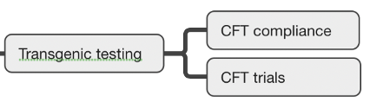

Objective 1 (Confined Field Trials)
CFT under permit number NBMA-CFT-010 – replanted in March 2024

Slide 3
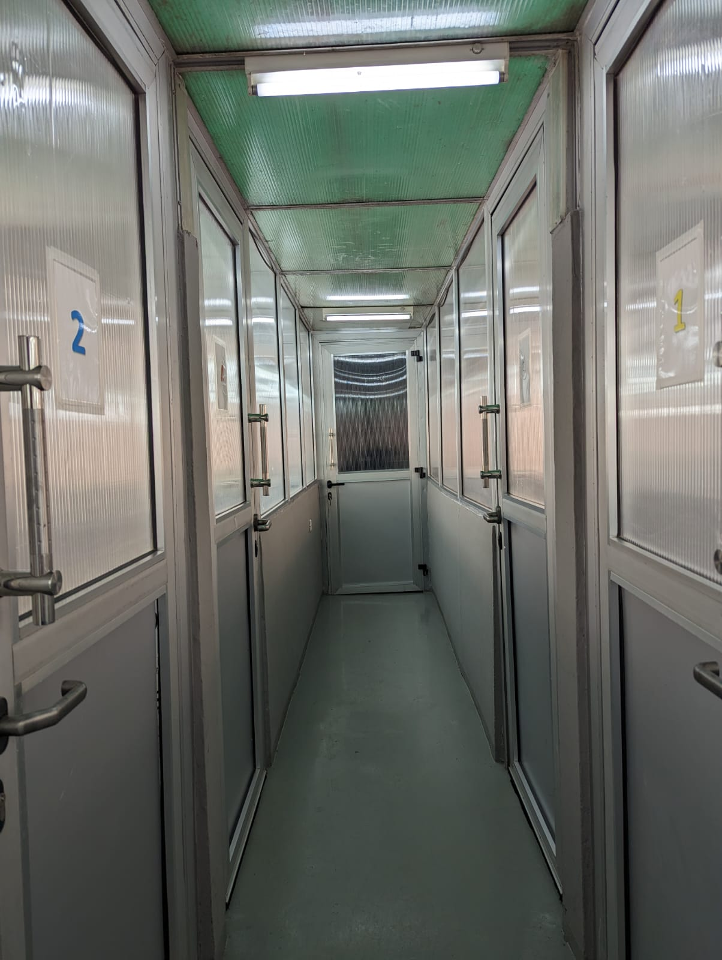
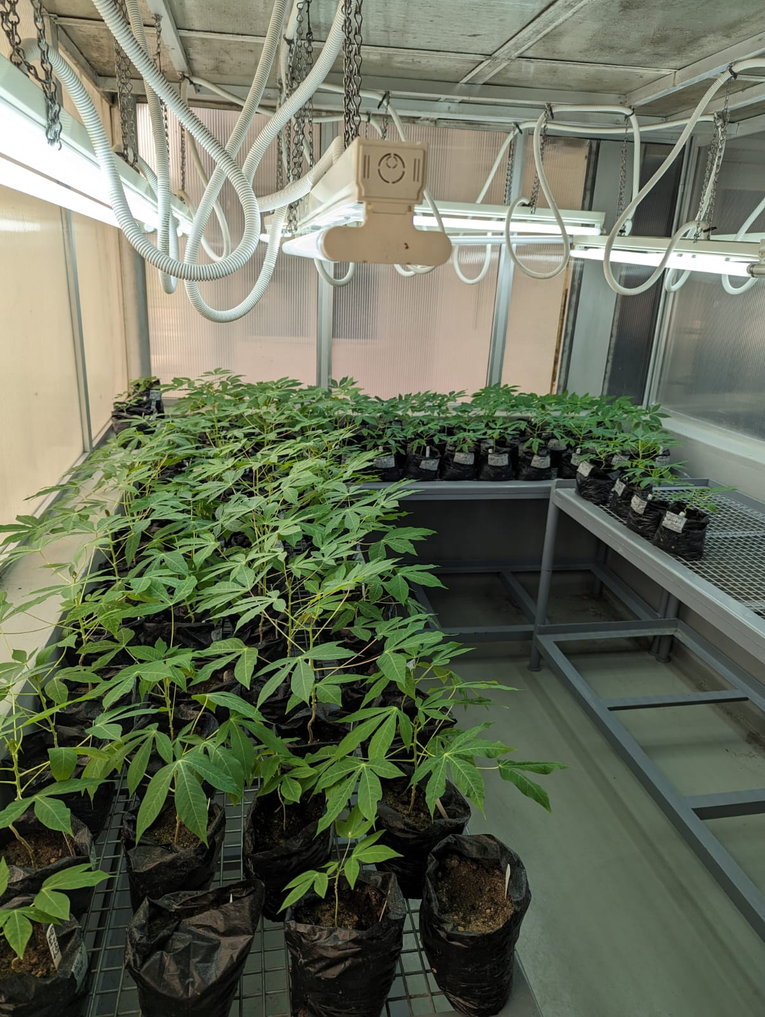
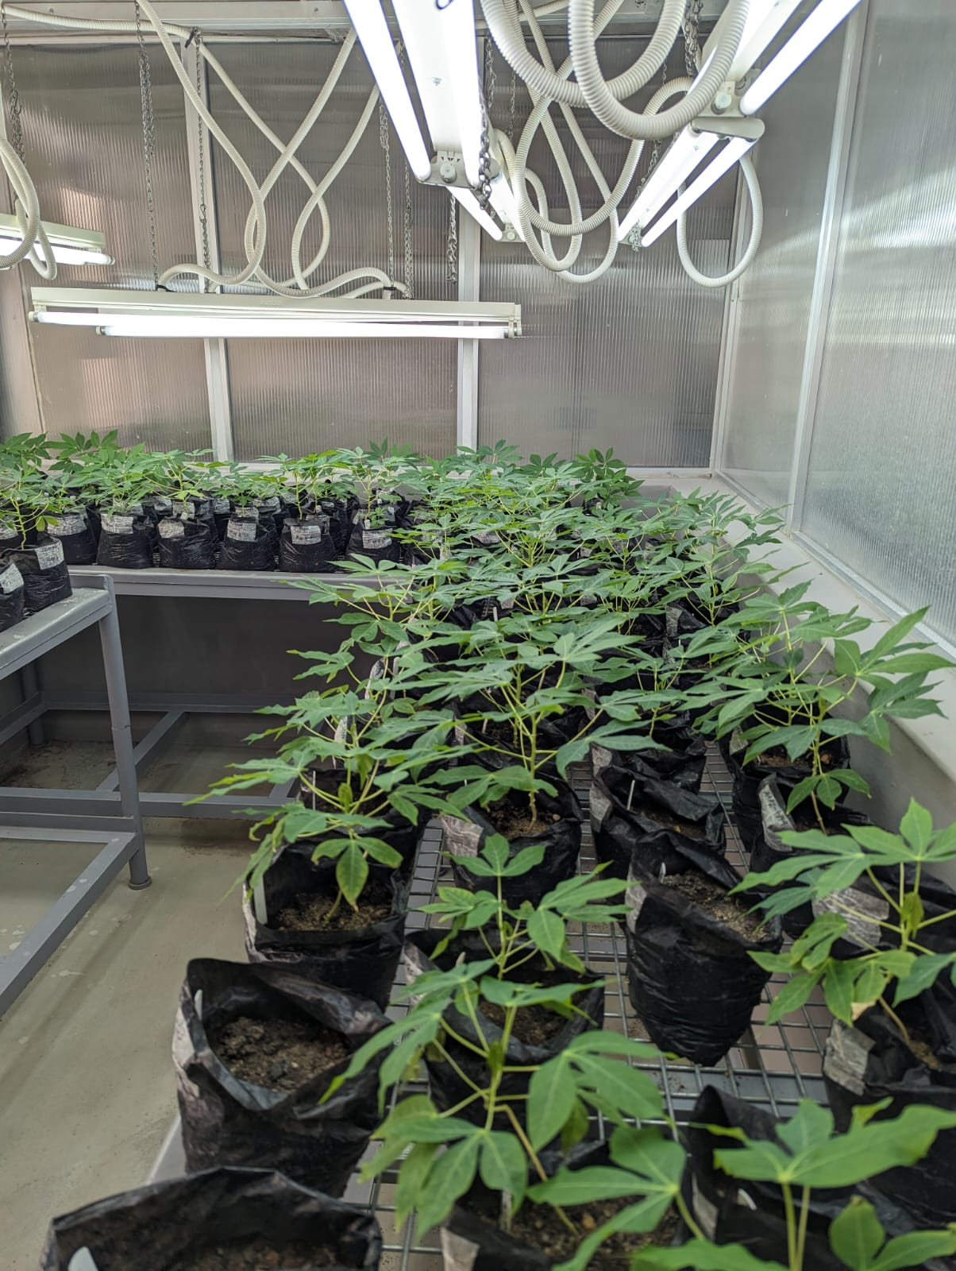
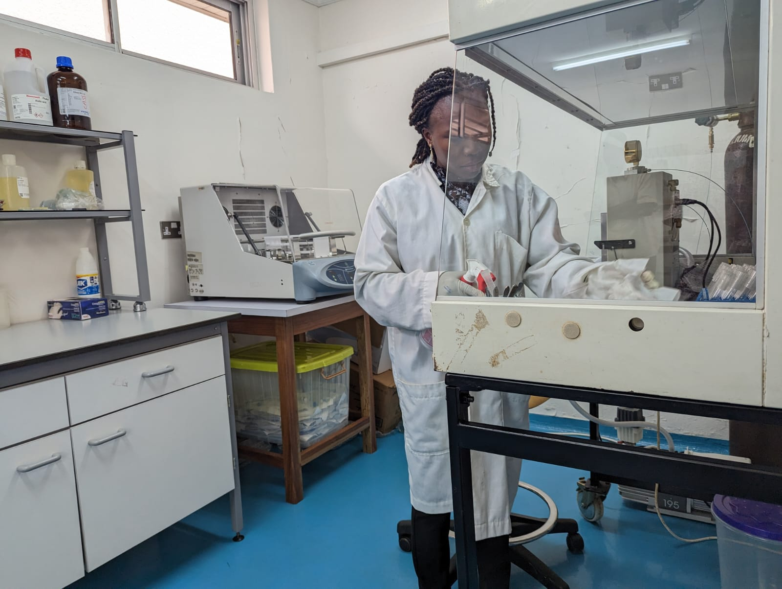
Confined Field Trial – 2023-2024

Slide 4
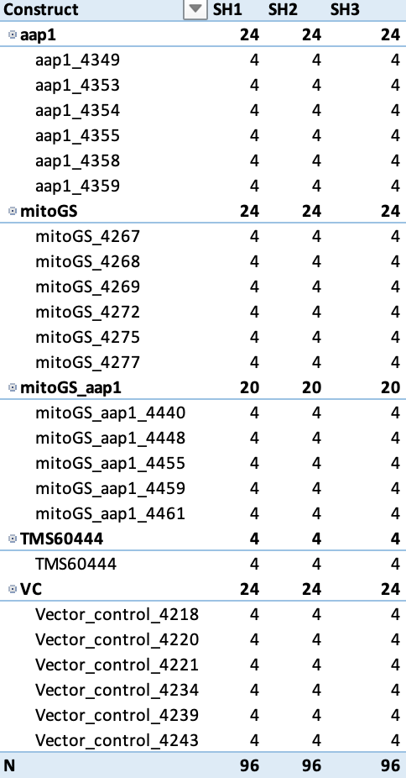
Screenhouse planting results
AAP1
MITO-GS
AAP1-MITOGS
TMS60444
Vector Control

Slide 5
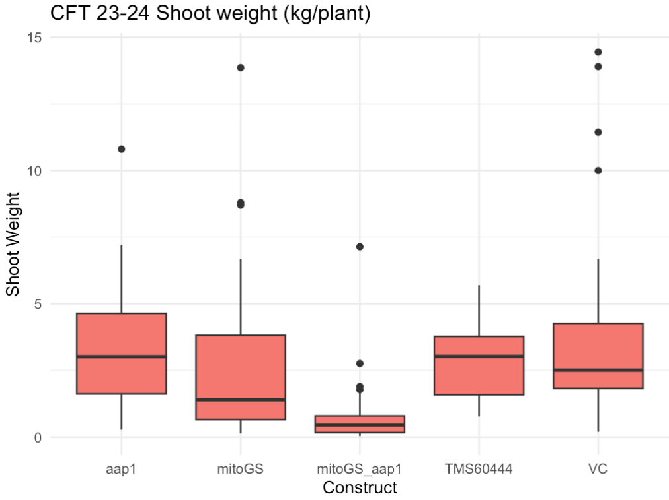
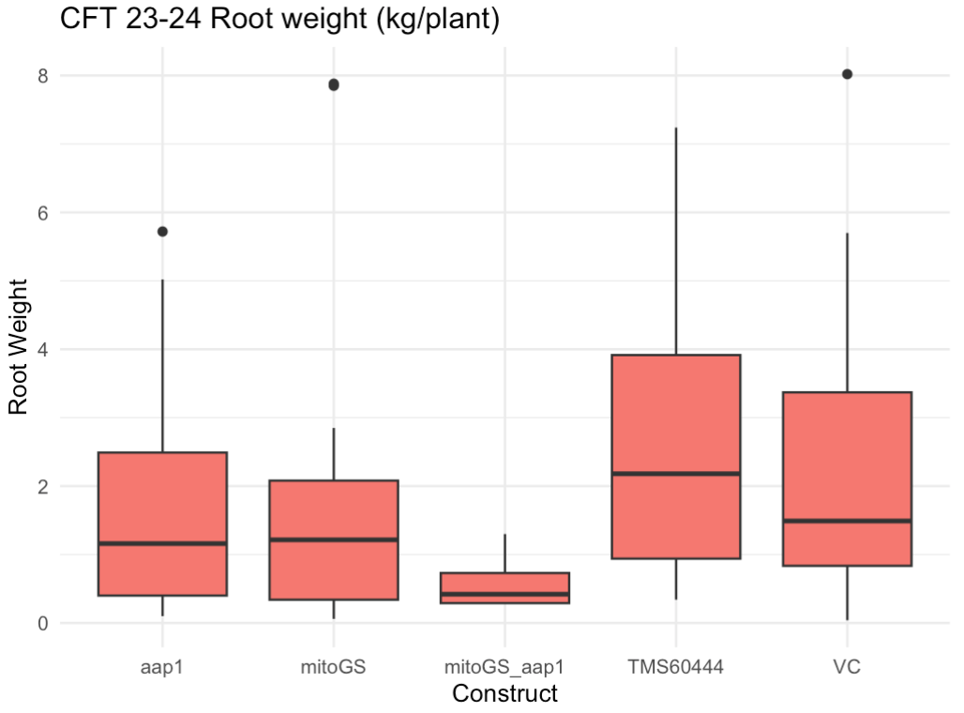
Screenhouse construct performance
Shoot weight
Root weight

Slide 6
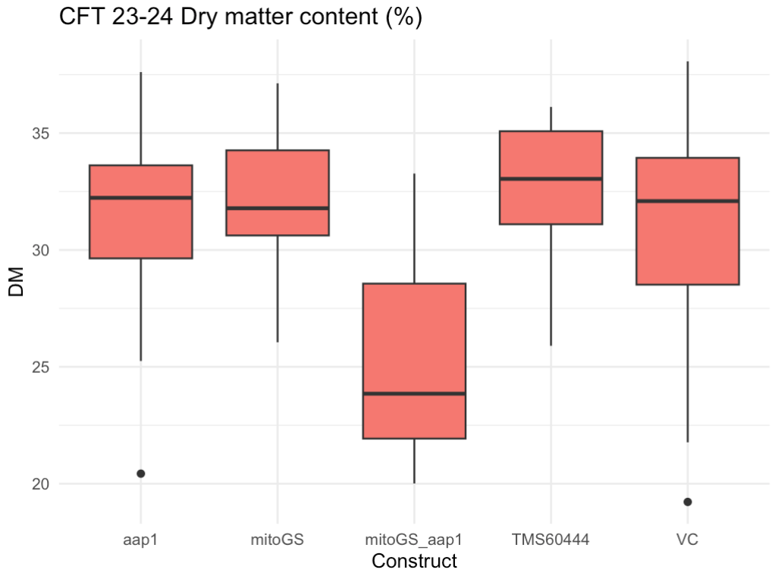
Screenhouse construct performance
Dry matter content
Next steps
Replanted the trial for maintenance and crosses if needed

Slide 7
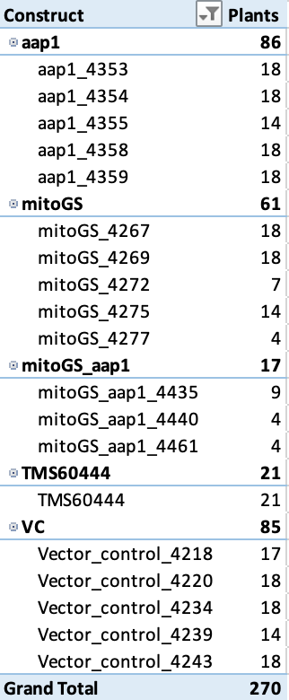
Open field planting results
Aap1 and mitoGS did better in terms of establishment and survival compared with mitoGS_aap1 dual construct

Slide 8
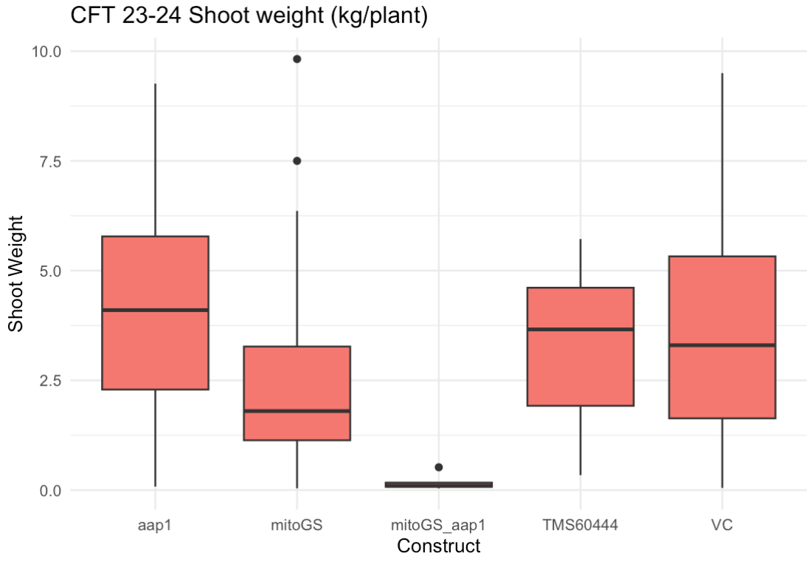
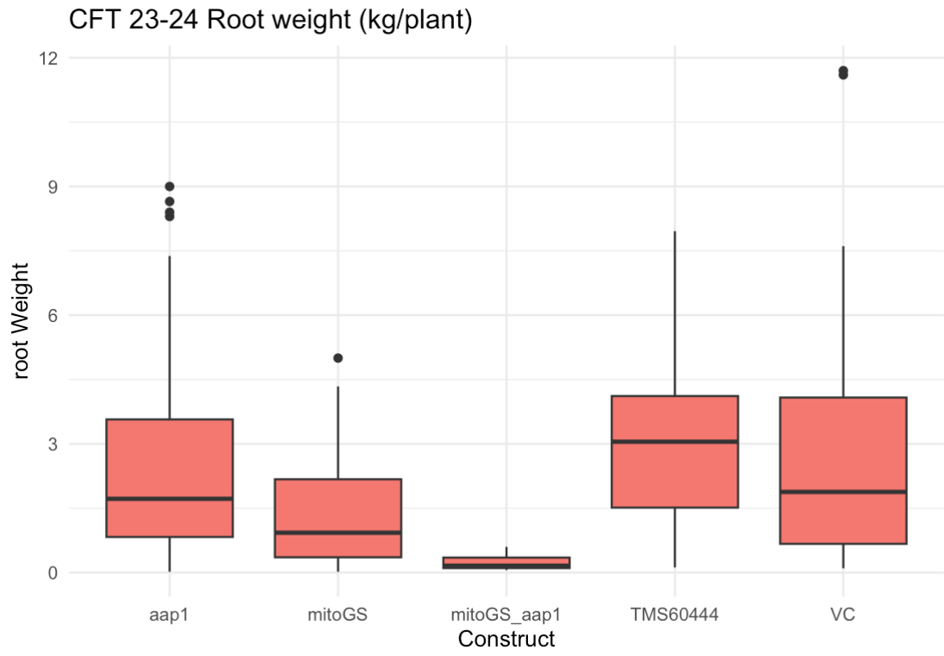
Open field planting results
Shoot weight
Root weight

Slide 9
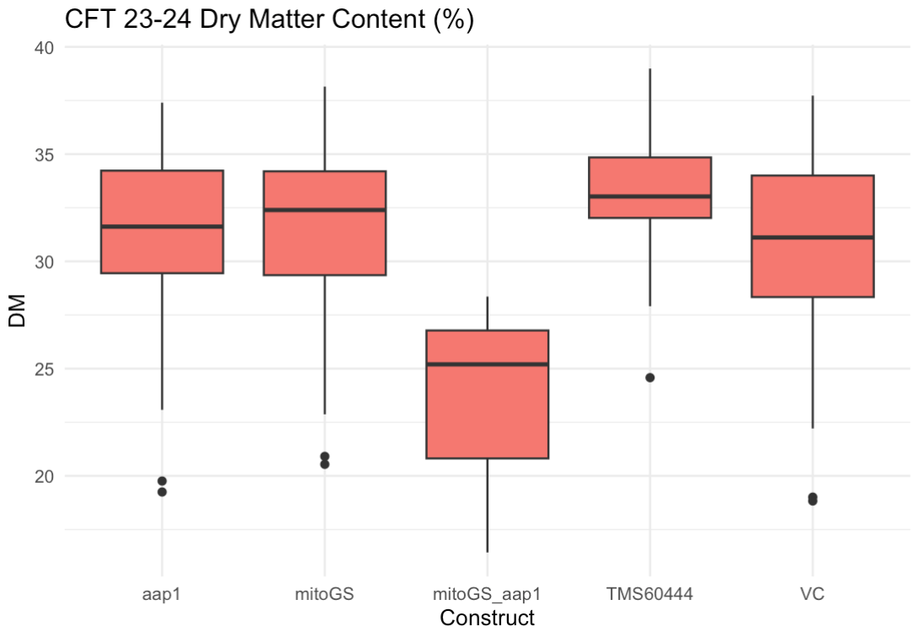
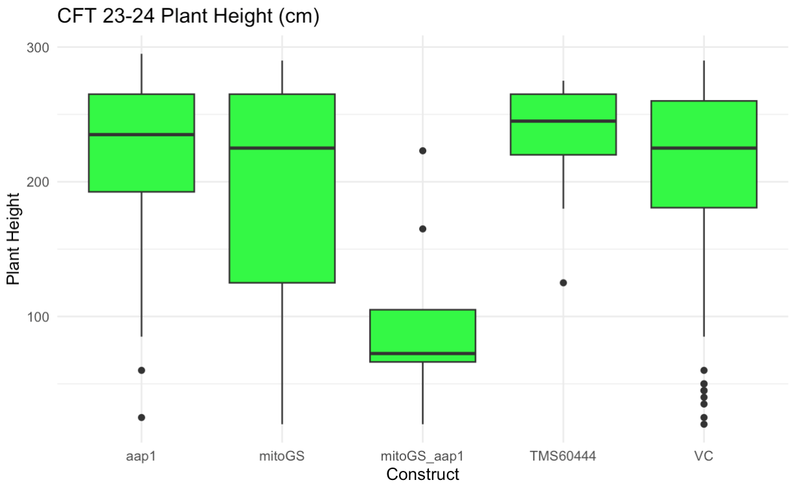
Open field planting results
Dry matter content
Plant height

Slide 10
Current CFT activities
Construct | Accession | Replicates | Plot Size | spacing
AAP1 | aap1_4349 | 2 | 2x4 | 1mx1m
AAP1 | aap1_4353 | 2 | 2x4 | 1mx1m
AAP1 | aap1_4354 | 2 | 2x4 | 1mx1m
AAP1 | aap1_4355 | 2 | 2x4 | 1mx1m
AAP1 | aap1_4358 | 2 | 2x4 | 1mx1m
AAP1 | aap1_4359 | 2 | 2x4 | 1mx1m
mitoGS | mitoGS_4267 | 2 | 2x4 | 1mx1m
mitoGS | mitoGS_4268 | 2 | 2x4 | 1mx1m
mitoGS | mitoGS_4269 | 2 | 2x4 | 1mx1m
mitoGS | mitoGS_4272 | 2 | 2x4 | 1mx1m
mitoGS | mitoGS_4275 | 2 | 2x4 | 1mx1m
mitoGS | mitoGS_4277 | 2 | 2x4 | 1mx1m
mitoGS_AAP1 | mitoGS_aap1_4435 | 2 | 2x4 | 1mx1m
mitoGS_AAP1 | mitoGS_aap1_4440 | 2 | 2x4 | 1mx1m
mitoGS_AAP1 | mitoGS_aap1_4448 | 2 | 2x4 | 1mx1m
mitoGS_AAP1 | mitoGS_aap1_4455 | 2 | 2x4 | 1mx1m
mitoGS_AAP1 | mitoGS_aap1_4459 | 2 | 2x4 | 1mx1m
mitoGS_AAP1 | mitoGS_aap1_4461 | 2 | 2x4 | 1mx1m
TMS60444 | TMS60444 | 2 | 2x4 | 1mx1m
VectorControl | Vector_control_4218 | 2 | 2x4 | 1mx1m
VectorControl | Vector_control_4220 | 2 | 2x4 | 1mx1m
VectorControl | Vector_control_4221 | 2 | 2x4 | 1mx1m
VectorControl | Vector_control_4234 | 2 | 2x4 | 1mx1m
VectorControl | Vector_control_4239 | 2 | 2x4 | 1mx1m
VectorControl | Vector_control_4243 | 2 | 2x4 | 1mx1m
Re-planted aap1, mitoGS in March 2024 (8 months)
Pre-harvest data collected every month
Harvesting to be done by end of October (9 months after planting)

Slide 11
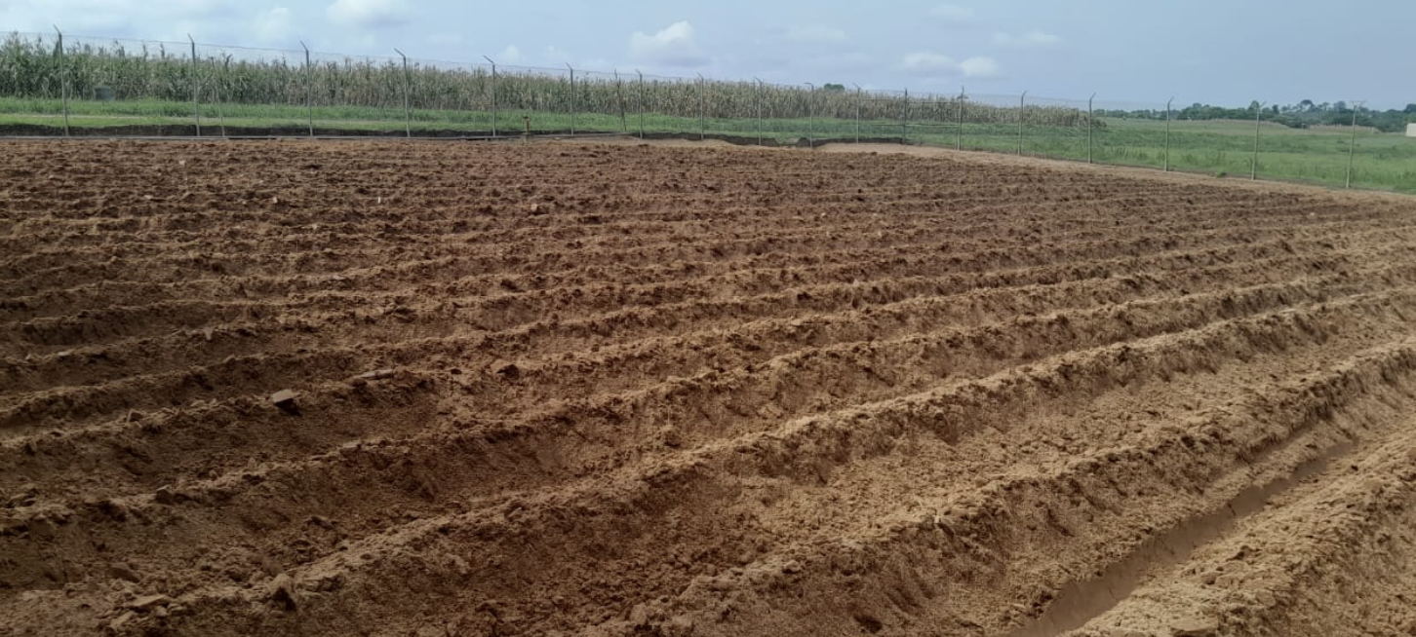
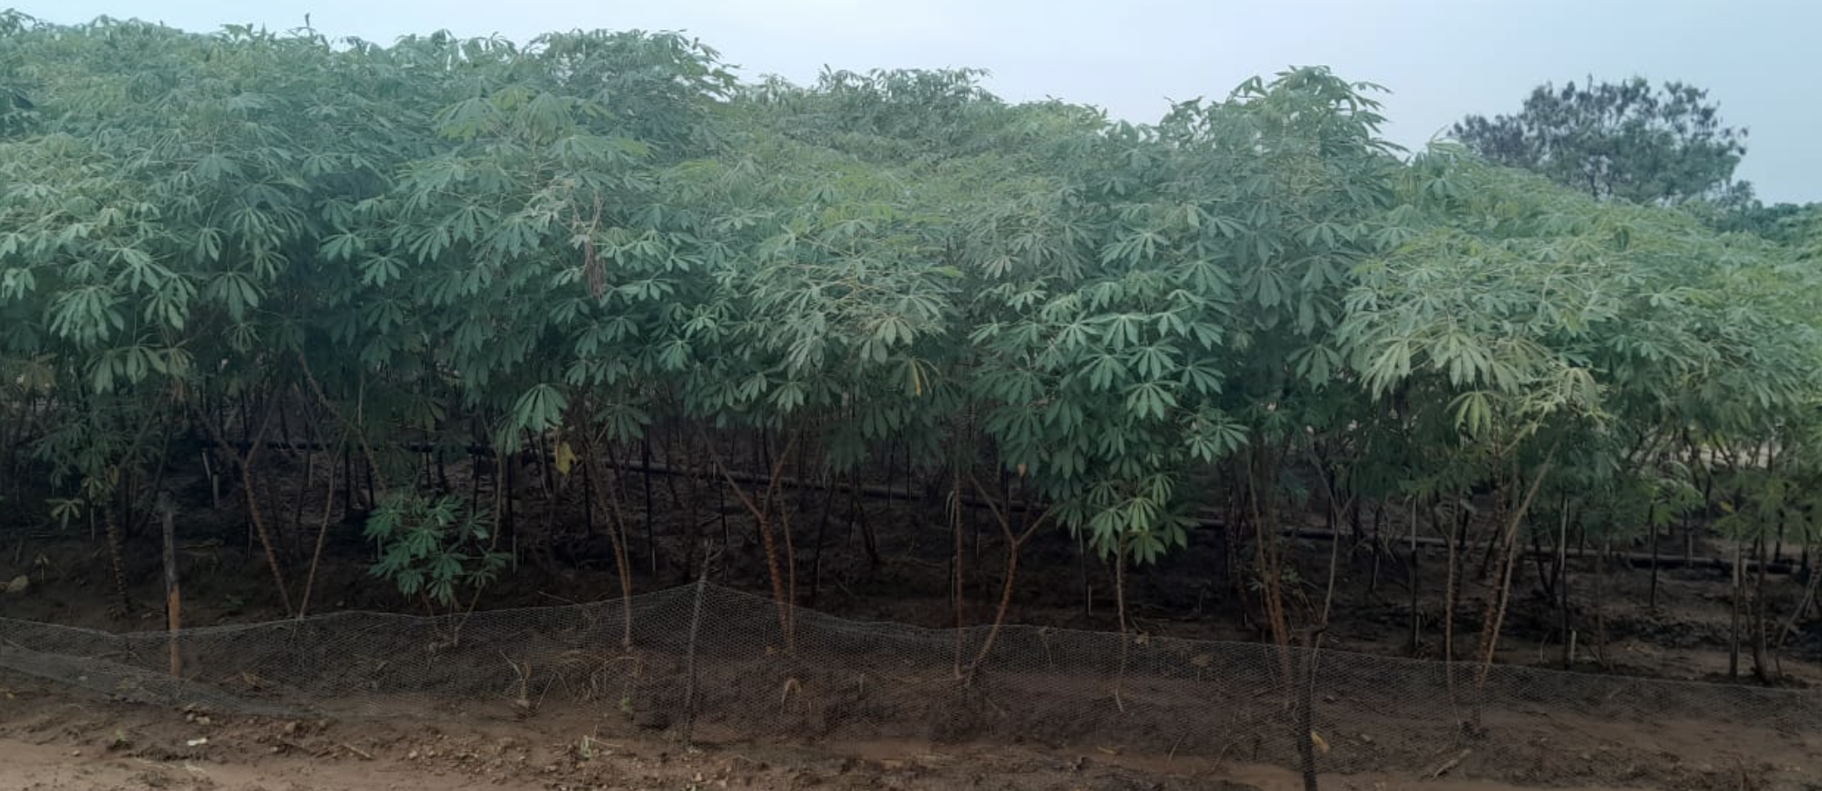
Current CFT
Land preparation
Current growth of the trial

Slide 12
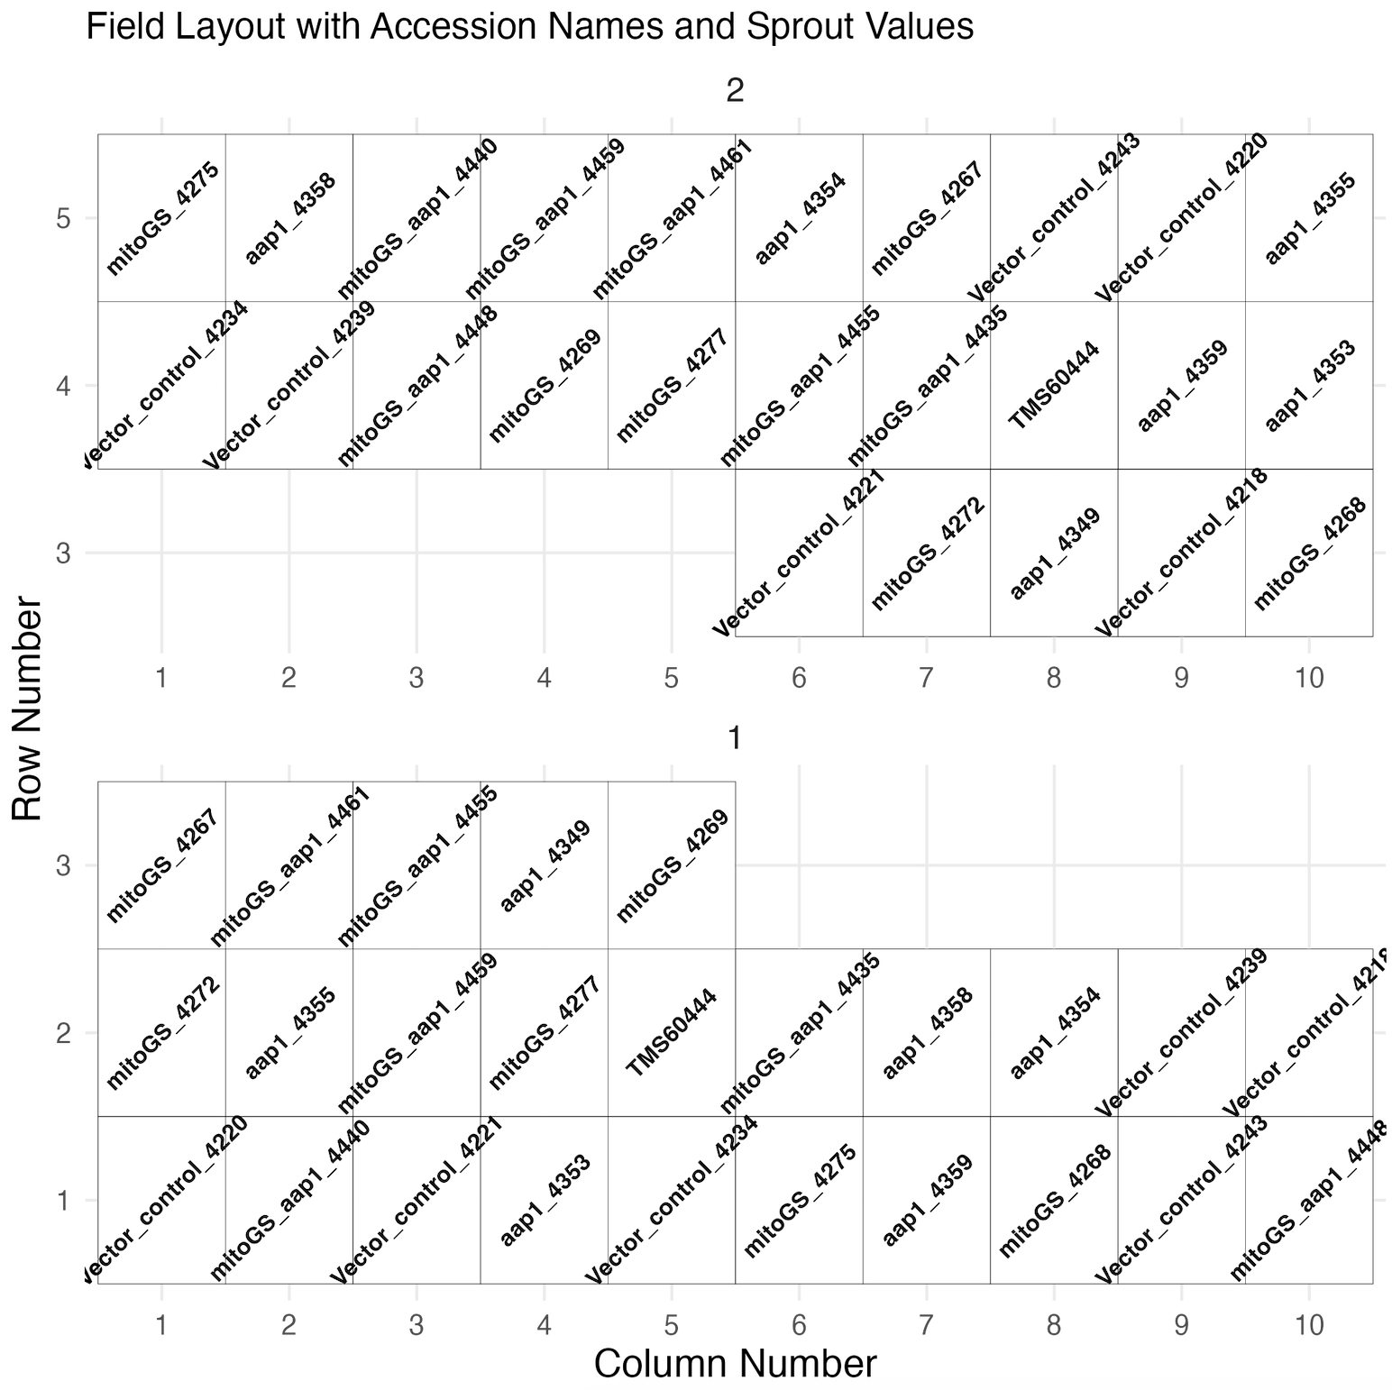
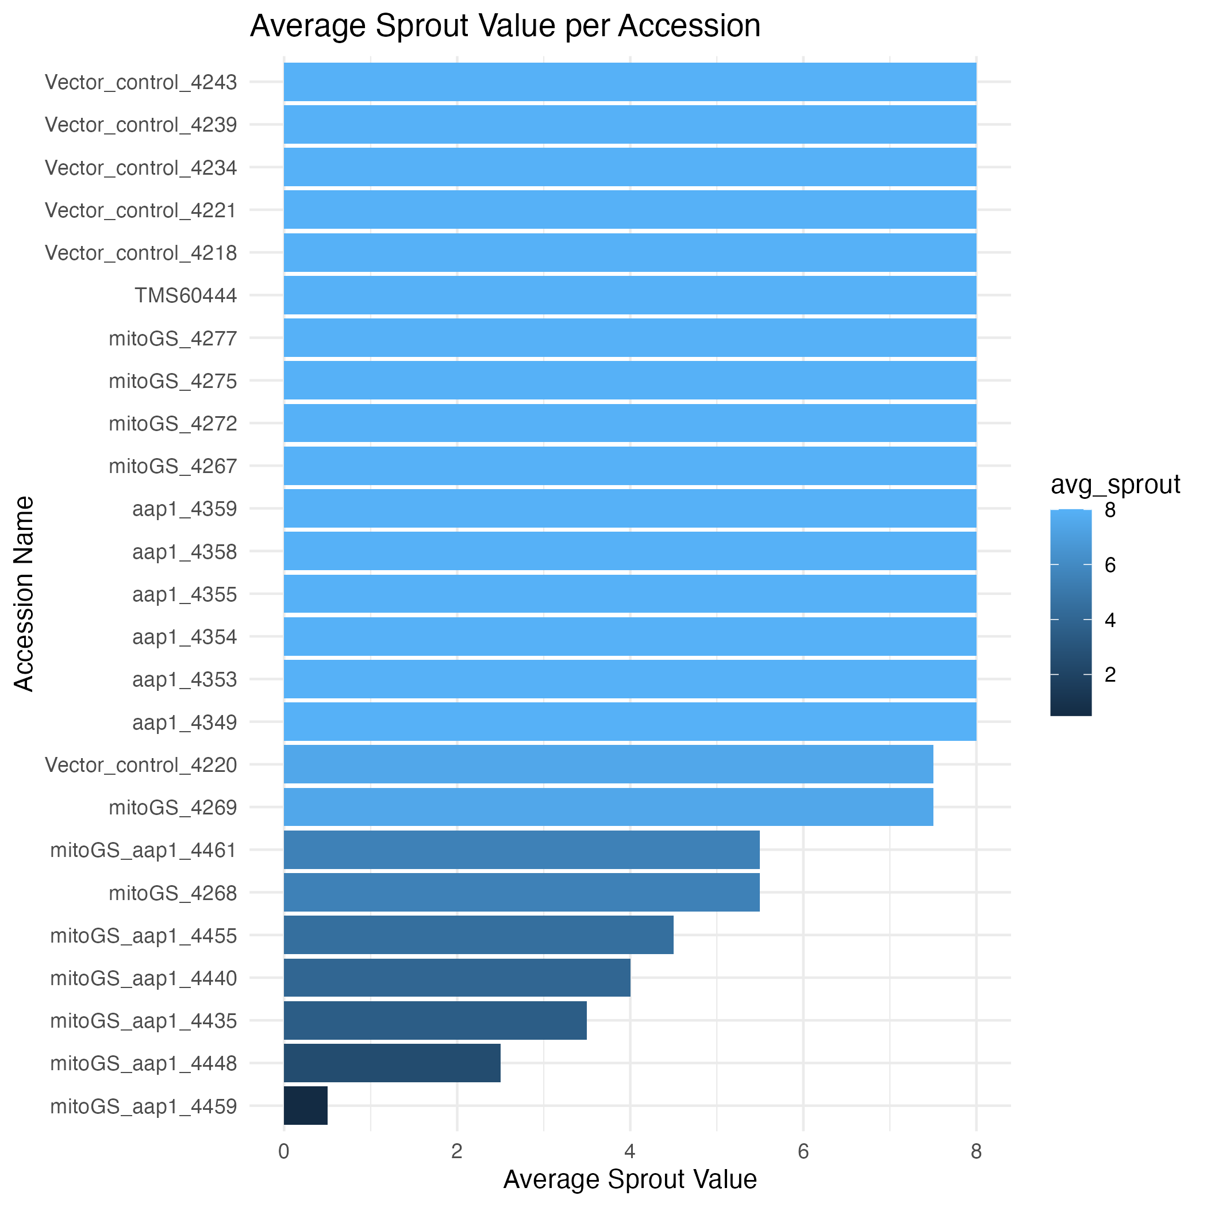
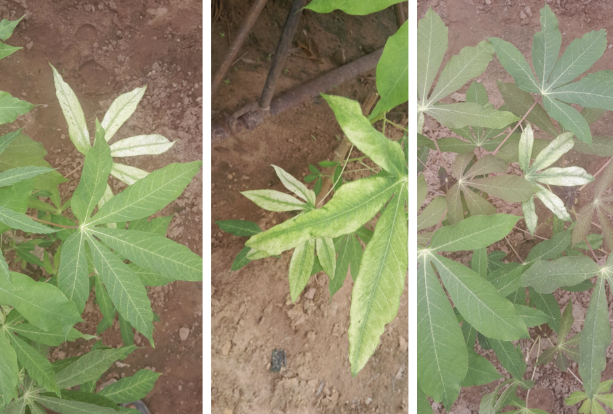
Trial layout
Trial design
Number of stands sprouting

Slide 13
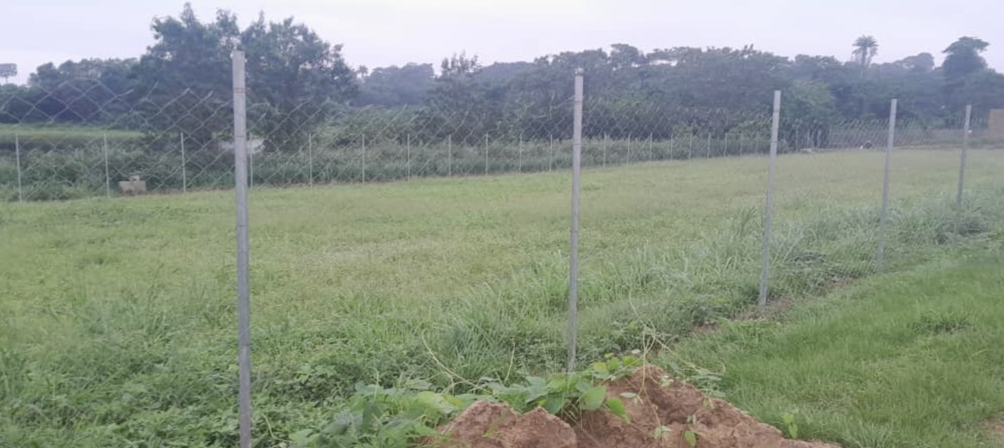
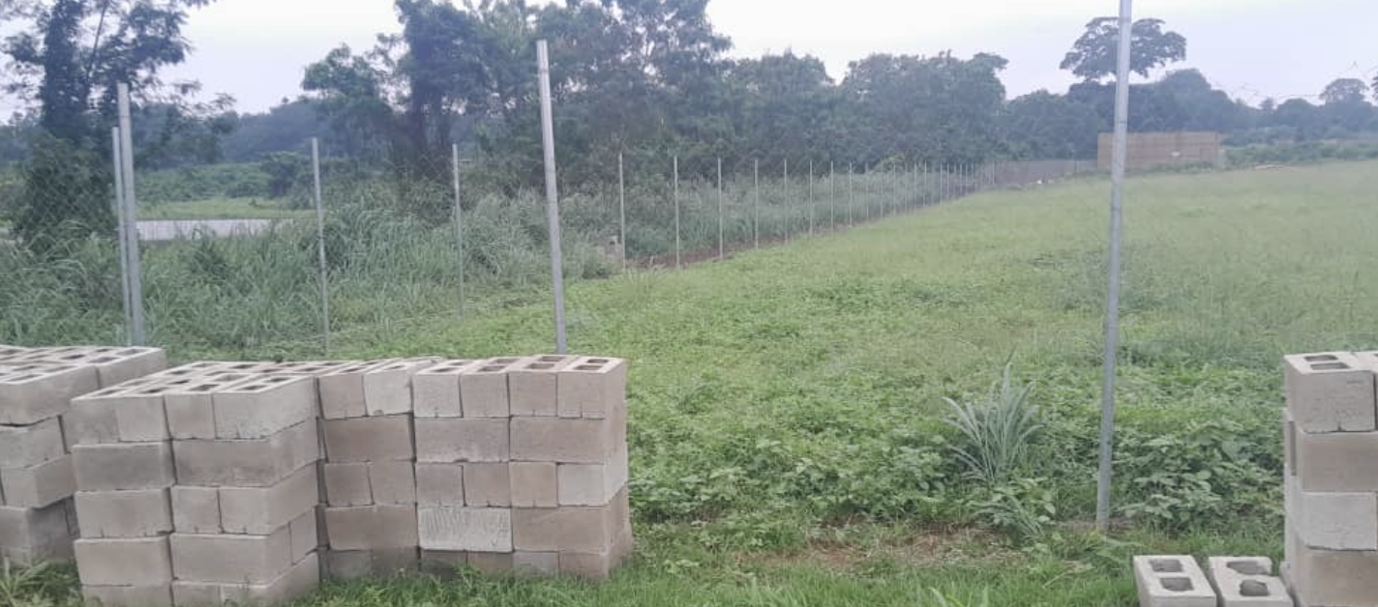
Expansion of the CFT area
Adjascent land acquired from IITA farm management
Securing of the trial area completed

Slide 14
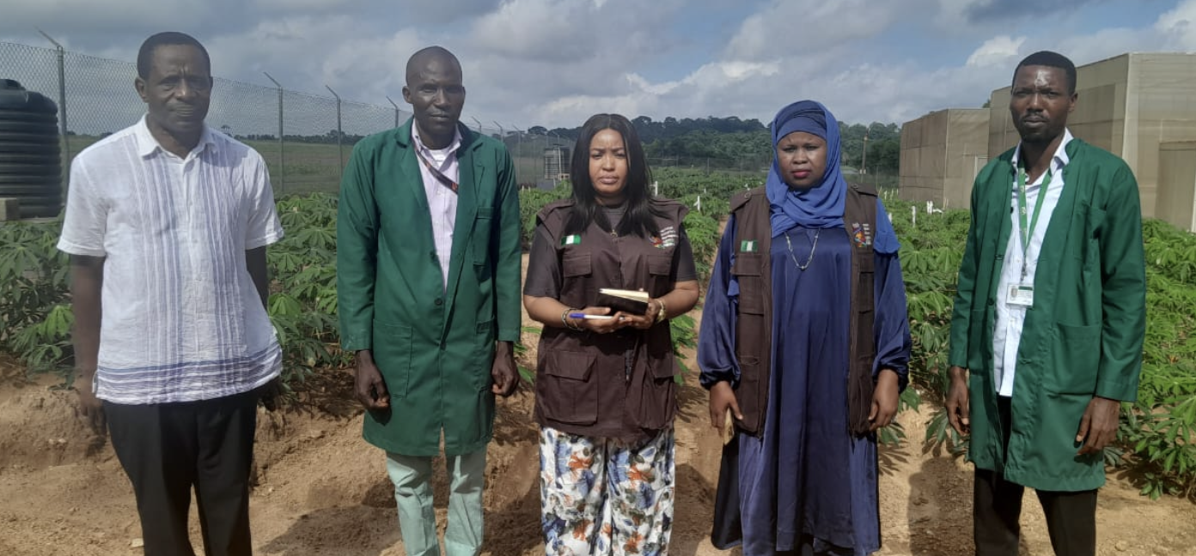
Plans for 2024-2025 season
New application for AKT2CFT and crossing submitted and public consultation concluded.
Approval permit expected this October.
Next steps
  Import permit multiplication
  CFT implementation and crosses
Inspection visit by NBMA Director of Compliance

Slide 15
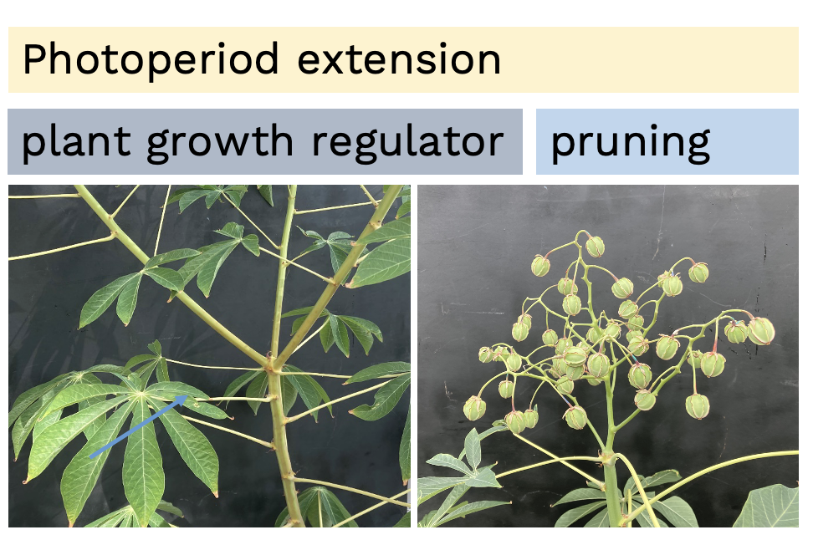
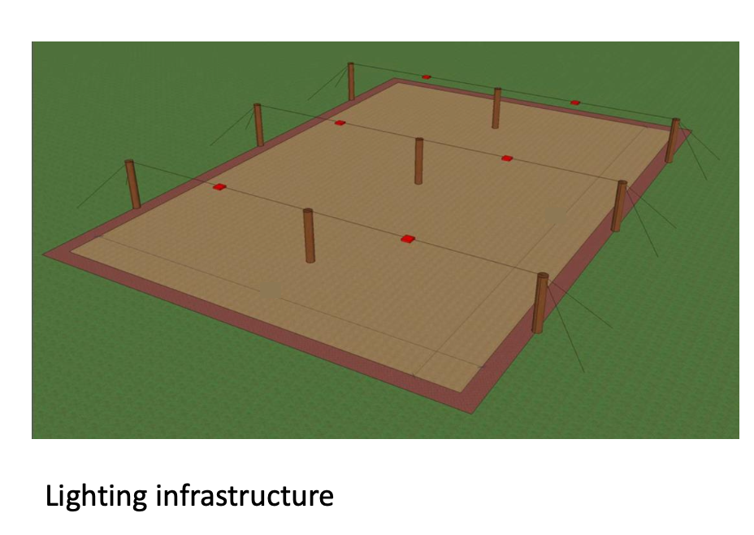
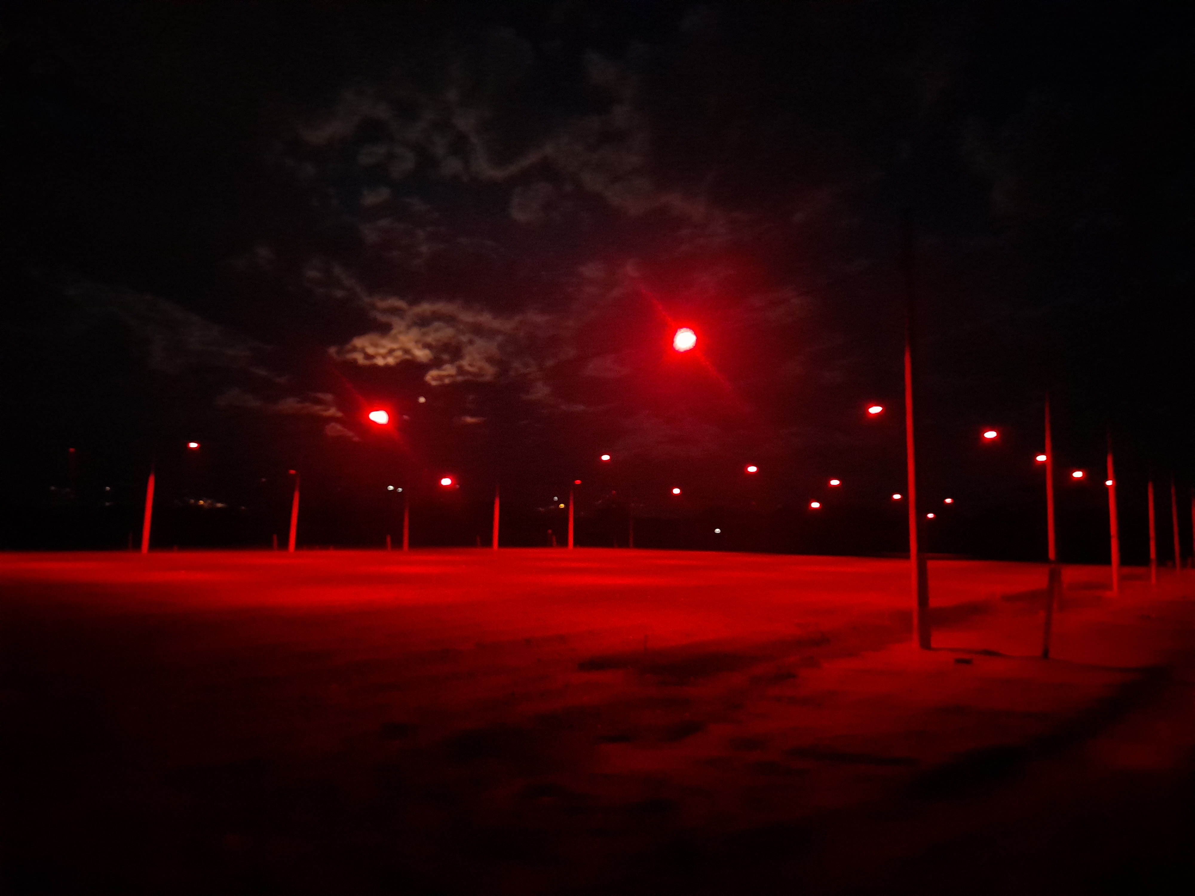
Flowering induction for crosses
Flowering induction
Rapid multiplication

Slide 16
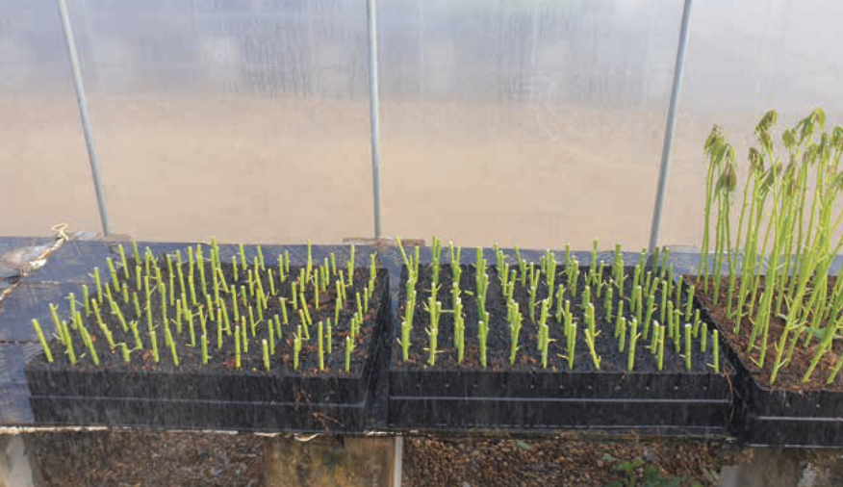
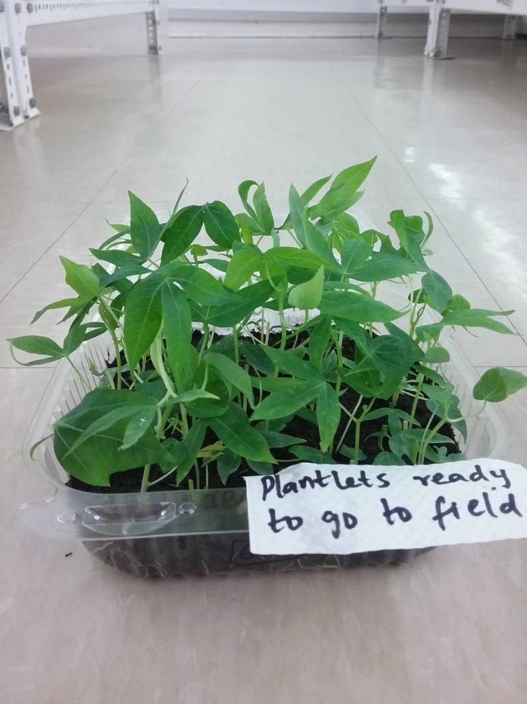
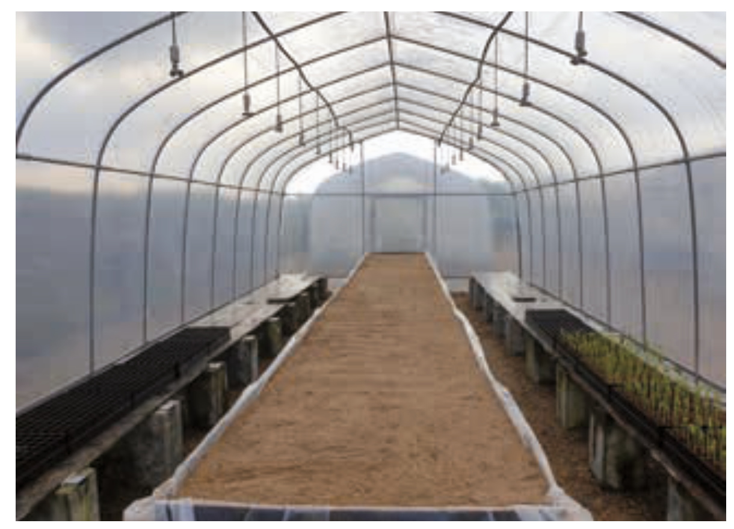
Rapid multiplication of the plants for field trials
Pencil stem multiplication
Semi-autotrophic hydoponics
Controlled growing tunnel

Slide 17
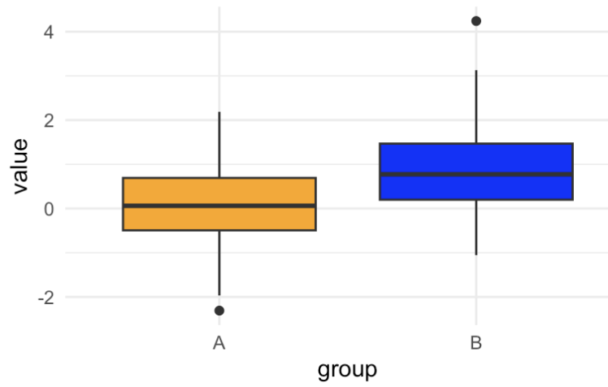
Performance evaluation of the crosses
Construct (Tt)
X
Adapted line (tt)
Group comparison to estimate transgene effect in adapted backrgoud
PCR
Tt (50%)
tt (50%)
Field trial
Rep 1
Rep 2
Rep 3
Rep 4

Slide 18

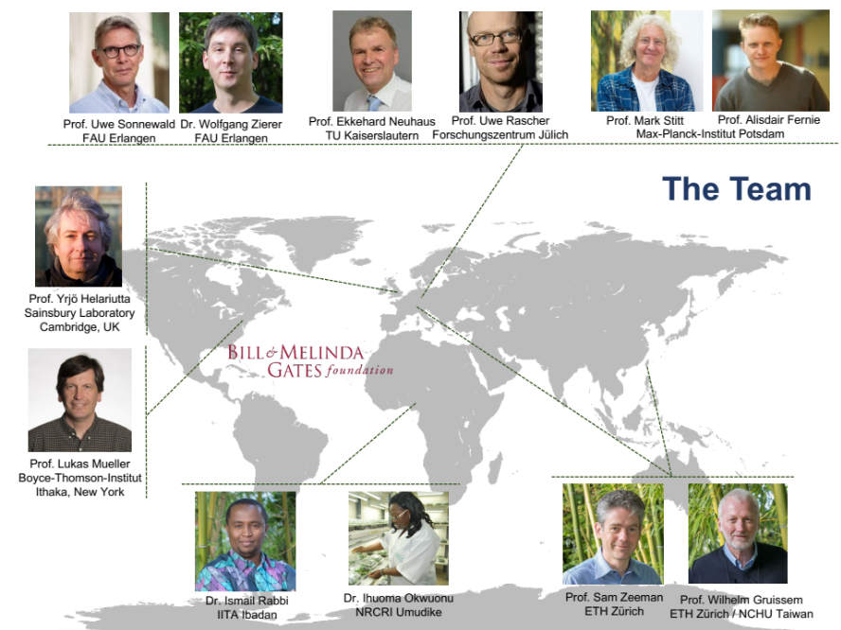
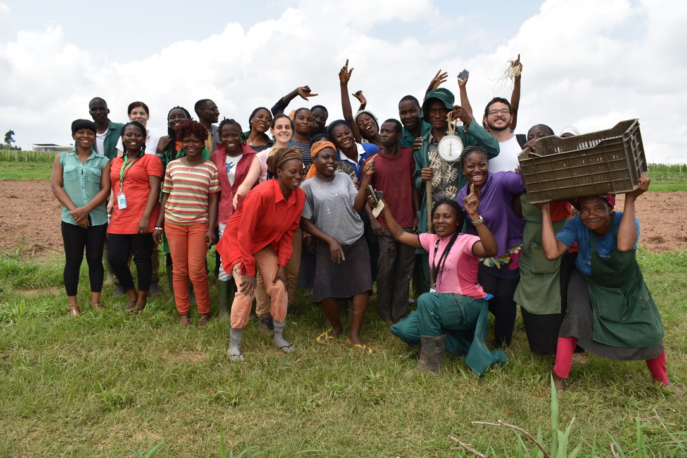
Thanks to all the partners who have contributed to the germplasm characterization!

