Slide 1
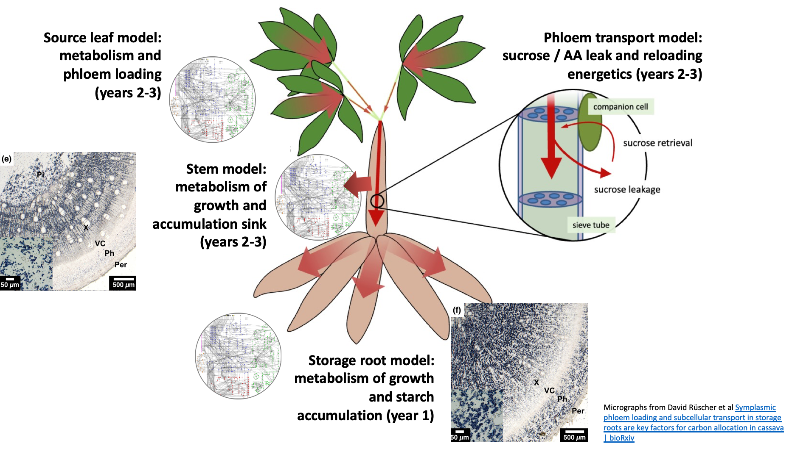
Cassava Metabolic Modelling – data generation
Notes:
This session focus on stem model
Data collection for the storage root model in the first 6 months. To allow us to contribute to the choice of transgenes being used in the storage root metabolism engineering workpackage.
Data collection for the stem and leaf models is scheduled to be completed by the end of the first year, although there is a bit more flexibility there

Slide 2
Modelling timeline
June 2024
Nov 2024
March 2027
May 2025
Transformation – Greenhouse tests
Field trials of root targets
EM 3.4
Data collection
Root model
M1: experimental data for model collected
M2: Metabolic targets identified
Apr 2029
Apr 2024
Dec 2025
Dec 2026
M4: Whole plant targets
Whole plant model
EM 1.3
Data collection
Leaf Model
Stem transport model
M4: Root predictions from field data
M1: experimental data for model collected
M2: Phloem loading leaf targets
M3: stem transport model targets
Notes:
Remind CASS of overall purpose of modelling and the aims for the different part. i.e specific target for roots asap and then larger integrated model for understanding field growth

Slide 3
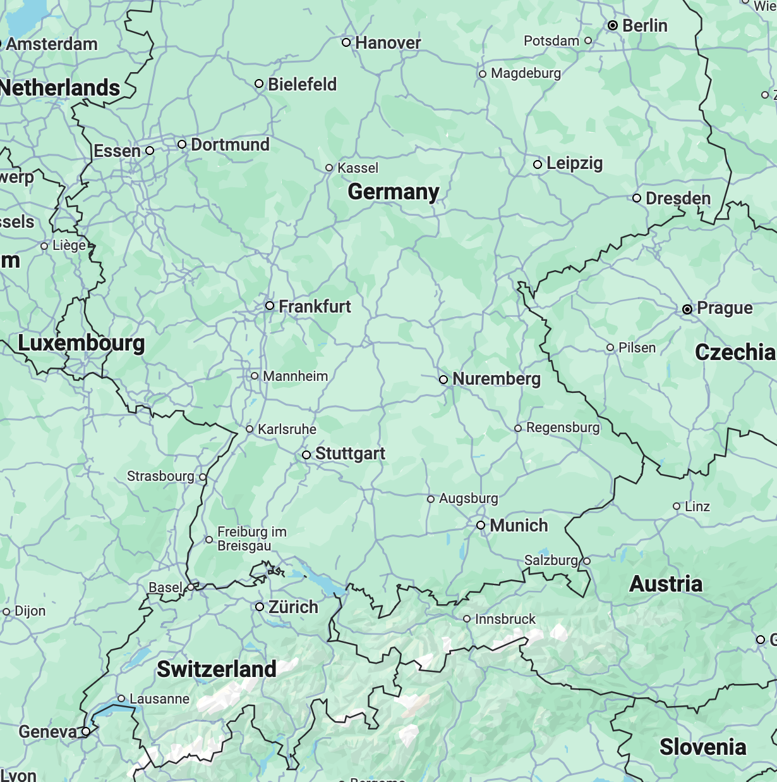
Root model data collection is underway
Greenhouse bonsai plants – November harvest
Growth rates
Microscopy
  Cell volumes vs starch content
  Cell volumes vs radius
Biomass composition
  Metabolomics
  Proteomics
  Total lipids
  Total starch
  Total cell wall
  Osmolarity
Macroscopic parameters
  FW/DW/volume
MPI
FZJ
RPTU
FAU
ETH
Notes:
Bonsai greenhouse plants
Harvest planned in November
Aim to understand relationship between growth, cell expansion and starch accumulation
Define biomass composition and proportions
Phloem composition

Slide 4
Cassava stem model overview
Companion cell
Sucrose
Apoplastic transport
Hexose
Symplasmic transport
H⁺
?
Sieve
element
Phloem Parenchyma
Cambium
Xylem parenchyma
H⁺
SUC2
Starch
Starch
SWEET
expansion
Cell-division biomass
expansion
Phloem
Xylem
Apoplast
Vascular ray
Pith
Starch
Starch
wood

Slide 5
Stem phloem model data requirements
Stems can contribute up to 11% of total photosynthesis in some species (Simkin, 2020)
Phloem metabolite composition/concentrations
C11 leak rates
Stem cell anatomy
  Number of dividing vs expanding cells
Macroscopic parameters (FW/DW/volume)
Biomass composition
  Metabolomics
  Proteomics
  Total lipids
  Total starch
  Total cell wall
  Woody biomass composition
CO₂
Do stems photosynthesise?
Do stems have stomata?
CO₂ refixation or net fixation?
Photosynthetic electron transport/energy production?
CO₂
NADPH
ATP
  Simkin, Andrew J., Michele Faralli, Siva Ramamoorthy, and Tracy Lawson. 2020. ‘Photosynthesis in Non-Foliar Tissues: Implications for Yield’. The Plant Journal 101 (4): 1001–15.
Notes:
Photosynthetic carbon fixation/energy generation
Stems can make 4-11% contribution to total photosynthesis of whole plant
Simkin, Andrew J., Michele Faralli, Siva Ramamoorthy, and Tracy Lawson. 2020. ‘Photosynthesis in Non-Foliar Tissues: Implications for Yield’. The Plant Journal 101
(4): 1001–15. https://doi.org/10.1111/tpj.14633

Slide 6
Whole plant model data requirements
Field data
Leaf biomass composition
Canopy leaf area (m²)
Photosynthetic assimilation rate (field LiCor/PAM)
Stem height/thickness
Diel metabolomics
Fibrous root vs storage root proportion
Timing of bulking

Slide 7
Modelling timeline
June 2024
Nov 2024
March 2027
May 2025
Transformation – Greenhouse tests
Field trials of root targets
EM 3.4
Data collection
Root model
M1: experimental data for model collected
M2: Metabolic targets identified
Apr 2029
Apr 2024
Dec 2025
Dec 2026
M4: Whole plant targets
Whole plant model
EM 1.3
Data collection
Leaf Model
Stem transport model
M4: Root predictions from field data
M1: experimental data for model collected
M2: Phloem loading leaf targets
M3: stem transport model targets
Notes:
Remind CASS of overall purpose of modelling and the aims for the different part. i.e specific target for roots asap and then larger integrated model for understanding field growth

